Slide 1
How Grand Challenges Link Together
Dr. Ali Aslan Gümüsay
University of Hamburg
Humboldt Institute for Internet & Society
@guemuesay

Slide 2
How does this crisis relate to other grand challenges?

Slide 3
Covid19 as a Grand Challenge
3 facets
Complex
Uncertain
Evaluative
Ferraro, F., Etzion, D., & Gehman, D. (2015) Tackling Grand Challenges Pragmatically: Robust Action Revisited. Organization Studies 35(39) pp. 363-390.

Slide 4
Engaging with grand challenges
3 strategies
Participatory architecture
Multivocal inscription
Distributed experimentation
Ferraro, F., Etzion, D., & Gehman, D. (2015) Tackling Grand Challenges Pragmatically: Robust Action Revisited. Organization Studies 35(39) pp. 363-390.

Slide 5
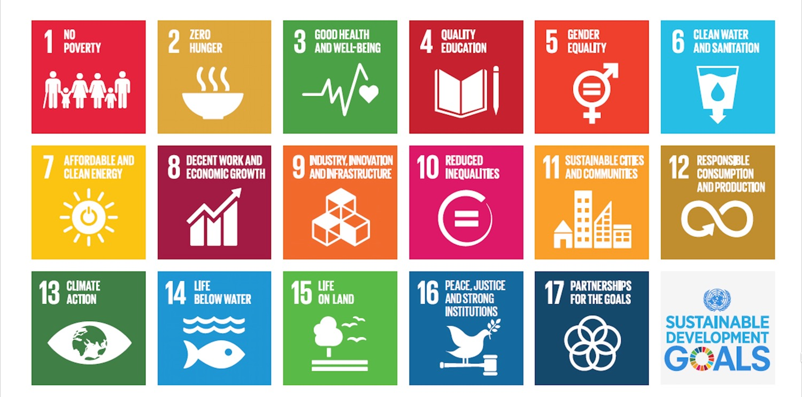
Grand ChALLenges
Sachs, J.D. et al. (2019) Six Transformations to achieve Sustainable Development Goals. Nature Sustainability 2(9): pp. 805-814.

Slide 6
Covid19 as a
Budgetary
Business
Education
Employment
Family
Finance
Governance
Health(care)
Humanitarian
Information
Insurance
Petrol
Poverty
Real estate
Security
Supply chain
Social welfare
Travel
…
Crisis

Slide 7
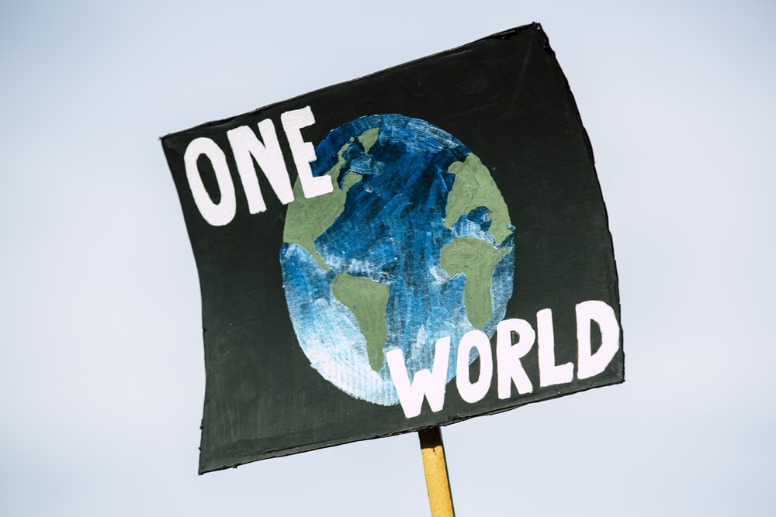
Covid19 & Climate Change

Slide 8
volatile
uncertain
complex
ambiguous
paradoxical
vucap
Gümüsay, A.A. (2019) Leading through vucap. http://guemuesay.com/2019/08/20/leading-through-vucap/

Slide 9
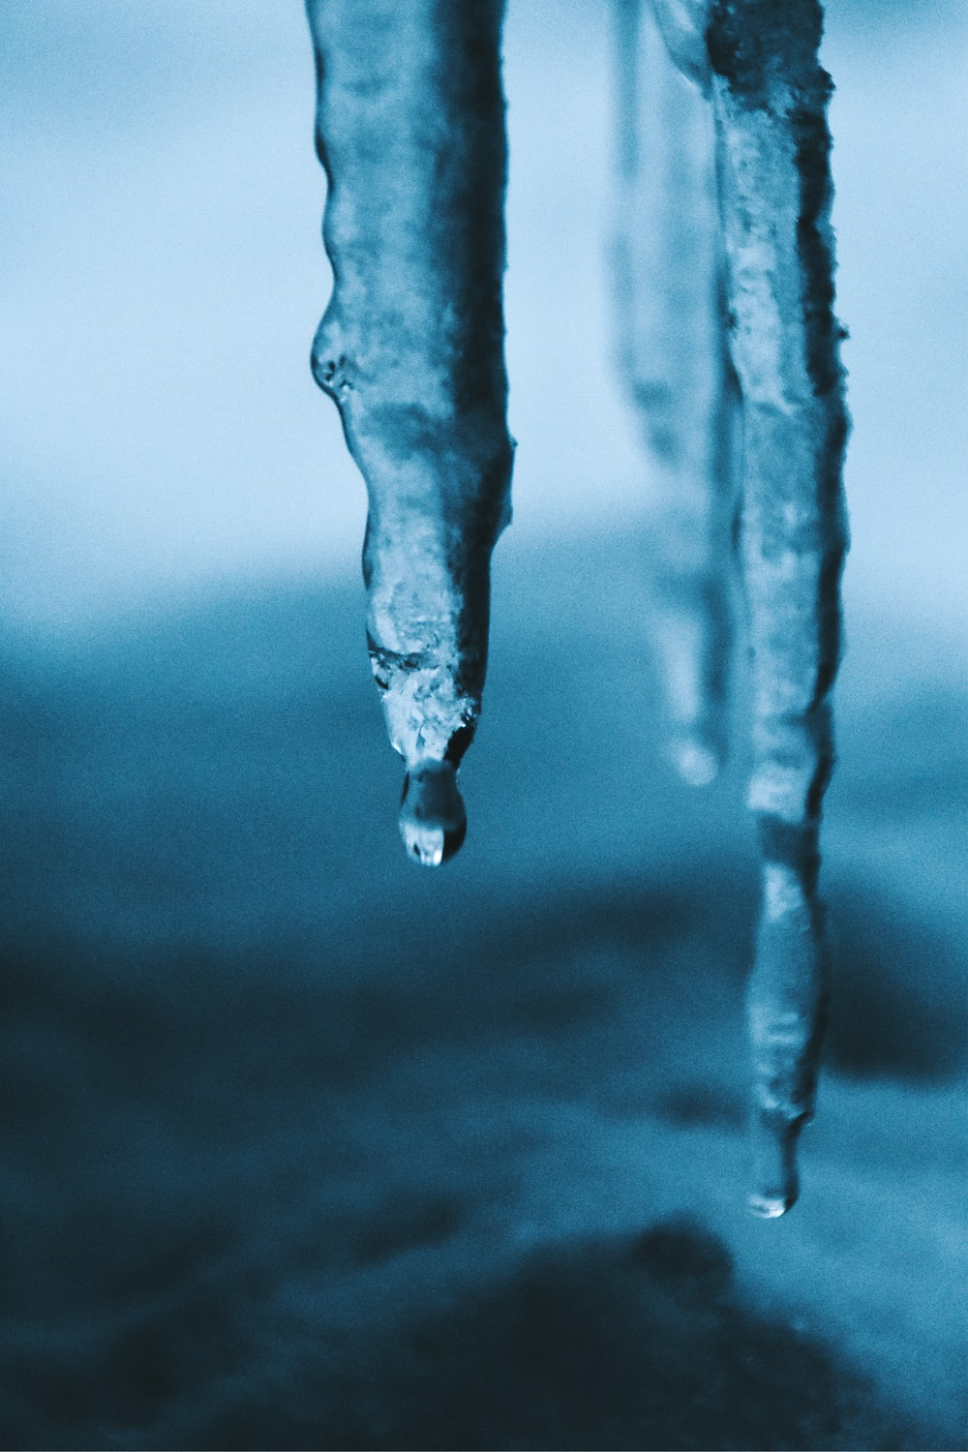
Engaging with Covid19
Coordinated, collaborative & collective
Robust action
(Re)active crisis management
Participation, Multivocality, Experimentation
Embracing vucap
Link to other grand challenges
  “not worse than before”
  “better than before”
Mindsets, Organizations & Societies

Slide 10
Literature
Core reading
  Ferraro, F., Etzion, D., & Gehman, J. (2015). Tackling grand challenges pragmatically: Robust action revisited. Organization Studies, 36(3), pp. 363-390. SSRN
Contemporary news article
  Watts, J. & Kommenda, N. (2020). Coronavirus pandemic leading to huge drop in air pollution. The Guardian, March 23.
Background readings
  George, G., Howard-Grenville, J., Joshi, A., & Tihanyi, L. (2016). Understanding and tackling societal grand challenges through management research. Academy of Management Journal, 59(6), 1880-1895. PDF
  Sachs, J. D., Schmidt-Traub G., Mazzucato, M., Messner, D., Nakicenovic, N., Rockström, J. (2019): Six transformations to achieve the Sustainable Development Goals (SDGs). Nature Sustainability, in print. PDF

Slide 11
Thank you.
Dr. Ali Aslan Gümüsay
University of Hamburg
Humboldt Institute for Internet & Society
@guemuesay

