Slide 1

Organizing in Times of Crisis: The Case of Covid-19
Class 3: Crisis Management and Bureaucracy
Leonhard Dobusch
April 2020
University of Innsbruck

Slide 2
“
[Bureaucracy] is superior to any other form in precision, in stability, in stringency of its discipline and in its reliability’.
Max Weber (1978, p. 223)

Slide 3
“
[Bureaucracy] is superior to any other form in precision, in stability, in stringency of its discipline and in its reliability’.
Max Weber (1978, p. 223)

Slide 4
Weberian Bureaucracy as a Specific Modern Form of Organization
Power belongs to an office, not the office holder
Authority configuration is specified by formal rules
Rules specify tasks for different categories of personnel
>> specialization
Tendency towards hierarchy
Formal credentials certify required qualifications
Career: promotion by seniority or merit of service
Communication, coordination and control are centralized

Slide 5
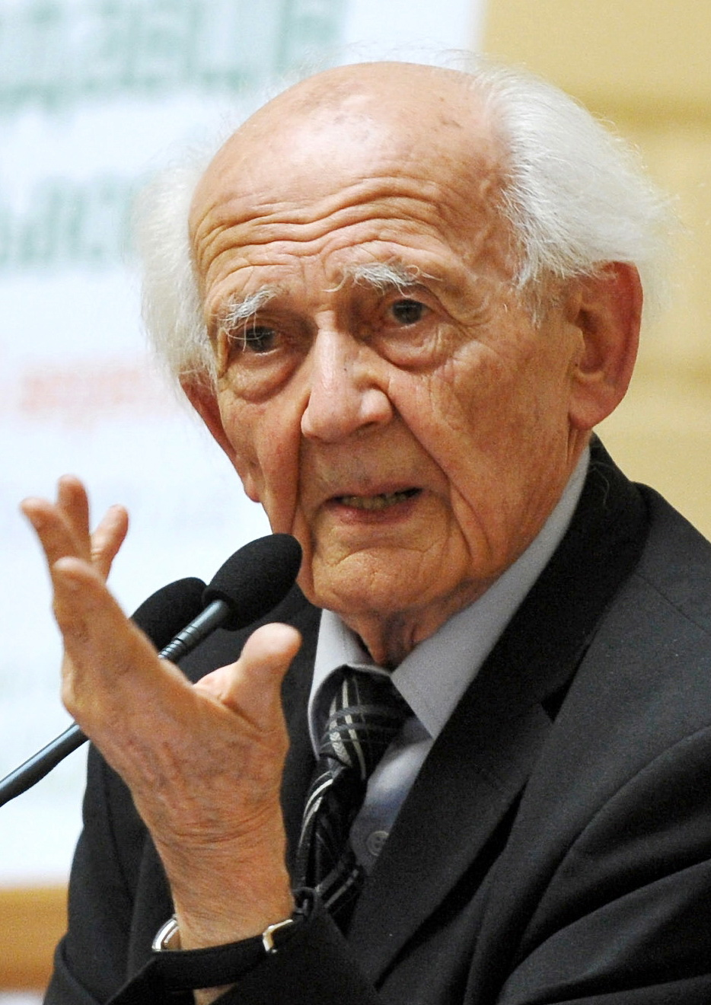
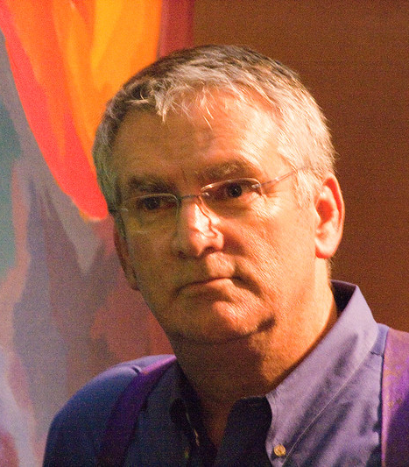
Two Traditions of Bureaucracy Critique
Entrepreneurial
Ethical
Tom Peters
(cited in Du Gay, 1994)
Zygmunt Baumann
(1989, p. 15)
Foto: ShashiBellamkonda, CC-BY 2.0, https://www.flickr.com/photos/drbeachvacation/4644032058
Credit Baumann photo: Forumlitfest, CC BY 3.0, https://de.wikipedia.org/wiki/Datei:Zigmunt_Bauman_na_20_Forumi_vydavciv(Cropped).jpg

Slide 6
Two Traditions of Bureaucracy Critique
Entrepreneurial
Ethical
“
the Holocaust is so crucial to our understanding of the modern bureaucratic mode of rationalization ... because it reminds us ... just how formal and ethically blind is the bureaucratic pursuit of efficiency
“
I beg each and everyone of you to develop a public and passionate hatred of bureaucracy
Tom Peters
(cited in Du Gay, 1994)
Zygmunt Baumann
(1989, p. 15)
Foto: ShashiBellamkonda, CC-BY 2.0, https://www.flickr.com/photos/drbeachvacation/4644032058
Credit Baumann photo: Forumlitfest, CC BY 3.0, https://de.wikipedia.org/wiki/Datei:Zigmunt_Bauman_na_20_Forumi_vydavciv(Cropped).jpg

Slide 7
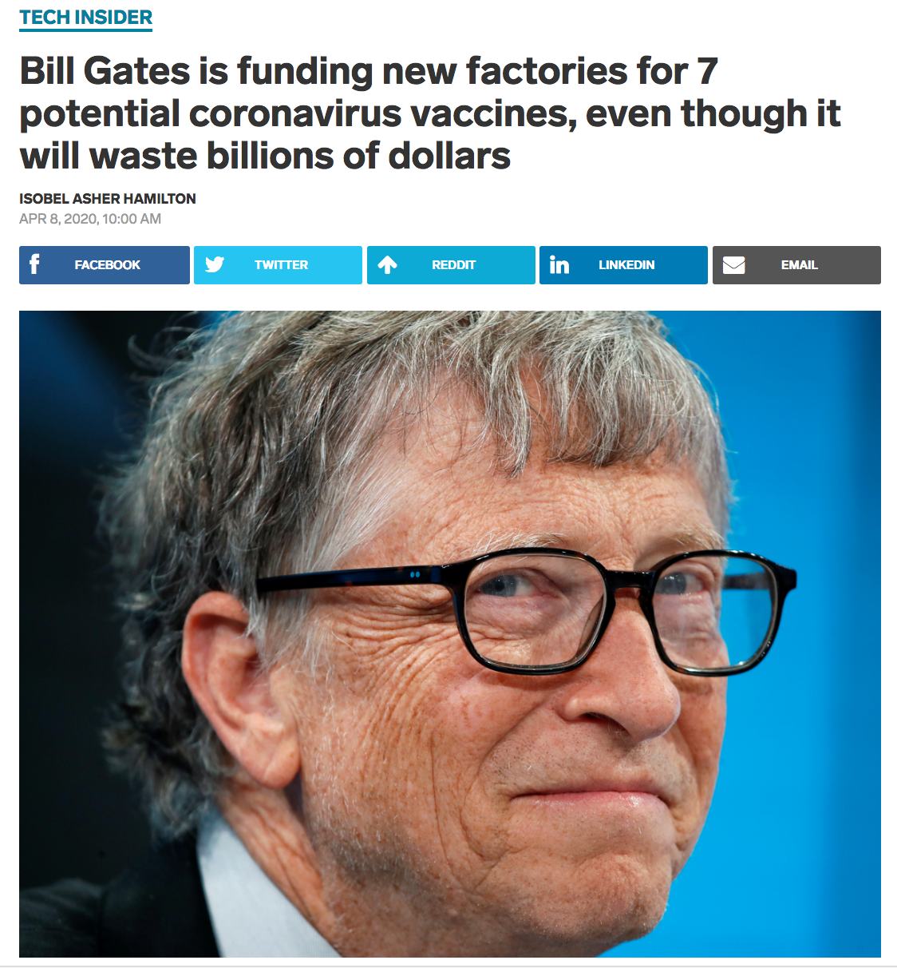
Entrepreneurial, Ethical and Bureaucratic?
“
Even though we’ll end up picking at most two of them, we’re going to fund factories for all seven, just so that we don’t waste time in serially saying, ‘OK, which vaccine works?’ and then building the factory.
Bill Gates
Screenshot: https://www.businessinsider.com.au/bill-gates-factories-7-different-vaccines-to-fight-coronavirus-2020-4

Slide 8
Public Bureaucracy in Crisis?

Slide 9
The Democratic Case for Public Bureaucracy
Proviso of the law: no administrative action may take place without a legal, democratic basis
>> formally codified rules, prohibition of arbitrary action
Equality before the law: individuals must be treated equally by the law
>> predictability, stability
Rational legal authority: individual actions of public officials follow a clear chain of command
>> tendency towards hierarchy; roles, not persons

Slide 10
Public Bureaucracy vs. New Public Management
}
Proviso of the law
Equality before the law
Rational legal authority
Ideal-typical qualities of
public administrations
“
The basic rationale behind NSM is an increase in efficiency by utilizing the mechanisms of business-like performance management, while at the same time stepping up the decentralization and autonomy of local governments
NEW PUBLIC MANAGEMENT
Vogel (2012, p. 370)

Slide 11

Public Bureaucracy vs. New Public Management
MANAGERIAL
BUREAUCRATIC
Focus on reliability and legality, mainly pursued by means of input and process control
Focus on efficiency, mainly pursued by means of output control

Slide 12
Public Bureaucracy vs. Open Government
}
Proviso of the law
Equality before the law
Rational legal authority
Ideal-typical qualities of
public administrations
“
a more democratic, collaborative, and transparent administration through public access to data, deliberations, and decisions
OPEN GOVERNMENT
Kornberger et al.
(2017, p. 180)

Slide 13


Public Bureaucracy: More Managerial and More Open?
PUBLIC BUREAUCRACY
More in Class 8:
Open Science,
Data and Commons
NEW PUBLIC MANAGEMENT
OPEN GOVERNMENT
Entrepreneurial
Ethical

Slide 14
Contact
E-Mail: Leonhard.Dobusch@uibk.ac.at
Twitter: @leonidobusch
Web: bit.ly/LD-UIBK // dobusch.net
Research blogs:
osconjunction.net
governancexborders.com

Slide 15
References
Baumann, Z. (1989). Modernity after the Holocaust. Cambridge: Polity Press.
Du Gay, P. (1994). Making up managers: bureaucracy, enterprise and the liberal art of separation. British journal of Sociology, 655-674.
Kornberger, M., Meyer, R. E., Brandtner, C., & Höllerer, M. A. (2017). When bureaucracy meets the crowd: Studying “open government” in the Vienna City Administration. Organization Studies, 38(2), 179-200.
Vogel, R. (2012). Framing and counter‐framing new public management: The case of Germany. Public Administration, 90(2), 370-392.
Weber, M. (1978). Economy and society: An outline of interpretive sociology (Vol. 1). Univ of California Press.

