Slide 1
This class is part of the online course „Organizing
in Times of Crisis“ (https://timesofcrisis.org/)

Slide 2

Overview – Learning Aims
Networks as an Alternative to Bureaucratic Organizations in Times of Crisis
Interorganizational Networks as a Form of Governance
How are Inter-organizational Networks Managed? –
Functions, Practices, Institutions
Understanding Network Dynamics: A Governance View on
the FED in Düsseldorf (by reading and reflecting on the FED case)

Slide 3

Networks as an Alternative to
Bureaucracies in Times of Crisis?
What kind of networks are particulary relevant?
Healthcare networks: In- and outpatient care,
rehabilitation, home for the elderly, … „integrated care“ …
Global supply chains/networks: Food, pharma, PPE, medical instruments, …
R&D consortia for testing, tracking, treatment and vaccination
Organizing for interest representation: formal associations vs. ad-hoc networks (incl. for organizing for conversion)
Policy networks
…

Slide 4
Interorganizational Networks as a
Form of Governance – Overview
Networks as a form of governance network perspective
Inter- and intraorganizational networks
Networks between or beyond market and hierarchy
(Williamson 1991; Powell 1990)
Modes of network governance (Provan & Kenis 2008; Kenis et al. 2019)
Governance modes and network management (Sydow et al. 2016), filling „governance voids“ through „interactive governing behavior“ (Jarvenpaa & Välinkangas 2016)

Slide 5
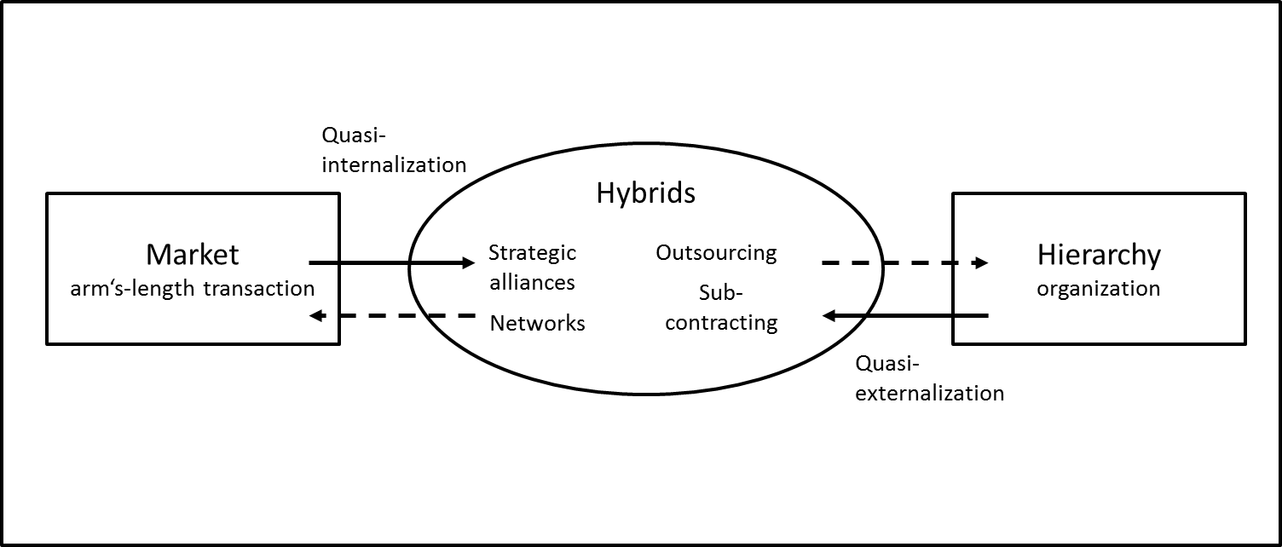
Interorganizational Networks as a
Form of Governance – An Intermediary Form?
a) Network as a hybrid form of governance (Willamson 1991)
Market coordination
NETWORK
Hierarchical coordination
Network formation between market and hierarchy (Sydow et al. 2016: 13)

Slide 6
Interorganizational Networks as a
Form of Governance – An Intermediary Form?
a) Network as a hybrid form of governance (Willamson 1991)
Market coordination
NETWORK
Hierarchical coordination
b) Network beyond market and hierarchy (Powell 1990)
NETWORK
Market coordination
Hierarchical coordination

Slide 7
Forms of Network Governance I
Following Provan & Kenis (2008):
Shared governance
Lead-organization governance
Network administrative organization (NAO)
Networks give preference to one of these modes, depending on: (1) the level of trust, (2) the number of participants, (3) the extent of goal consensus, and (4) the need for network-level competencies.
Beyond a contingency theory of network governance:
dynamics and practices (Berthod et al. 2017)

Slide 8
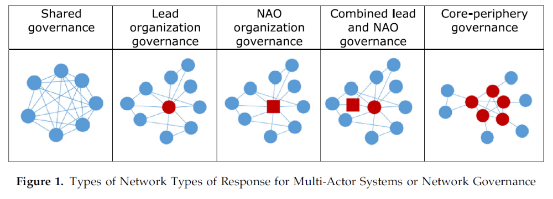
Forms of Network Governance II
Kenis et al. (2019) adding to Provan & Kenis (2008):
4. Shared governance with NAO
5. Lead-organization governance with NAO
6. Core-periphery model or: more than one lead organization (Kenis et al. 2019)
Organizational network governance approach (Raab et al. 2020)

Slide 9
Network Management:
Functions, Practices, Institutions
Trust
Control
Cooperation
Selection
Competition
ManagementPractices
Regulation
Allocation
Stability
Evaluation
…
Source: Sydow et al. (2016), p. 20
Change

Slide 10
Network Management:
Functions, Practices, Institutions
Interorganizational:
NAO
Interorganizational committees (IOCs)
Interorganizational projects (IOPs)
Networking tools (physical as well as virtual)
…
Intraorganizational:
Boundary spanning individuals, teams (incl. TMT), dept, …

Slide 11
Learnings – Next Steps
Interorganizational networks are an important alternative to bureaucratic organizations, also in times of crisis.
Such networks can be viewed as a form of governance either between OR beyond market and hierarchy.
Beyond looking at (static) governance structures network management practices are important, including managing tensions and contradictions.
Look at the network dynamics in the case of the FED (Berthod et al. 2017) – a lead-organization of an High-Reliability Network or HRN. Do not forget to answer the post-lecture questions!

Slide 12
References
Berthod, O., Grothe-Hammer, M., Müller-Seitz, G., Raab, J., & Sydow, J. (2017). From high-reliability organiza­tions to high-reliability networks: The dynamics of network governance in Times of Crisis. Journal of Public Administration Theory, 27 (2): 352-371.
Jaarvenpaa, S.L., & Välinkangas, L. (2016). From governance void to interactive governing behavior in new research networks. Academy of Management Discovery, 2(3): 226-246.
Powell, W.W. (1990). Neither market nor hierarchy: Network forms of organization. Research in Organizational Behavior, 12: 295-336.
Provan, K.G., & Kenis, P.N. (2008). Modes of network governance: Structure, management, and effectiveness. Journal of Public Administration Research and Theory, 18: 229-252.
Raab, J., Kenis, P., Kraaj-Dirkzwager, M., & Timen, A. (2020). Ex ante knowledge for infectious disease outbreaks. Introducing the organizational network governance approach. In: Glückler, J., Herrigel, G., & Handke, M. (Eds.). Knowledge for Governance. Berlin: Springer (in print).
Sydow, J., Schüßler, E., & Müller-Seitz, G. (2016). Managing Inter-organizational Relations: Debates and Cases. London: Palgrave Macmillan.
Williamson, O.E. (1991). Comparative economic organization: The analysis of discrete structural alternatives. Administrative Science Quarterly, 36 (2): 269-296.

