Slide 1

Organizing in Times of Crisis: The Case of Covid-19
Class 8: Open Science, Data and Commons
Leonhard Dobusch
April 2020
University of Innsbruck

Slide 2

“
If I have seen further it is by standing on the shoulders of Giants.
>
>
>
Isaac Newton
Mertonian Science Communism
All scientists should have common ownership of scientific goods, to promote collective collaboration; secrecy is the opposite of this norm.
Merton (1942)
Source: http://en.wikipedia.org/wiki/File:GodfreyKneller-IsaacNewton-1689.jpg

Slide 3
“
I hereby assign to [scientific publisher] exclusively all my right, title and interest in said article, including without limitation the copyright therein.
Source: standard copyright form of a large academic publisher

Slide 4
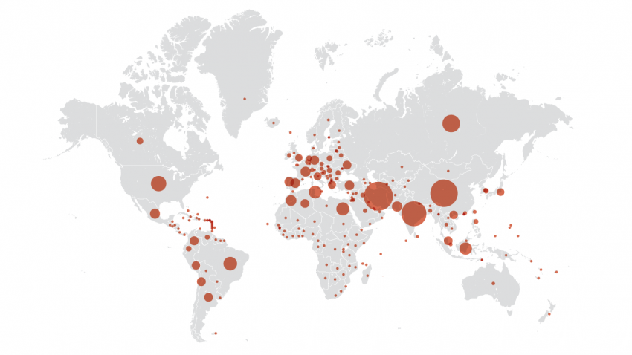
Sci-Hub: 28 million downloads in 6 months
Source: http://www.sciencemag.org/news/2016/05/survey-most-give-thumbs-pirated-papers

Slide 5
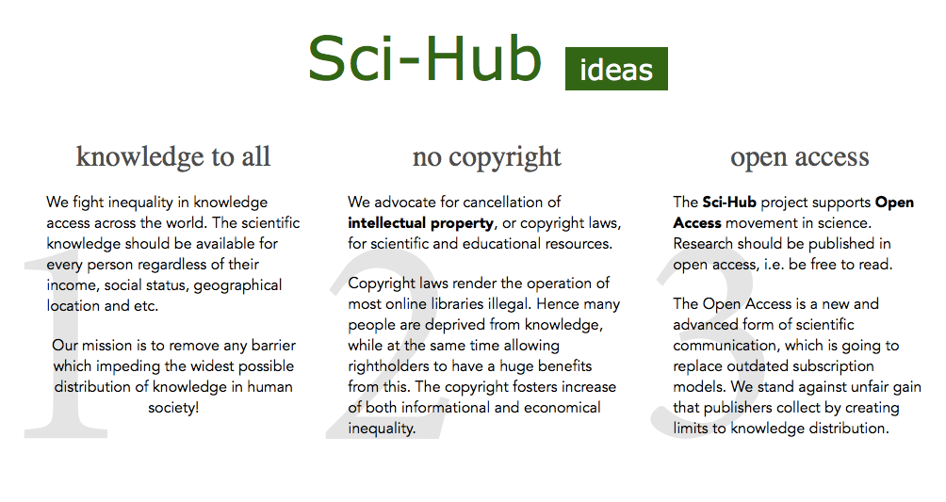
Source:Screenshot http://www.sci-hub.cc/
Notes:
While this is clearly in violation of copyright law, sci-hub makes a moral case for its offerings, stating that it fights inequality in knowledge access and supports the open access movement in science.

Slide 6
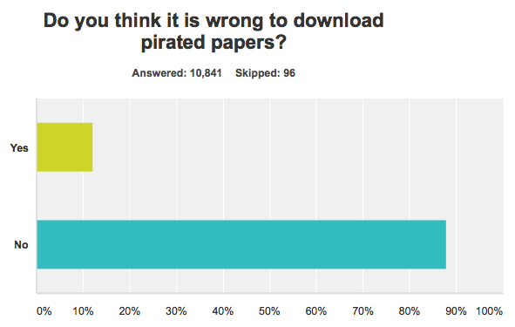
Source: http://www.sciencemag.org/news/2016/05/survey-most-give-thumbs-pirated-papers
Notes:
And when sci-hub users have been surveyed whether they have at least some guilty conscience for downloading pirated papers, their responses make it quite clear that they regret nothing.
I, to be honest, completely understand and share this position.

Slide 7
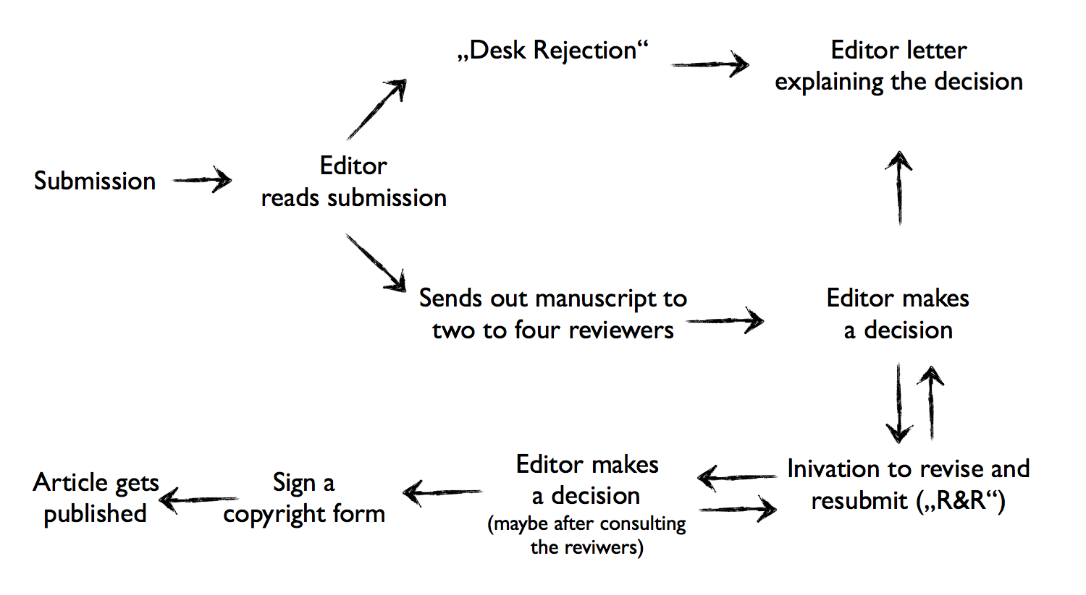
Scientific Publication
Process
Notes:
The reason is that the whole scientific publication process is organised by the scientific community with authors writing and handing in articles, editors deciding whether to immediately reject a submission or to send it out to other researchers for peer review and, often after several rounds of peer review, it’s the editors that decide on whether to publish an article or not. Only then you get to…

Slide 8
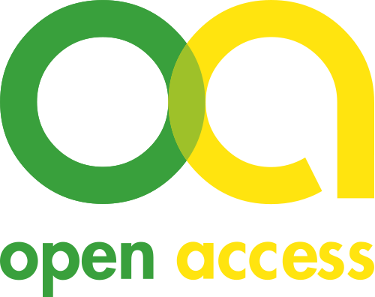
Scientific Publication
Process
Notes:
…sign a copyright form and the article gets published. And the Open Access movement originally only tried to intervene at this point: leaving the peer review process unaddressed, the open access movement wants publicly funded research to be openly available to anyone.

Slide 9


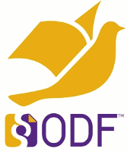
Open
Access
Open
Formats
Open
Licenses
Notes:
And with openly available it is not just meant to have access to the paper but also that the study and increasingly research data is openly licesned, which allows others to re-use research outputs without any further need of clearing copyrights and provided in open formats, which make it easy to engage in re-use and replication practices.

Slide 10
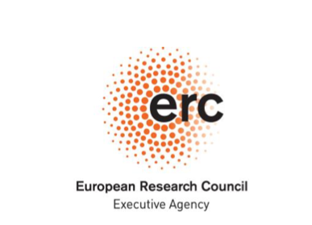
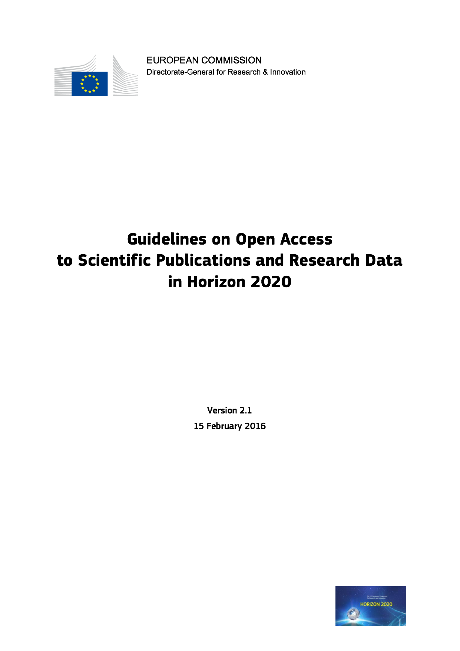

Open Access Mandates
by Funding Institutions
Notes:
Increasingly, research funding bodies require anyone who applies for funding to make their outputs openly available in such a manner.

Slide 11
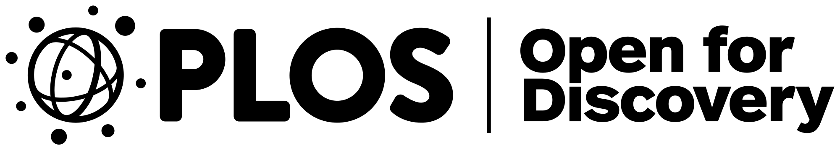
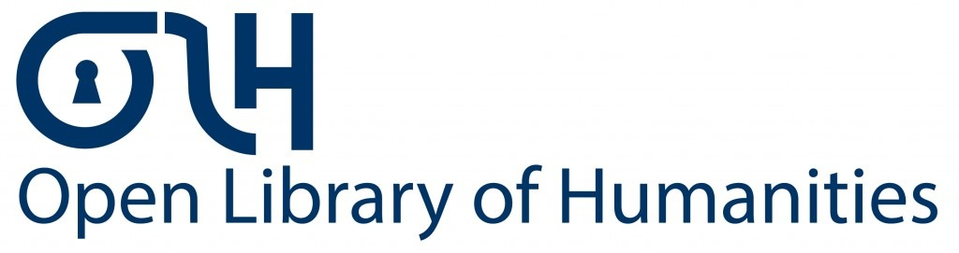
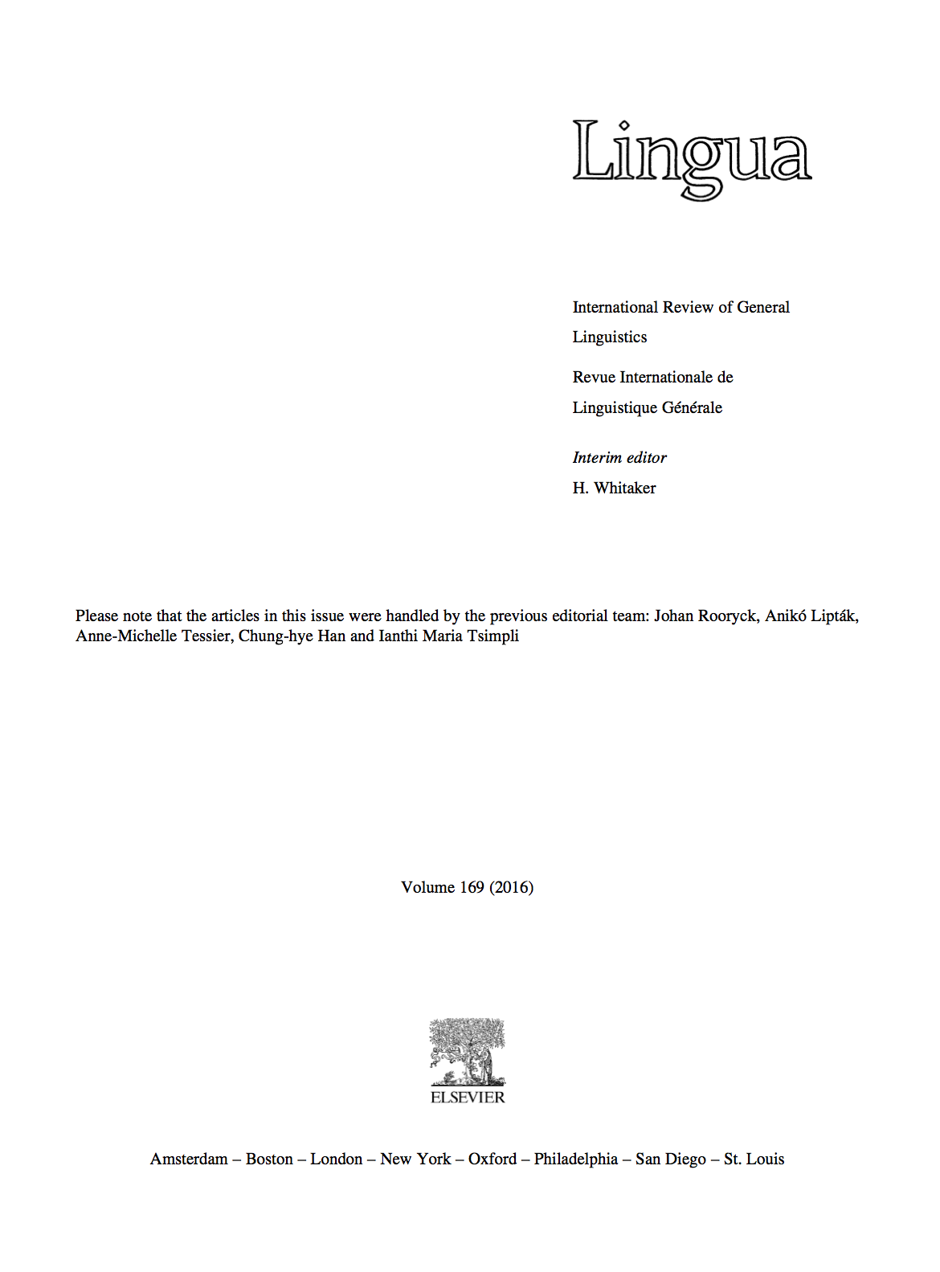
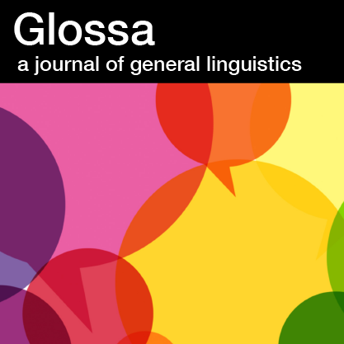

Open Access Publishing
(peer-reviewed)
>>
Context: https://governancexborders.com/2015/11/07/open-access-and-the-power-of-editorial-boards-why-elsevier-plays-hardball-with-deviant-linguists/
Notes:
And over the past two decades, we would observe some change in the academic publishing sector.
- Pioneered in the natural sciences by open access publishers such as the „Public Library of Science“ (short: PLOS),
Open access principles have already reached the humanities, for example with the platform „Open Library of Humanities“
And, a little late to the party, the new journal of the European Group of Organization Studies, called „Organization Theory“ is also a full open access journal.
While all these examples are newly founded outlets, there is also a growing number of cases where researchers in editorial boards put pressure on publishers to switch to full open access publishing models. And they have leverage, as was evidenced by the case of Lingua, one of the leading linguistic journals. When Elsevier did not want to switch to an open access model, the whole editorial board left Lingua and founded Glossa, taking their reputation and most of the authors with them.

Slide 12
From Open Access to Open Science
Notes:
But the title of this lecture is open science, not open access. And the reason is that over the last years, researchers across disciplines increasingly reached the consensus that mere access to final results and maybe underlying data sets is not enough.

Slide 13
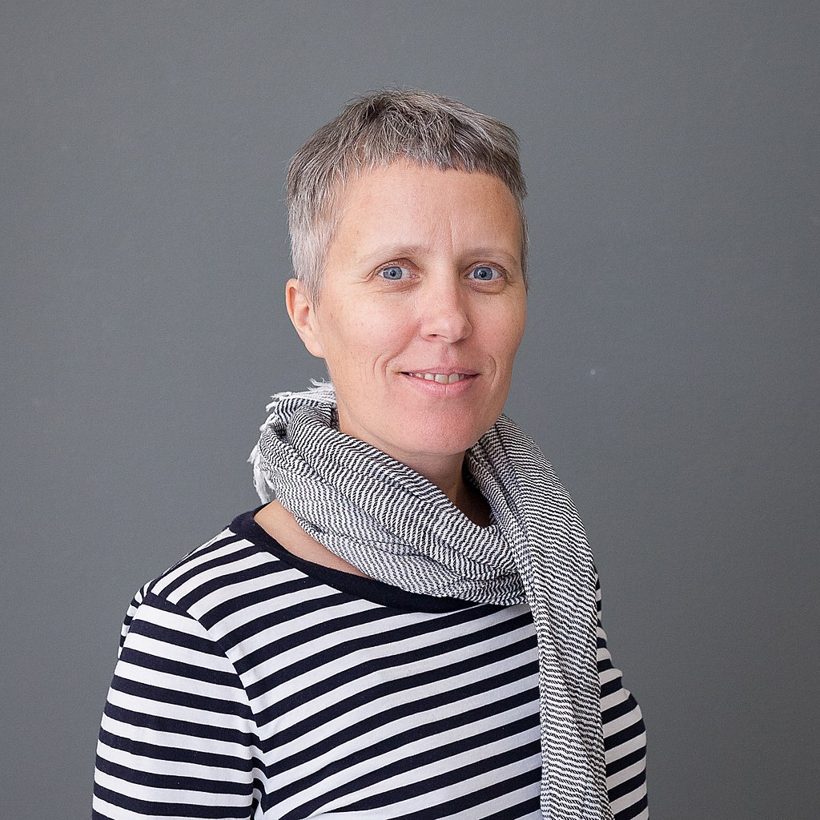
“
Open Science is the idea that scientific knowledge of all kinds should be openly
shared as early as is
practical in the research
process.
Open Access
Open (Research) Data / Materials
Open Source / Open Methods
Katja Mayer
O P E N S C I E N C E
Open Instructions
Open Education
Open Evaluation
Citizen Science
Foto: Ralf Rebmann, https://commons.wikimedia.org/wiki/File:Katja_Mayer_1.jpg, CC BY-SA 4.0 International
Notes:
Instead, in the words of Open Science researcher Katja Mayer, open science is the idea that scientific knowledge of all kinds should be openly shared as early as is practical in the research process.
Sol what are other kinds of scientific knowledge?
<read boxes>
And all these kinds of knowledge together are summarised under the umbrella term of open science. While we cannot discuss all these types of knowledge here, let me give some specific examples, also with relation to the current Covid-19 crisis.

Slide 14
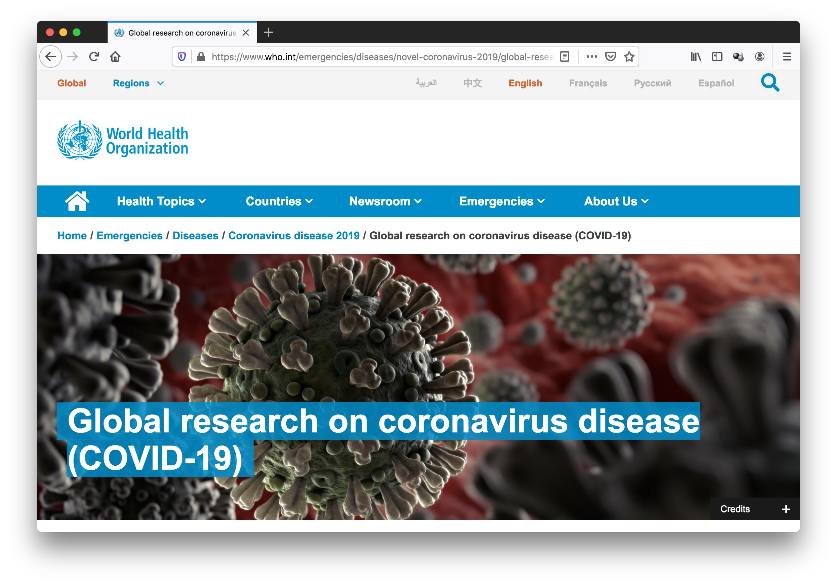
Open Access
Open (Research) Data / Materials
Open Source / Open Methods
O P E N S C I E N C E
Open Instructions
Open Education
Open Evaluation
Citizen Science
Screenshot:https://www.who.int/emergencies/diseases/novel-coronavirus-2019/global-research-on-novel-coronavirus-2019-ncov
Notes:
Given that responding to a pandemic in particular requires swift actions, all over the world we find pressure to share and aggregate all kinds of research data, materials, sources and methods that deal with Covid-19. Open access publisher Plos, for example, even made a promise to forward all studies and data related to Covid-19 to the World Health organization immediately after submission and prior to completion of the review process.

Slide 15
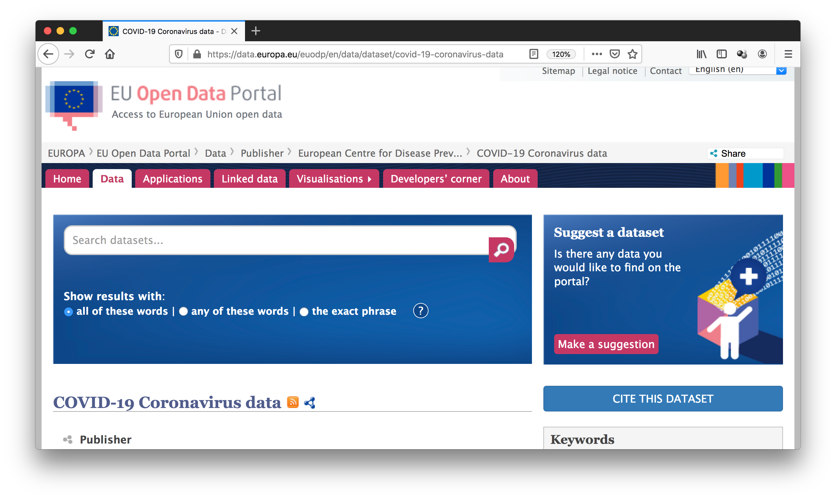
Open Access
Open (Research) Data / Materials
Open Source / Open Methods
O P E N S C I E N C E
Open Instructions
Open Education
Open Evaluation
Citizen Science
Screenshot: https://data.europa.eu/euodp/en/data/dataset/covid-19-coronavirus-data
Notes:
But it’s not just the WHO, also the European Union and most of its member states have established open data portals to allow open access to current corona data, enabling the maximum number of researchers to work on the best available base of data.

Slide 16

Open Access
Open (Research) Data / Materials
Open Source / Open Methods
O P E N S C I E N C E
Open Instructions
Open Education
Open Evaluation
Citizen Science
Screenshot:https://www.who.int/emergencies/diseases/novel-coronavirus-2019/global-research-on-novel-coronavirus-2019-ncov
Notes:
Another aspect of open science, which relates to Humboldt’s ideal of the unity between research and teaching, is open education.

Slide 17
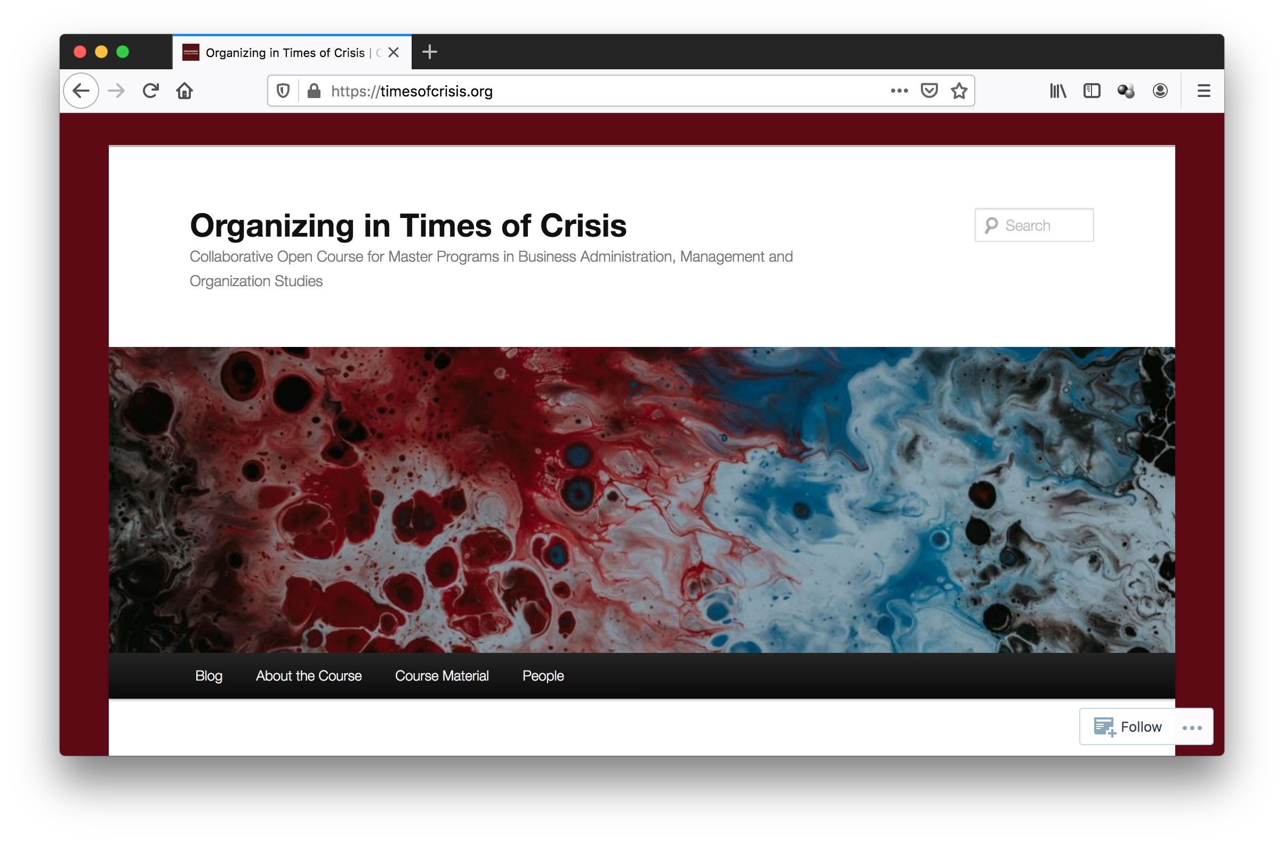
Open Access
Open (Research) Data / Materials
Open Source / Open Methods
O P E N S C I E N C E
Open Instructions
Open Education
Open Evaluation
Citizen Science
Screenshot:https://www.who.int/emergencies/diseases/novel-coronavirus-2019/global-research-on-novel-coronavirus-2019-ncov
Notes:
And by taking this course and watching this lecture, you are actually already part of this aspect of open science: the whole course material is openly licensed and available in open formats without access restrictions online at timesofcrisis.org.

Slide 18
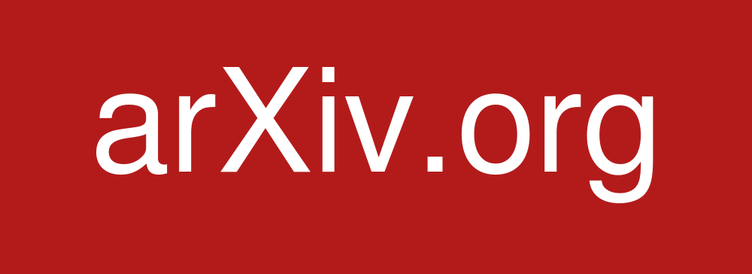

Open Access
Preprint server
Open (Research) Data / Materials
Scientific peers
Media audiences
Open Source / Open Methods
Open peer review
O P E N S C I E N C E
Open Instructions
Open identities
Open reports
Open participation
Open Education
Open Evaluation
Citizen Science
Credit: CC-BY-SA AJ Cann, via https://www.fosteropenscience.eu/learning/open-peer-review
Notes:
As a third and final example, let’s look at open evaluation. This means that not just reviewers of a journal but literally anyone willing and able is invited to evaluate works of research. One way to achieve that are pre-print servers. In a growing number of disciplines, articles are uploaded to preprint servers parallel to the submission to a journal. Again, in health crisis such as the current covid-19 pandemic, even fast review processes might cost lives and both scientific peers but also educated journalists check preprint servers every day for new insights.
Another approach tries to open up review processes. Open peer review may mean to even share identities of reviewers, or to keep reviewer identities private but share review reports or it may mean to invite broader audiences to engage in review.

Slide 19
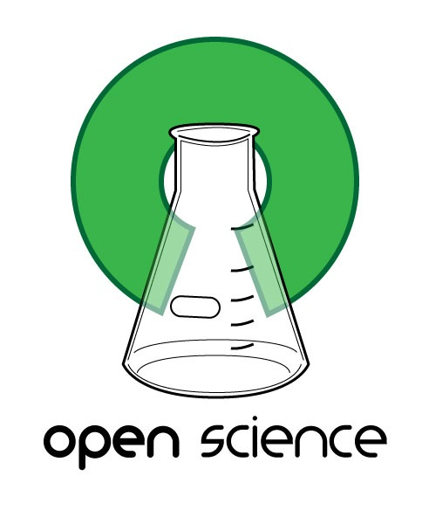
Open Access
Open (Research) Data / Materials
Open Source / Open Methods
O P E N S C I E N C E
Open Instructions
How to organize science
more openly?
Open Education
Open Evaluation
Citizen Science
Notes:
Taken together, Open Science is huge bundle of different practices which should help to bring research closer to the ideals of Newton and Merton mentioned in the beginning of this lecture.
But how do we organise science more openly, not just to fight a pandemic but to improve scientific knowledge creation overall?

Slide 20
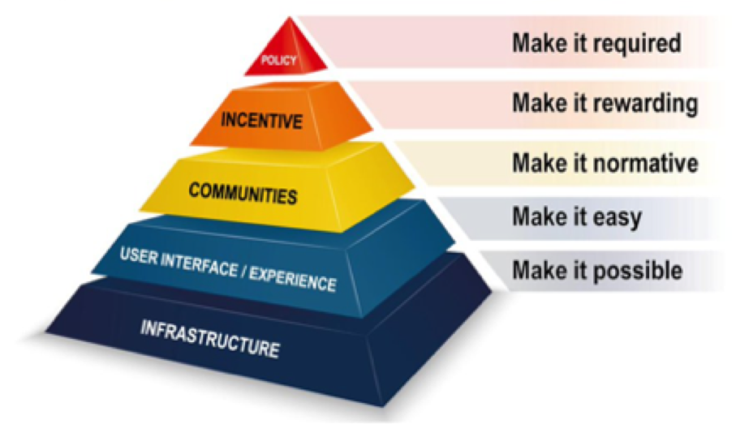
Organizing Open Strategies in Science
Goals
Sharing and collaboration
Transparency and reproducibility
Re-usability and new applications
Societal participation and feedback loops
Levels
Source: Presentation by Maximilian Heimstädt and Katja Mayer
Source: Taken from Brian Nosek https://osf.io/r9v3p/ and https://cos.io/blog/strategy-culture-change
Notes:
When Organizing open strategies in science, it is important to emphasise and also regularly evaluate whether key goals such as sharing and collaboration, transparency and reproducibility, re-usability and societal participation are realised or at least improved.
To do sow, several levels offer points of departure. For example, research institutions and funding bodies can make certain practices mandatory. Certain activities such as creating and sharing a data set should be recognised by these bodies and for academic career decisions to provide an incentive for openness. Within a scientific community, increasing openness needs to become a shared goal or even norm. And developing user interfaces and infrastructures for sharing all kinds of scientific knowledge would make it easier for broader strands of researchers to actually open up their research.

Slide 21
Contact
E-Mail: Leonhard.Dobusch@uibk.ac.at
Twitter: @leonidobusch
Web: bit.ly/LD-UIBK // dobusch.net
Research blogs:
osconjunction.net
governancexborders.com

Slide 22
References
Dobusch, L., & Heimstädt, M. (2019). Predatory publishing in management research: A call for open peer review. Management Learning, 50(5), 607-619.
Fecher, B., & Friesike, S. (2014). Open science: one term, five schools of thought. In Opening science (pp. 17-47). Springer.
Mayer, K. (2018): Open Science, all or nothing?, https://zenodo.org/record/1889751#.XpnCHlMzYWo
Merton, R. K. (1973) [1942]. The Normative Structure of Science. In: Merton, R. K. (ed.), The Sociology of Science: Theoretical and Empirical Investigations, Chicago: University of Chicago Press, ISBN 978-0-226-52091-9, OCLC 755754

