Slide 1
Entrepreneurship and Innovation for the Common Good
Dr. Ali Aslan Gümüsay
University of Hamburg
Humboldt Institute for Internet & Society
@guemuesay

Slide 2
How do entrepreneurial ventures and established companies engage with societal challenges such as the Covid19 crisis?
What is the role of technology?

Slide 3
Entrepreneurship involves the nexus of two phenomena: the presence of lucrative opportunities and the presence of enterprising individuals
(Venkataraman, 1997).
Venkataraman, S. (1997) The distinctive domain of entrepreneurship research.

Slide 4


recombination

Slide 5

recombination
Notes:
http://www.clker.com/cliparts/y/I/C/p/U/e/bottle-of-water-md.png

Slide 6

Notes:
https://unsplash.com/photos/89HtiQoRgPc

Slide 7

Baumol, W. J. (1996) Entrepreneurship: Productive, unproductive, and destructive. Journal of Business Venturing, 11(1), 3-22.

Slide 8
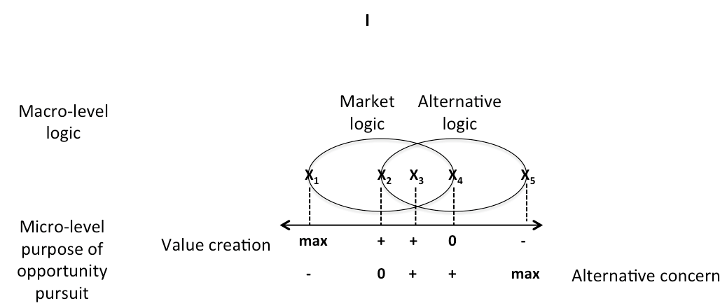
Gümüsay, A.A. (2018) Unpacking entrepreneurial opportunities: an institutional logics perspective. Innovation, Organization & Management, 20(3), 209-222.

Slide 9
Pivoting

Slide 11


Slide 12



Slide 13
Response orchestration

Slide 14
Literature
Core reading
  George, G., Merrill, R. K., & Schillebeeckx, S. J. D. (2020): Digital Sustainability and Entrepreneurship: How Digital Innovations Are Helping Tackle Climate Change and Sustainable Development. Entrepreneurship Theory & Practice, in print. PDF
Contemporary news article
  Lanier, J., & Weyl, E. G. (2020): How Civic Technology Can Help Stop a Pandemic. Foreign Affairs, March 20.
Background readings
  Gümüsay, A.A. (2018): Hybrid Organizing in the Face of Grand Challenges. BOS Blog, July 3.
  Günzel-Jensen, F., Siebold, N., Kroeger, A., Korsgaard, S. (2020): Do the United Nations’ Sustainable Development Goals matter for social entrepreneurial ventures? A bottom-up perspective. Journal of Business Venturing Insights, 13:e00162. PDF via Journal
  Tracey, P. (2020): The Corporate Pivot: Radical change in times of crisis. Cambridge Social Innovation Blog, March 25.
  Watson, I., Jeong, S., Hollingsworth, J., & Booth, T. (2020): How this South Korean company created coronavirus test kits in three weeks. CNN, March 12.

Slide 15
Thank you.
Dr. Ali Aslan Gümüsay
University of Hamburg
Humboldt Institute for Internet & Society
@guemuesay

