Slide 1
ORGANIZING
in Times of Crisis
Class 1: Organizational Decision Making in Crisis
Markus Reihlen
Leuphana University of Lüneburg
March 31, 2022

Slide 2

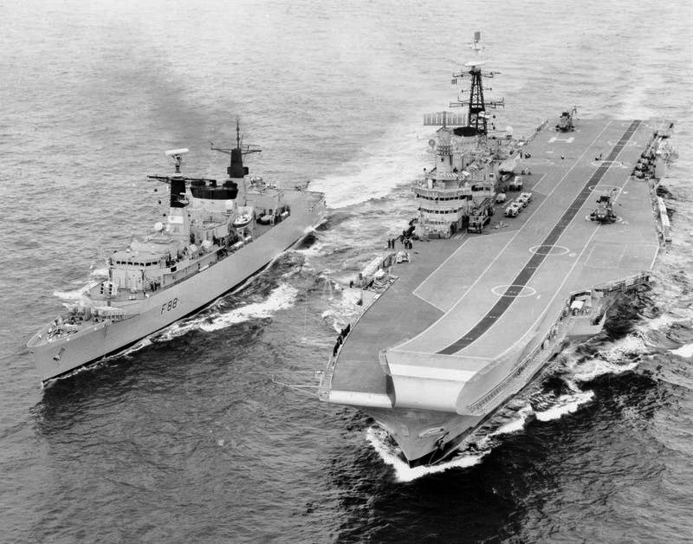
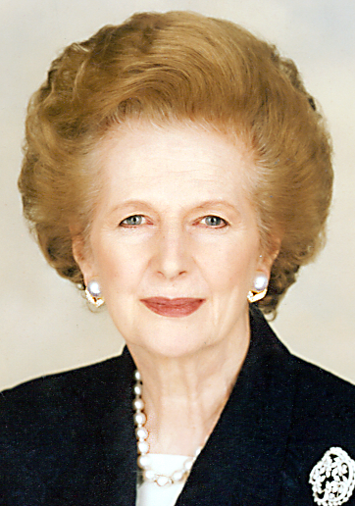
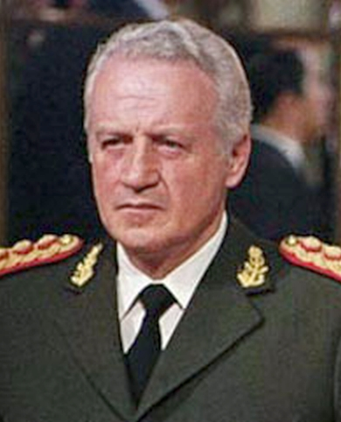
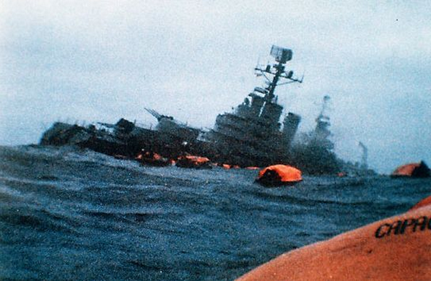
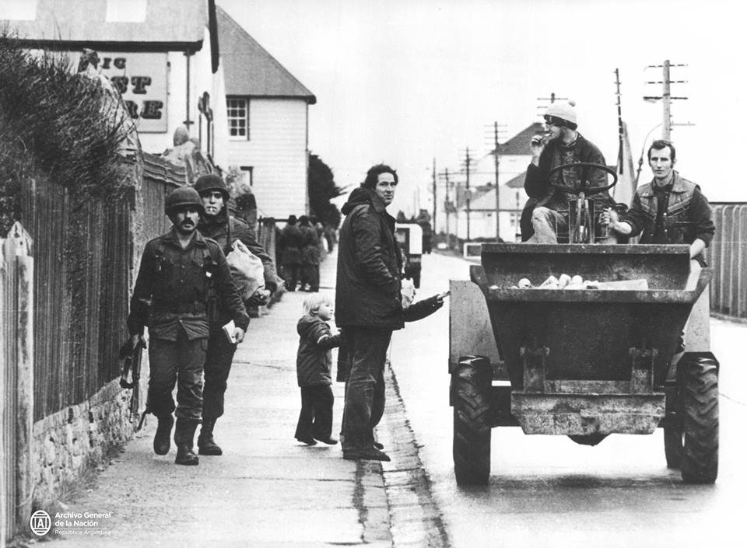
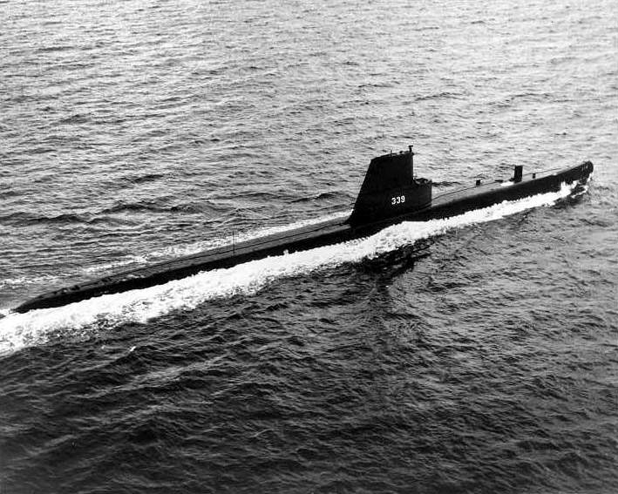
Rational Decision Making
Core Argument
The two
opposing leaders
during the Falklands War
1982
Margaret Thatcher
Leopoldo Galtieri
Prof. Dr. Markus Reihlen
Leuphana University of Lüneburg
2

Slide 3
Rational Decision Making
Core Argument
The rational theories of decision-making assume that every decision-maker
knows all the alternatives of action
knows all the consequences of every alternative course of action
has a consistent preference ordering for alternative courses of action, and
uses decision rules that can select a single action to take
Prof. Dr. Markus Reihlen
Leuphana University of Lüneburg
3

Slide 4
Rational Decision Making
Critique
From ideal to bounded rationality (Simon, 1957)
The logic of foolishness and adaptive intelligence (March, 2006)
Decision problems are not objective, but interpreted and enacted by decision-makers (Daft & Weick, 1984)
Organizational decision-making is infused by group dynamics and power plays (Pettigrew, 2014)
Prof. Dr. Markus Reihlen
Leuphana University of Lüneburg
4

Slide 5

Decision Making as Sensemaking
Scenario
Protagonist: Especially Karl Weick (1995).
Conditions: Ambiguity, information incompleteness, and
contradictory information.
Sensemaking entails:
Changes in perceptions to make them mutually consistent
Changes in goals and expectations to make them consistent with perceptions
Changes in perceptions to make them consistent with actions already taken; and
Active efforts to manipulate the environment to make them consistent with one’s perceptions and desires.
Prof. Dr. Markus Reihlen
Leuphana University of Lüneburg
5

Slide 6
Decision Making as Sensemaking
Extension
Breakdown in sensemaking (Weick, 1993;
Weick, & Roberts, 1993).
Dealing with inaccurate and unreliable information (Mezias & Starbucks, 2012)
How do decision-makers respond to inaccuracy and unreliable perceptions?
    Seeking more data
    Reverting to ideology
    Influencing the audiences
    Piecemeal social engineering
Prof. Dr. Markus Reihlen
Leuphana University of Lüneburg
6

Slide 7
Decision Making as Sensemaking
Extension
Breakdown in sensemaking (Weick, 1993;
Weick, & Roberts, 1993).
Dealing with inaccurate and unreliable information (Mezias & Starbucks, 2012)
Sensemaking and culture (Dougherty, 1992; Janis, 1972)
Prof. Dr. Markus Reihlen
Leuphana University of Lüneburg
7

Slide 8

Decision Making as Organizational Routine
Core Argument
Organizations become collective sense makers that operate on the basis of routines shaping how information is collected, analyzed, translated into choices, and how choices are executed in the organization. Thus, organizational routines constrain the formation of decision options (Allison, 1969, 1971).
Connection between organizational routines and the causes of war (Levy, 1986)
JFK and
Ted Sorensen
Prof. Dr. Markus Reihlen
Leuphana University of Lüneburg
8

Slide 9
Decision Making as Organizational Routine
Extension
The nature of organizational routines: Ostensive and performative aspects (Feldman & Pentland, 2003)
Building better bureaucracies: From coercive to enabling (Alder & Borys, 1996)
Prof. Dr. Markus Reihlen
Leuphana University of Lüneburg
9

Slide 10
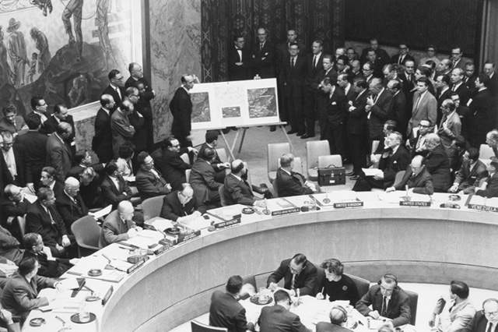
Decision Making as a Political Process
Core Argument
To make decisions is to act politically, which means exercising influence and power in any possible way. A leader can use power to mobilize resources, energy, and information in accordance with a goal or a strategy (Allison, 1969, 1971).
The political process model highlights that the influence of multiple stakeholders and coalitions exercise influence on the decision-making.
Prof. Dr. Markus Reihlen
Leuphana University of Lüneburg
10

Slide 11
Decision Making as a Political Process
Core Argument
The Garbage Can Model (Cohen, March, & Olsen, 1972)
Organizations as political coalitions (March, 1962) or power systems (Mintzberg, 1983).
Internal Coalition
Formal authority
Ideology
Expertise
Micropolitics
Prof. Dr. Markus Reihlen
Leuphana University of Lüneburg
11

Slide 12
Decision Making as a Political Process
Extension
From the internal to the external coalition
Interpretations of reality as influenced by power games (Meindl et al., 1994)
Internal Coalition
Formal authority
Ideology
Expertise
Micropolitics
External Coalition
Dominated
Divided
Passive
Prof. Dr. Markus Reihlen
Leuphana University of Lüneburg
12

Slide 13
Developing the Art and Science of Organizational Analysis
Rational model
Deliberate, “rational“ Plans
Sense-making model
Struggle for Meaning
Routine model
Shaped by institutional structures and processes
Political model
Bargaining, power games, and micropolitics
Prof. Dr. Markus Reihlen
Leuphana University of Lüneburg
13

Slide 14

Thank you for your attention!

Slide 15
Contact
Prof. Dr. Markus Reihlen
Professor of Strategic Management
Institute of Management & Organization
Leuphana University of Lüneburg
Universitätsallee 1
D-21335 Lüneburg, Germany
+49 (4131) 677 2354
reihlen@leuhana.de
https://www.leuphana.de/en/institutes/imo/persons/markus-reihlen.html
» www.leuphana.de

Slide 16
Sources
Music
Life-World by Jeris (c) copyright 2012 Licensed under a Creative Commons Attribution Noncommercial (3.0) license. http://dig.ccmixter.org/files/VJ_Memes/37087 Ft: audiotechnica
Pictures
Wikipedia
Pixabay
Video material
Defcon 2 - Cuban Missile Crisis;: https://www.youtube.com/watch?v=Jwz7YAQj-r0&t=42s
Robert McNamara on the Cuban Missile Crisis: https://www.youtube.com/watch?v=3lrH7RtiobQ

Slide 17
References
Adler, P. S., & Borys, B. (1996). Two types of bureaucracy: Enabling and coercive. Administrative Science Quarterly, 41(1), 61-89.
Allison, G. T. (1969). Conceptual models and the Cuban missile crisis. American Political Science Review, 63(3), 689-718.
Allison, G. T. (1971) Essence of decision. Explaining the Cuban missile crisis. Little Brown and Company: Boston.
Bukkvoll, T. (2016). Why Putin went to war: ideology, interests and decision-making in the Russian use of force in Crimea and Donbas. Contemporary Politics, 22(3), 267-282.
Cohen, M. D., March, J. G., & Olsen, J. P. (1972). A garbage can model of organizational choice. Administrative Science Quarterly, 1-25.
Daft, R. L., & Weick, K. E. (1984). Toward a model of organizations as interpretation systems. Academy of Management Review, 9(2), 284-295.
Dougherty, D. (1992). Interpretive barriers to successful product innovation in large firms. Organization Science, 3(2), 179-202.
Feldman, M. S., & Pentland, B. T. (2003). Reconceptualizing organizational routines as a source of flexibility and change. Administrative Science Quarterly, 48(1), 94-118.
Gorlizki, Y. (2001). Stalin's cabinet: the Politburo and decision making in the post-war years. Europe-Asia Studies, 53(2), 291-312.
Levy, J. S. (1986). Organizational routines and the causes of war. International Studies Quarterly, 30(2), 193-222.
Hodgkinson, G. P.; Starbuck, W. H. (2012a) The Oxford handbook of organizational decision making. Oxford University Press: Oxford.
Hodgkinson, G. P.; Starbuck, W. H. (2012b) Organizational Decision Making: Mapping Terrains on Different Planets, in: Hodgkinson, G. P.; Starbuck, W. H. (Eds.), The Oxford handbook of organizational decision making. Oxford University Press: Oxford, 1-29
March, J. G. (1962). The business firm as a political coalition. The Journal of Politics, 24(4), 662-678.
March, J. G. (2006). Rationality, foolishness, and adaptive intelligence. Strategic Management Journal, 27(3), 201-214.
Mezias, J. M.; Starbuck, W. H. (2012) Decision Making with Inaccurate, Unreliable Data, in: Hodgkinson, G. P.; Starbuck, W. H. (Eds.), The Oxford handbook of organizational decision making. Oxford University Press: Oxford, 76-96.
Janis, I. L. (1972). Victims of groupthink. Boston: Houghton Mifflin.
Pettigrew, A. M. (2014). The politics of organizational decision-making. Routledge.
Simon, H. A. (1957). Models of man; social and rational. Wiley: New York.
Weick, K. E. (1993). The collapse of sensemaking in organizations: The Mann Gulch disaster. Administrative Science Quarterly, 628-652.
Weick, K. E. (1995). Sensemaking in organizations. Sage.
Weick, K. E., & Roberts, K. H. (1993). Collective mind in organizations: Heedful interrelating on flight decks. Administrative Science Quarterly, 357-381.

