Slide 1
ORGANIZING
in Times of Crisis
Class 12: Time, Temporality and Organizing in Times of Crisis
Blagoy Blagoev
Technische Universität Dresden
May 20, 2022

Slide 2
Learning objectives
Being able to reflect upon the temporal dimensions of organizing in times of crisis as well as how a temporal lens can illuminate the Ukraine crisis
How to get there:
  Develop an understanding of crisis as a temporal concept
  Apply three temporal lenses—structure, resource, and process—to understand organizational responses to crisis situations
  Critically examine the dominance of short-term horizons and fast-pace orientations in (Western) organizations and institutions

Slide 3
Crisis as a temporal concept
“normal” course of events
“new normal” ?
crisis as disruption

Slide 4
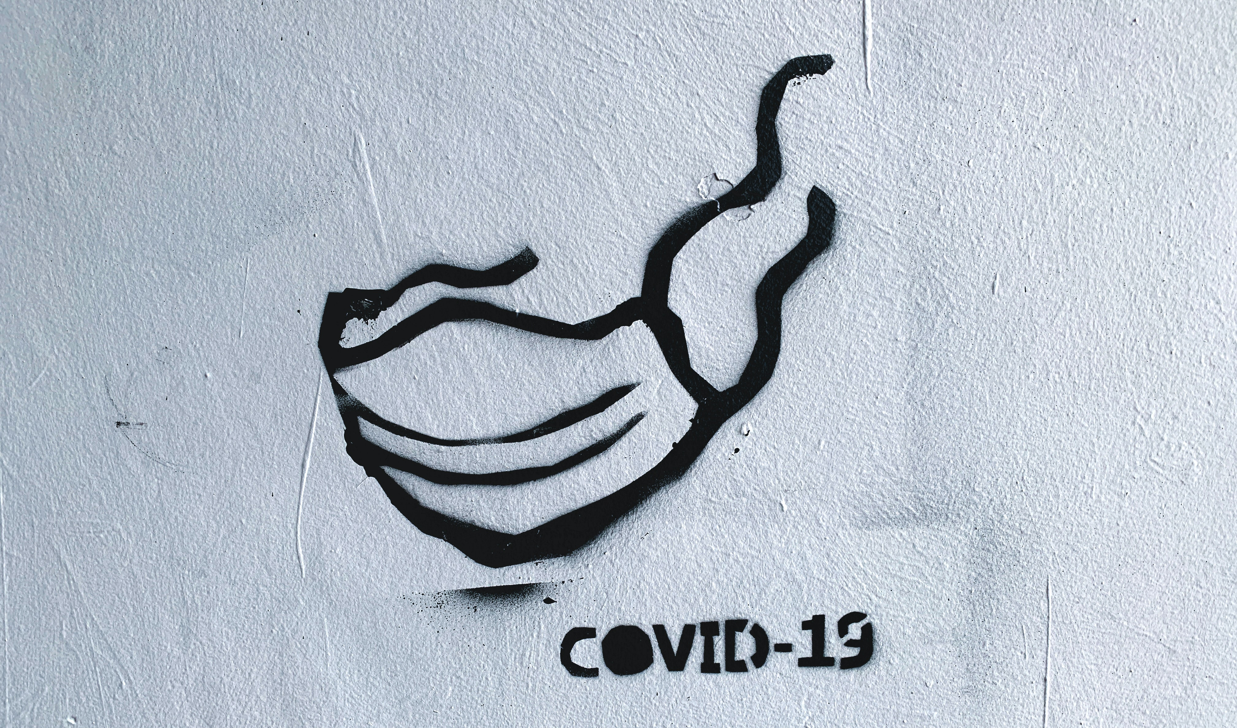
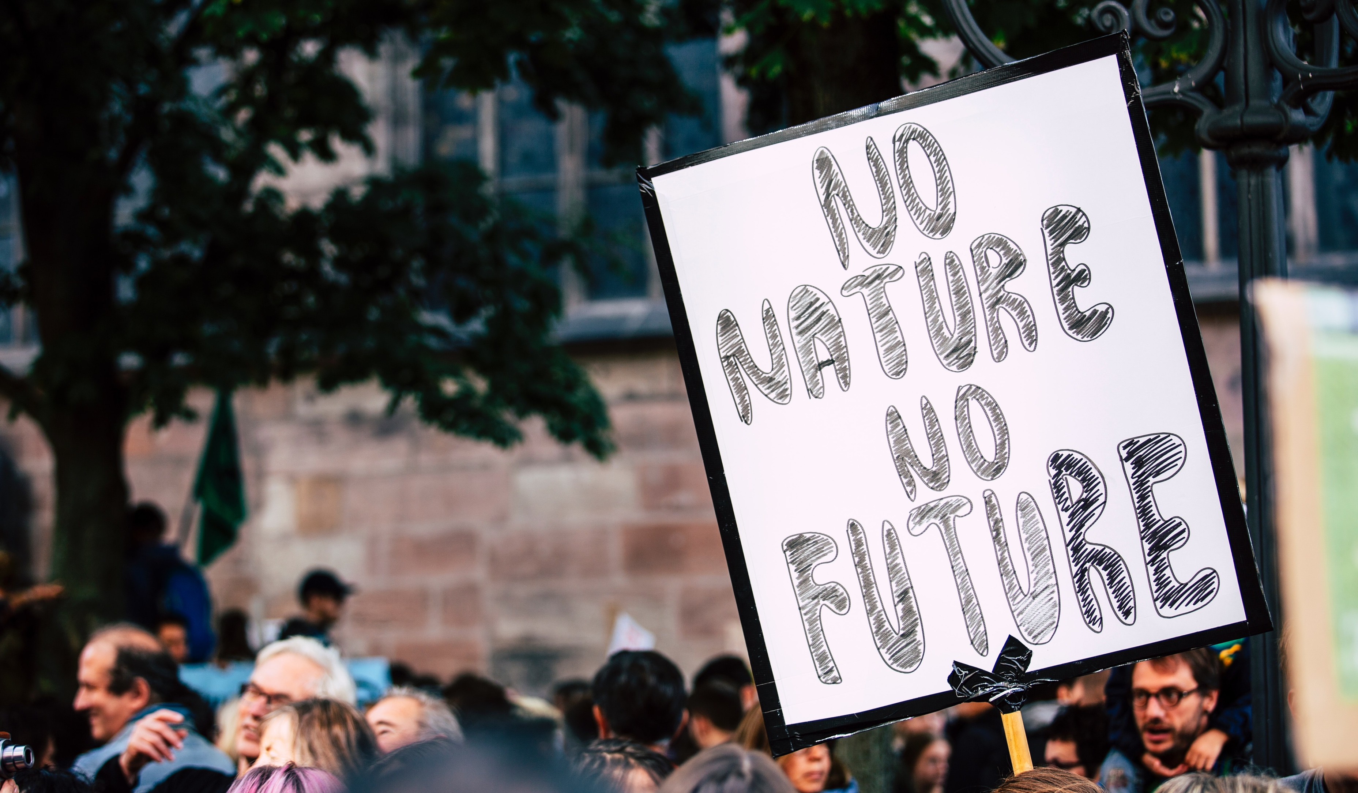
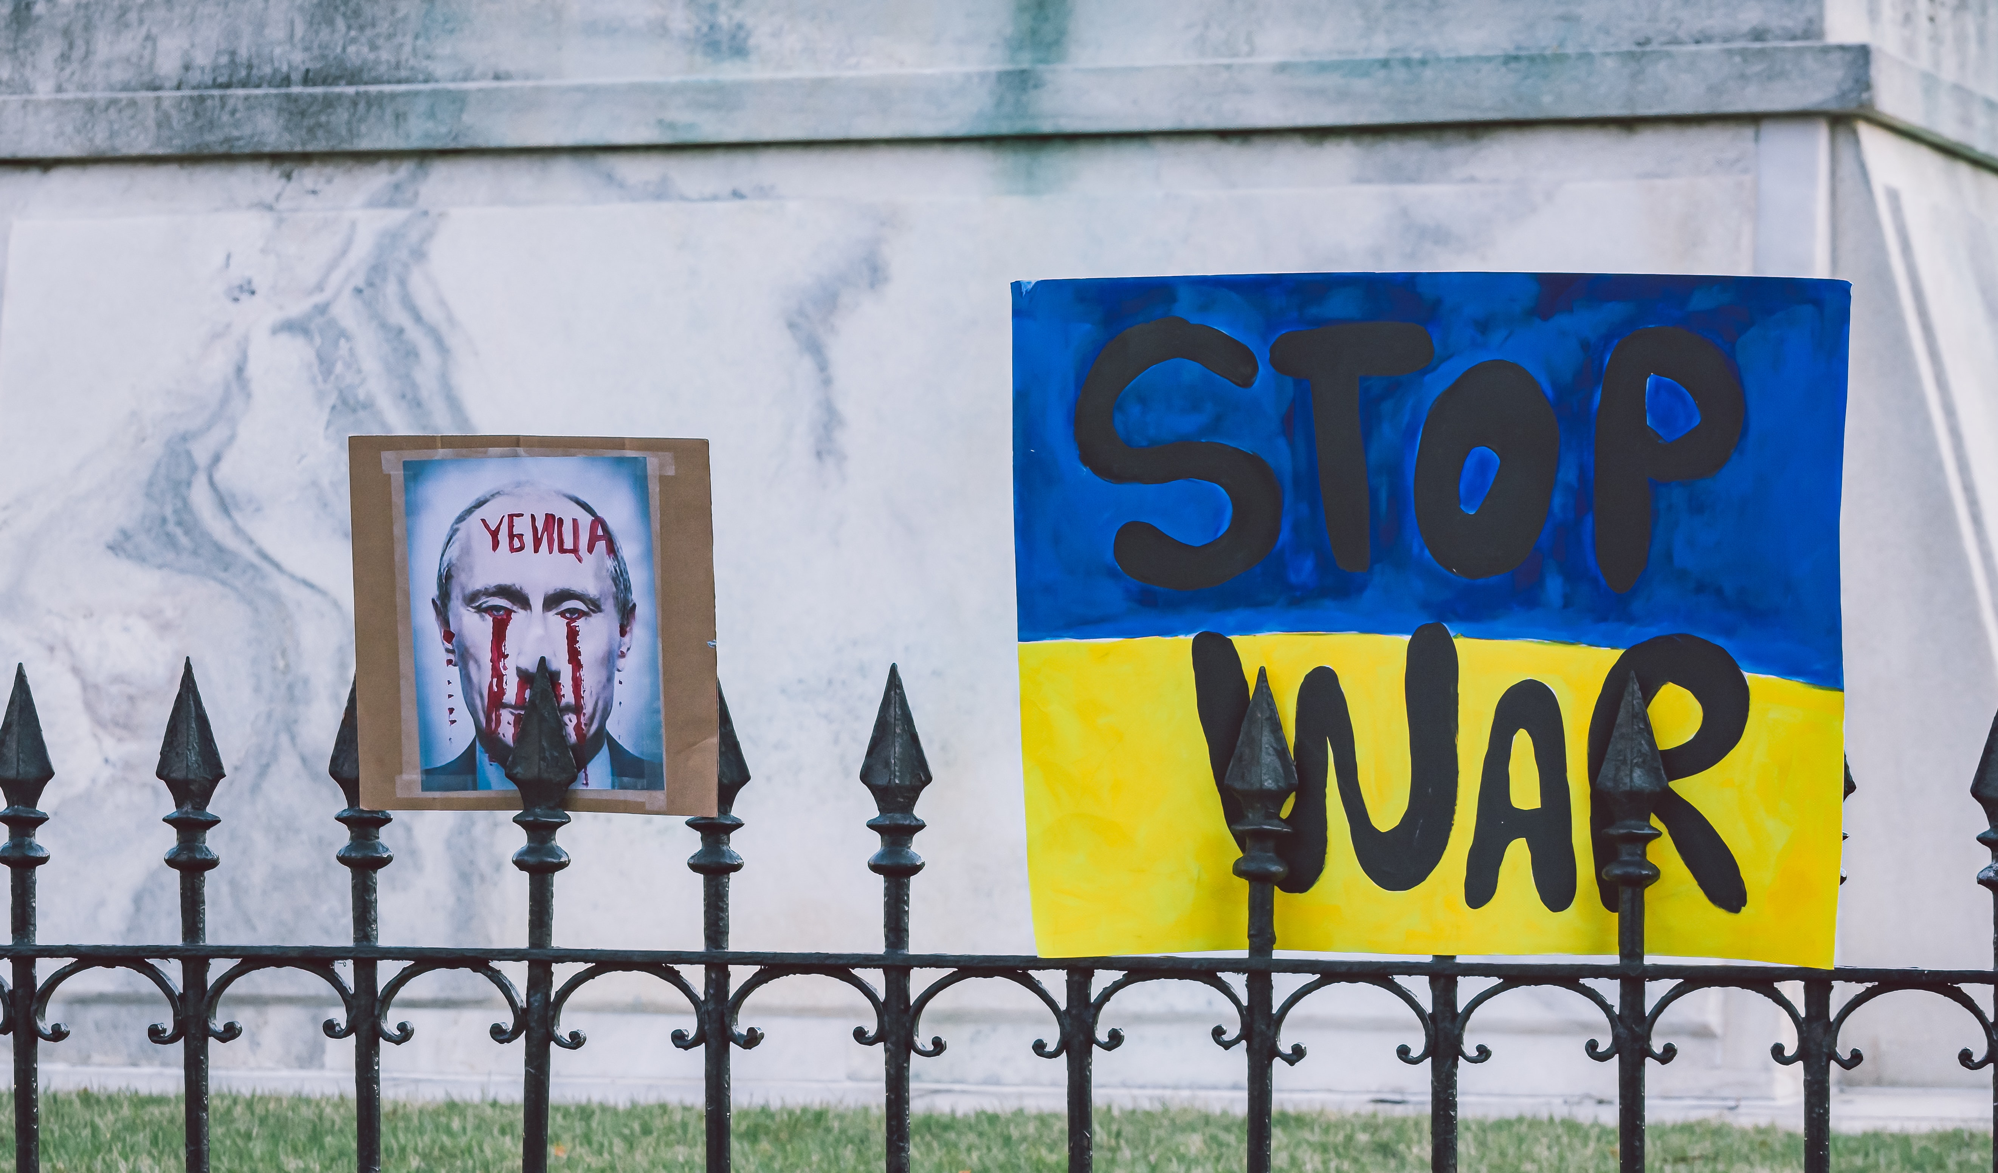
Crises expose the complex fabric of time
Photo by Adam Nieścioruk on Unsplash
Photo by Markus Spiske on Unsplash
Photo by Gayatri Malhotra on Unsplash
  ”Flattening the curve” as a strategy to slow down the spread of the virus
  Accelerated development and distribution of vaccines & digitalization
  Kunisch et al., 2021; Antenas, 2021
  Economic short-termism and discounting the future
  Translating distant future goals into present-day activity
  Slawinski & Bansal, 2015; Hernes & Schultz, 2020
  Russian expectations for a fast-paced “blitzkrieg” cast down by Ukrainian resistance
  Unclear time horizon: temporary conflict or perpetual war?

Slide 5
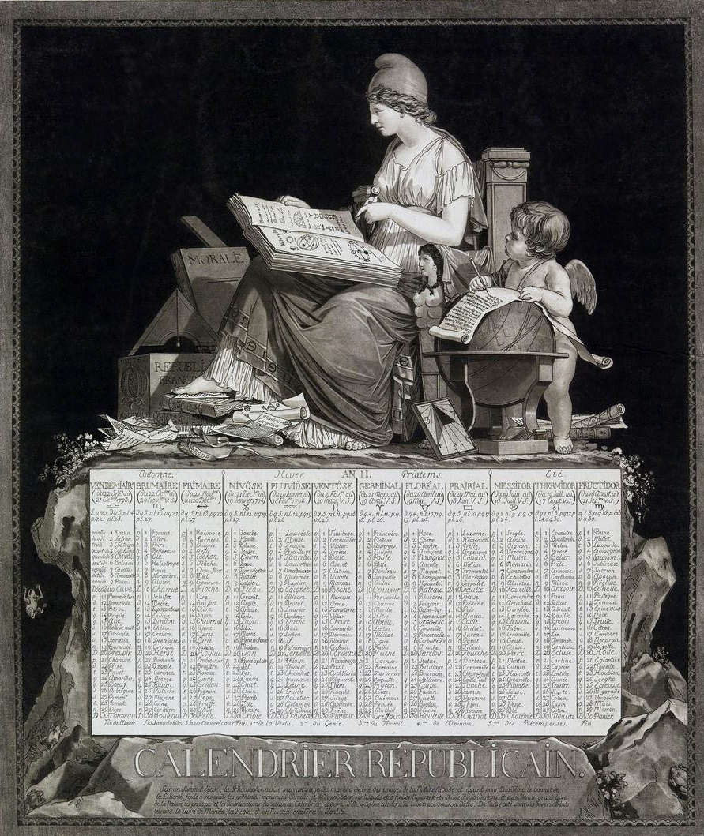
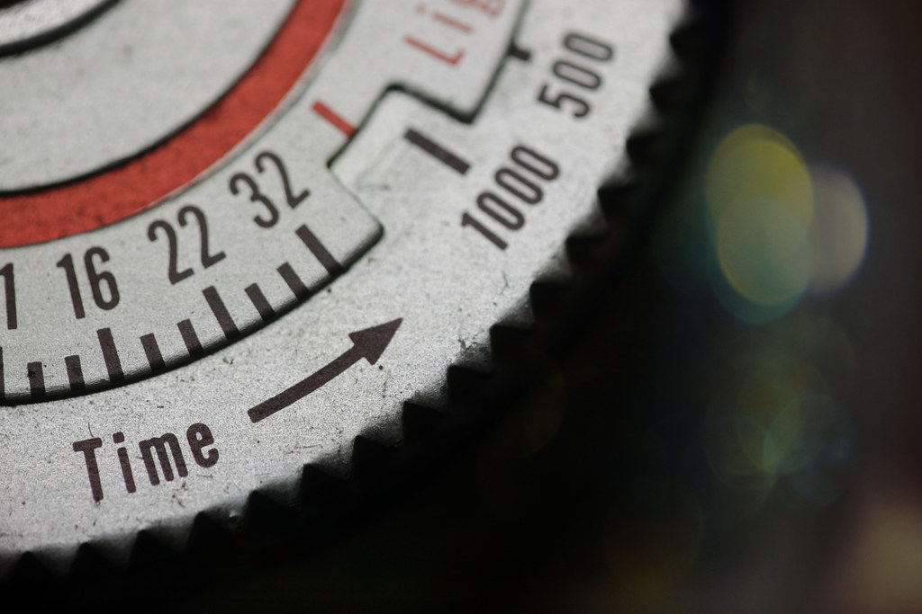
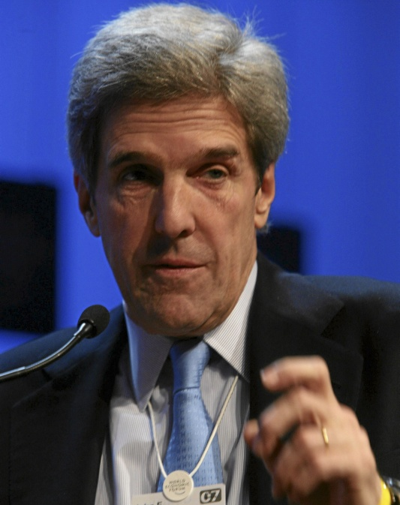
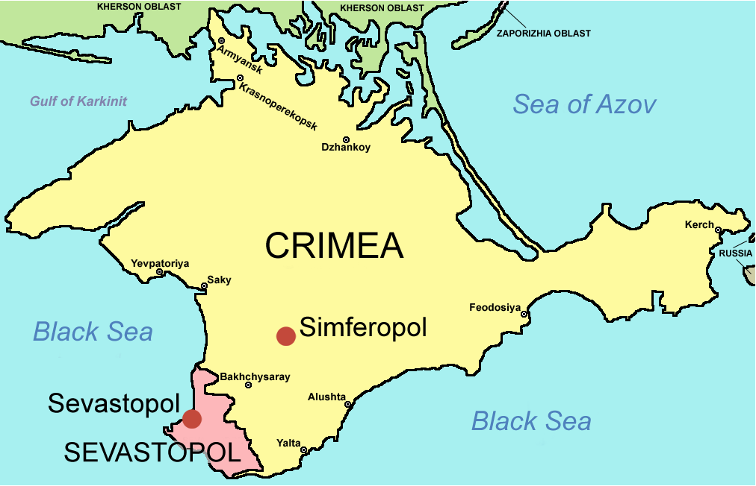
Wars and armed conflicts expose the political nature of time
Neal Fowler, CC BY-NC 2.0, via Flickr
Debucourt, Philibert Louis, Public domain, via Wikimedia Commons
Soerfm, CC BY-SA 3.0, via Wikimedia Commons
World Economic Forum from Cologny, Switzerland, CC BY-SA 2.0, via Wikimedia Commons

Slide 6
Temporal work
individual, collective or organizational effort to influence, sustain or redirect the temporal assumptions or patterns that shape strategic [and organizational] action.
(Bansal et al., 2022: 7)
“

Slide 7
Manifestations of time in organizing
Time as
Structure
Time as
Process
How to create and maintain temporal order?
How to enact
continuity among past, present, and future activity?
Time as
Resource
How to get the right timing, pacing, and time horizons?
Source: Blagoev et al., 2022

Slide 8
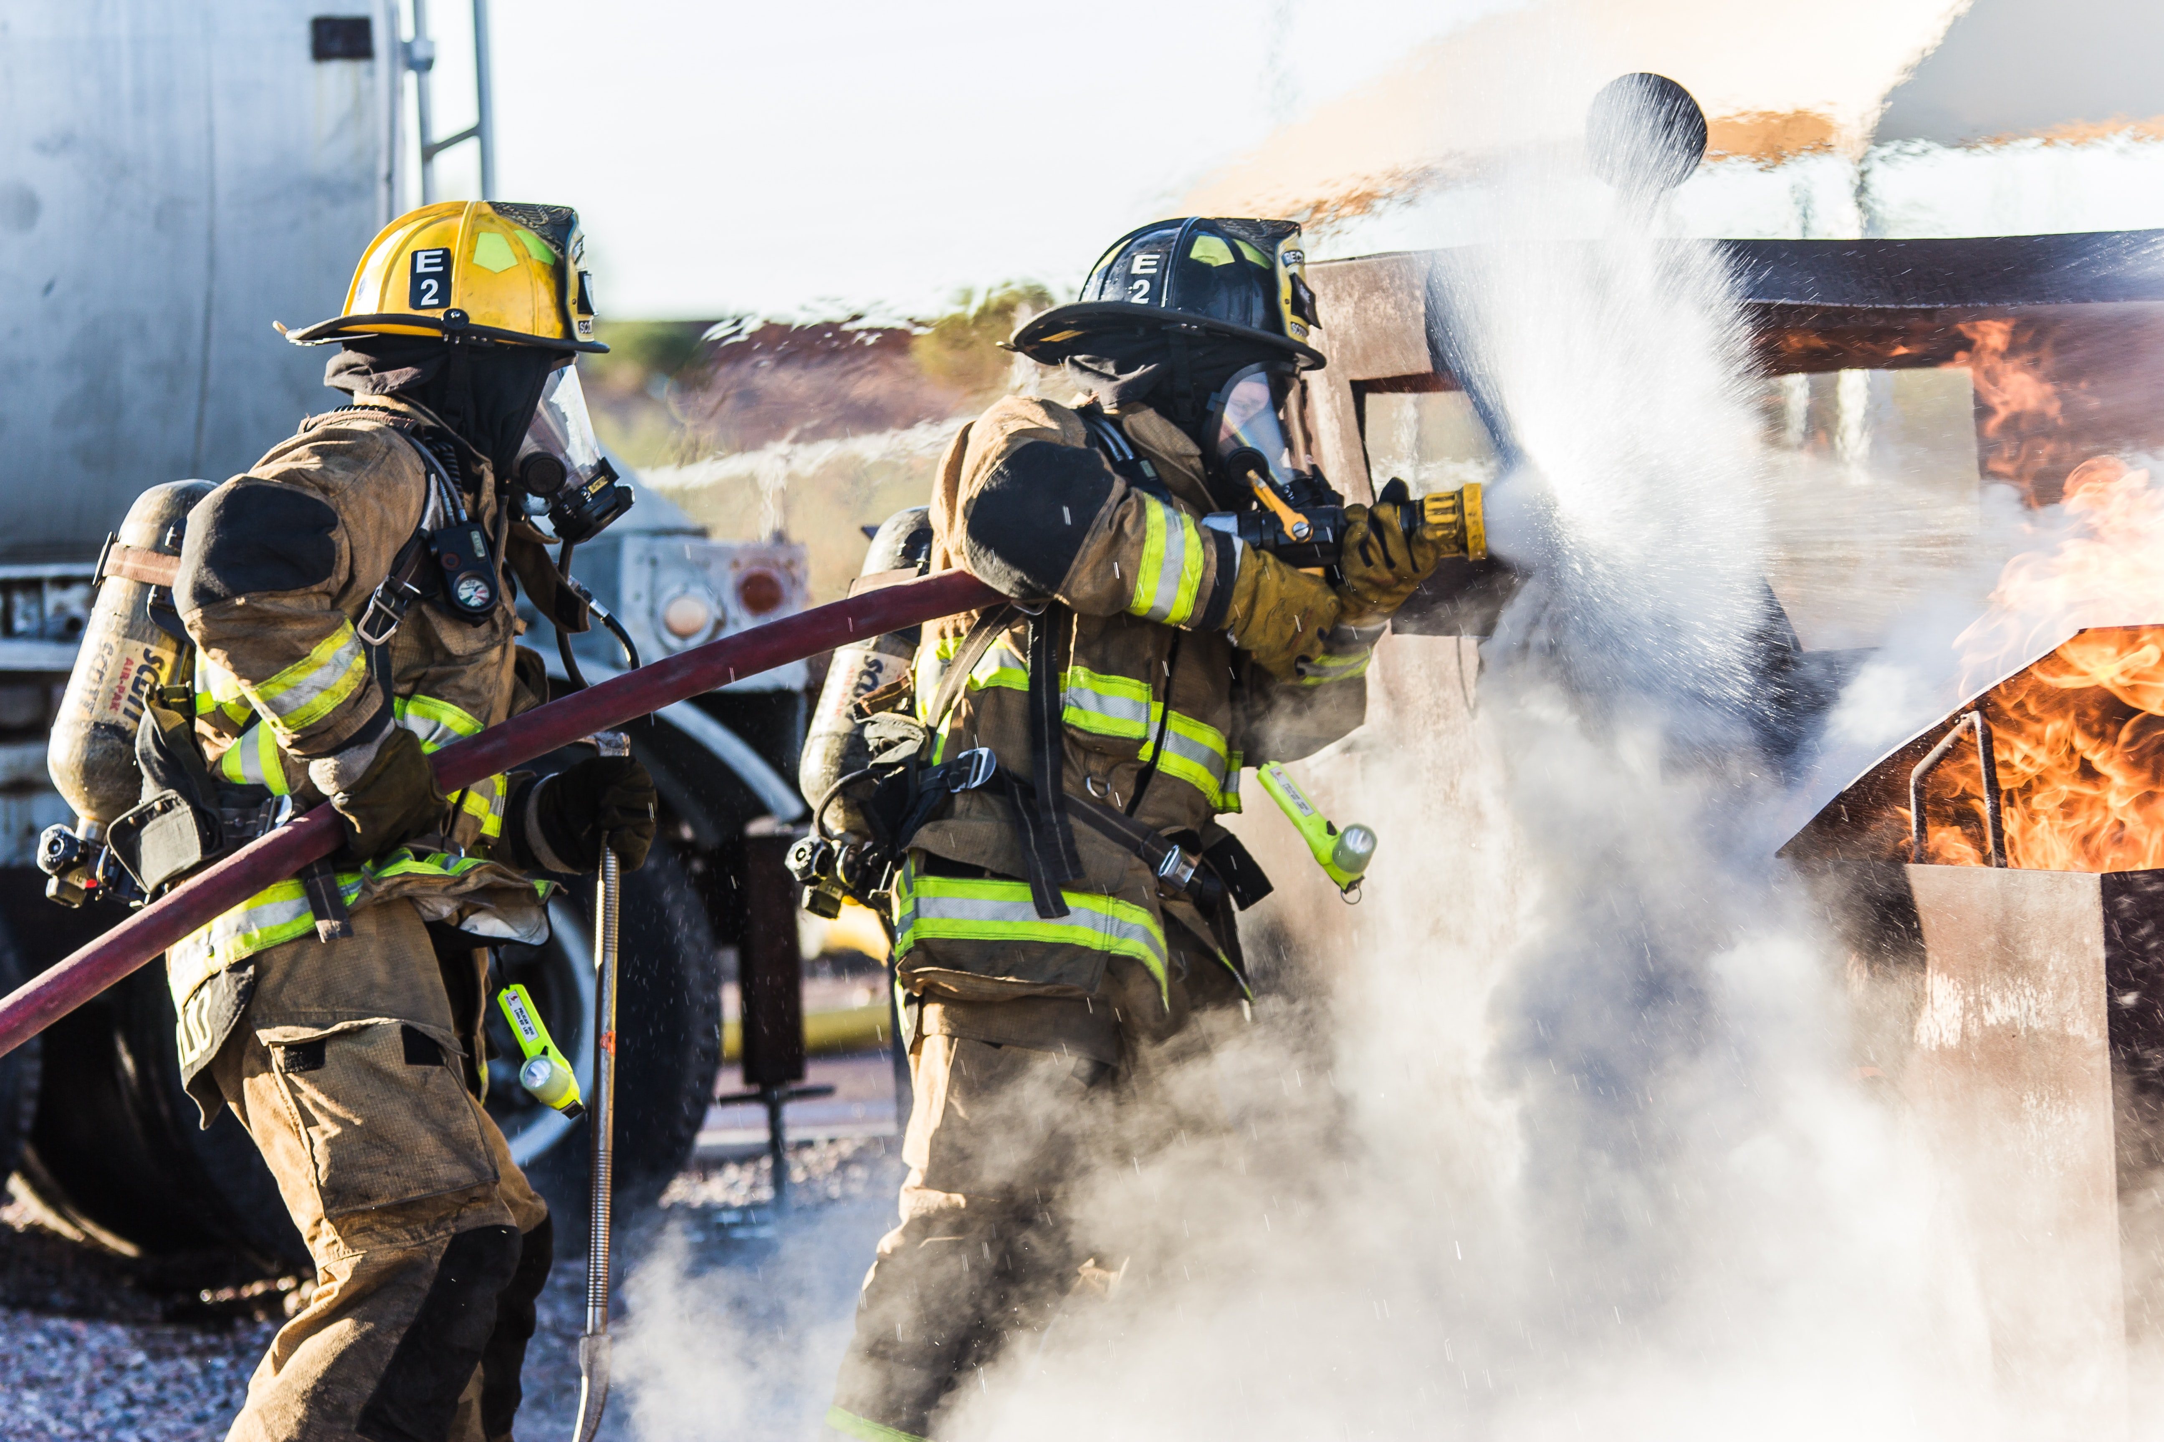
Time as structure
Temporally uncoupling from unfolding crisis situations
Temporal uncertainty
Temporal
uncoupling
Temporal autonomy
“The worst is if you run behind, then you lose grip of the situation and focus. . . . All our efforts are geared towards getting ahead of time—we need to be in control and know what happens next.” (Geiger et al., 2021, p. 235)
“Getting ahead
of time”
Maintaining a temporal order
in crisis situations
Photo by Matt C on Unsplash
Source: Geiger et al., 2021; Blagoev & Schreyögg, 2019

Slide 9
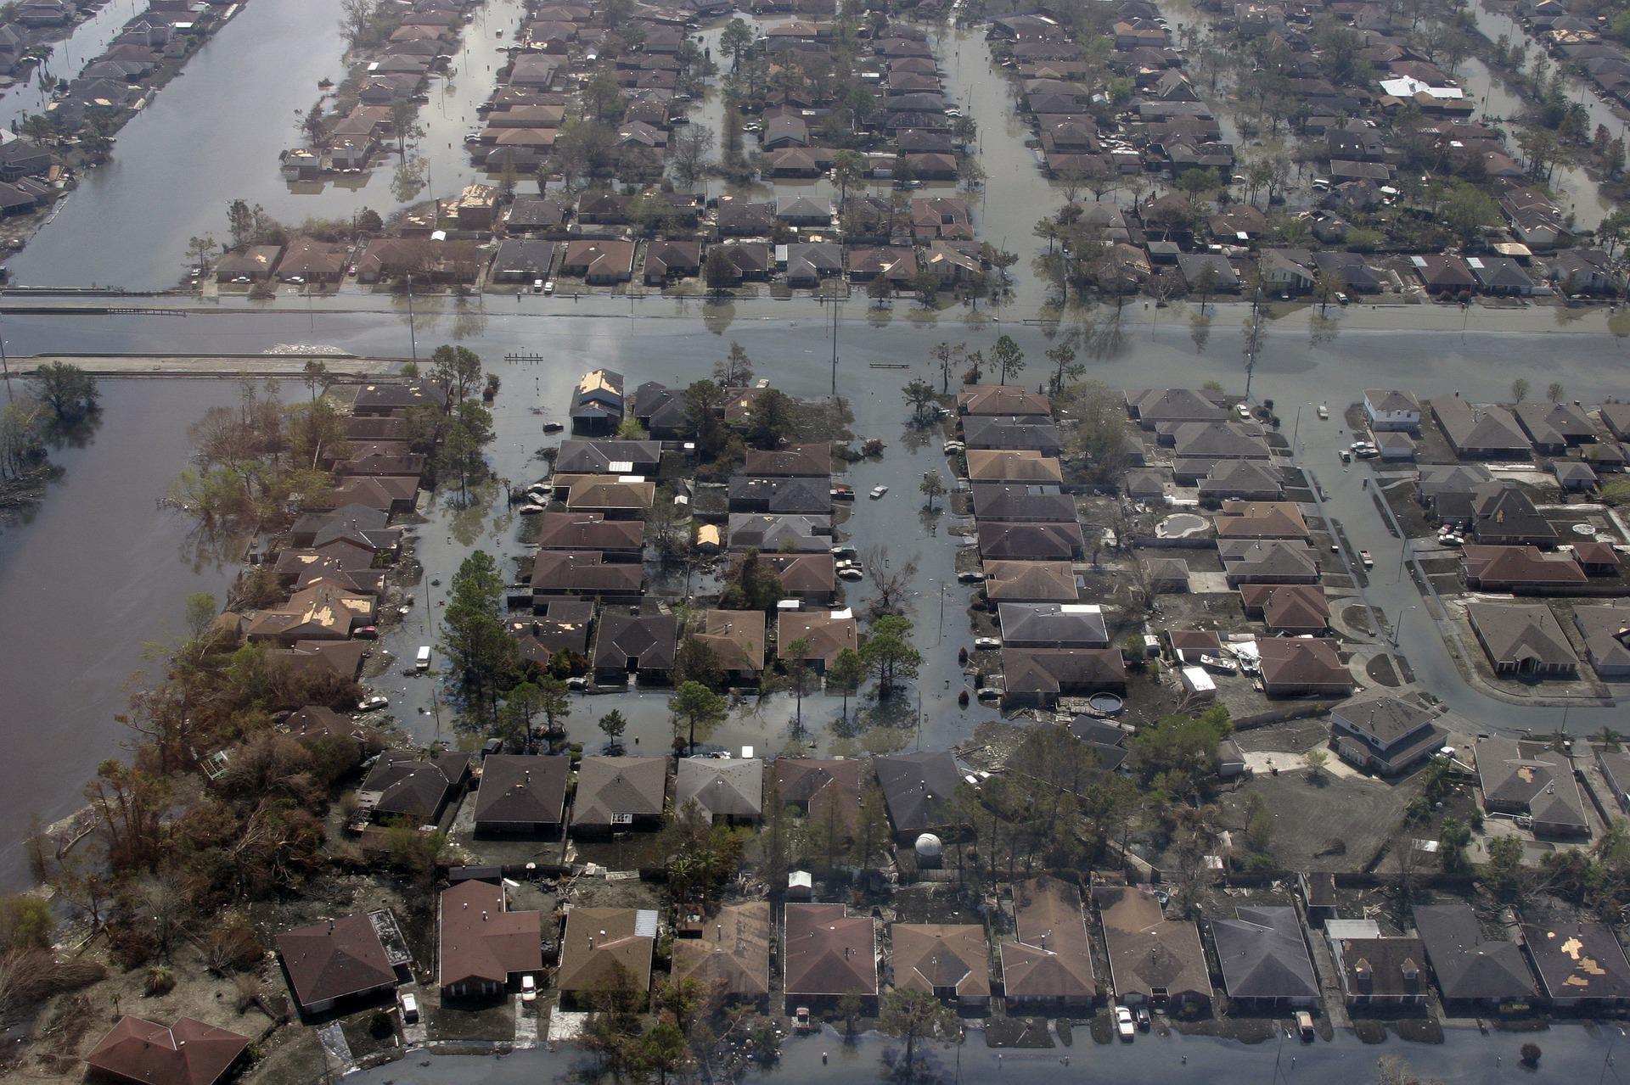
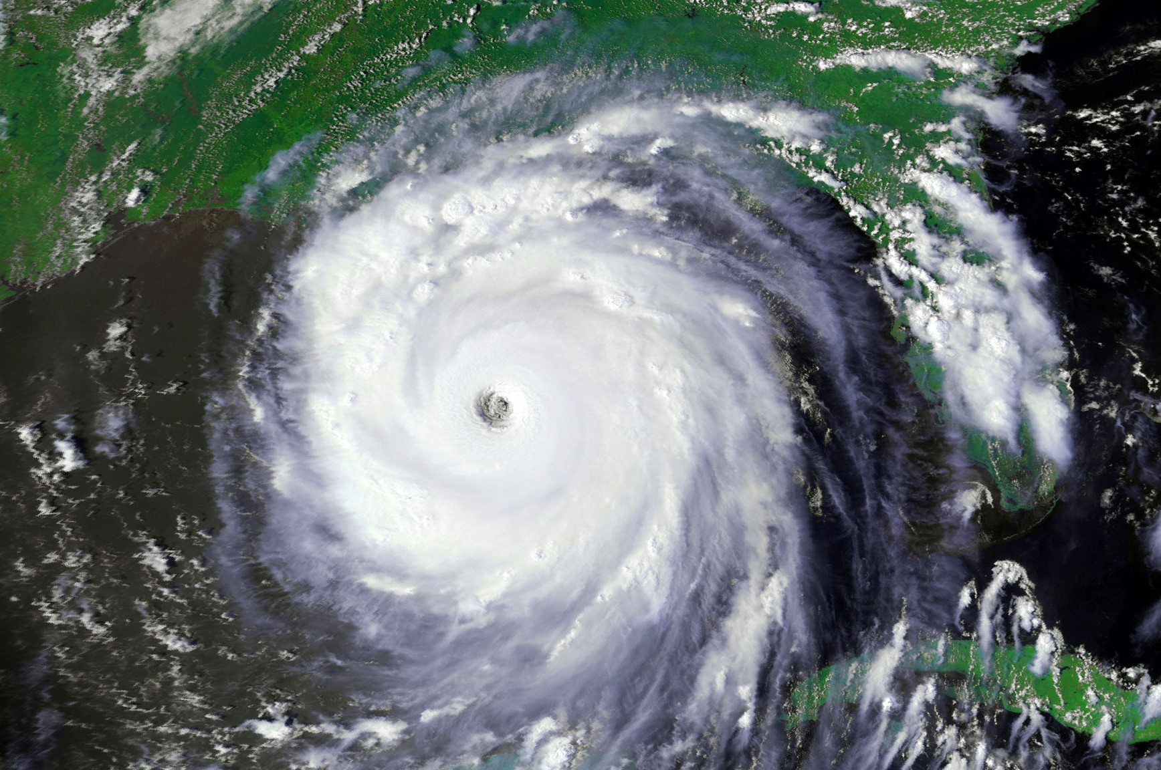
Time as process
Continuity patterning in times of crisis
Routine activity
Major
disruption
(1) Taking actions through
provisional adjusting
(2) Connecting actions
into (new) paths into the future
(3) Paths form (new) patterns
Photo by Carol Colman on Pixabay
NOAA, CC-BY 2.0, via Flickr
Source: Feldman et al., 2022

Slide 10
Time as resource
Time horizons and the climate crisis
Quantitative & qualitative planning
Stakeholder engagement
Cross-sector collaboration
Past
Present
Future
Long-term horizon
Short-term horizon
5 years
30 years
Quantitative planning
One-way stakeholder engagement
Limited collaboration
Sources: Slawinski & Bansal, 2015; Bansal et al., 2018; Schultz & Hernes, 2013; Hernes & Schultz, 2020

Slide 11


Discounting the future
Future value
Present value

Slide 12
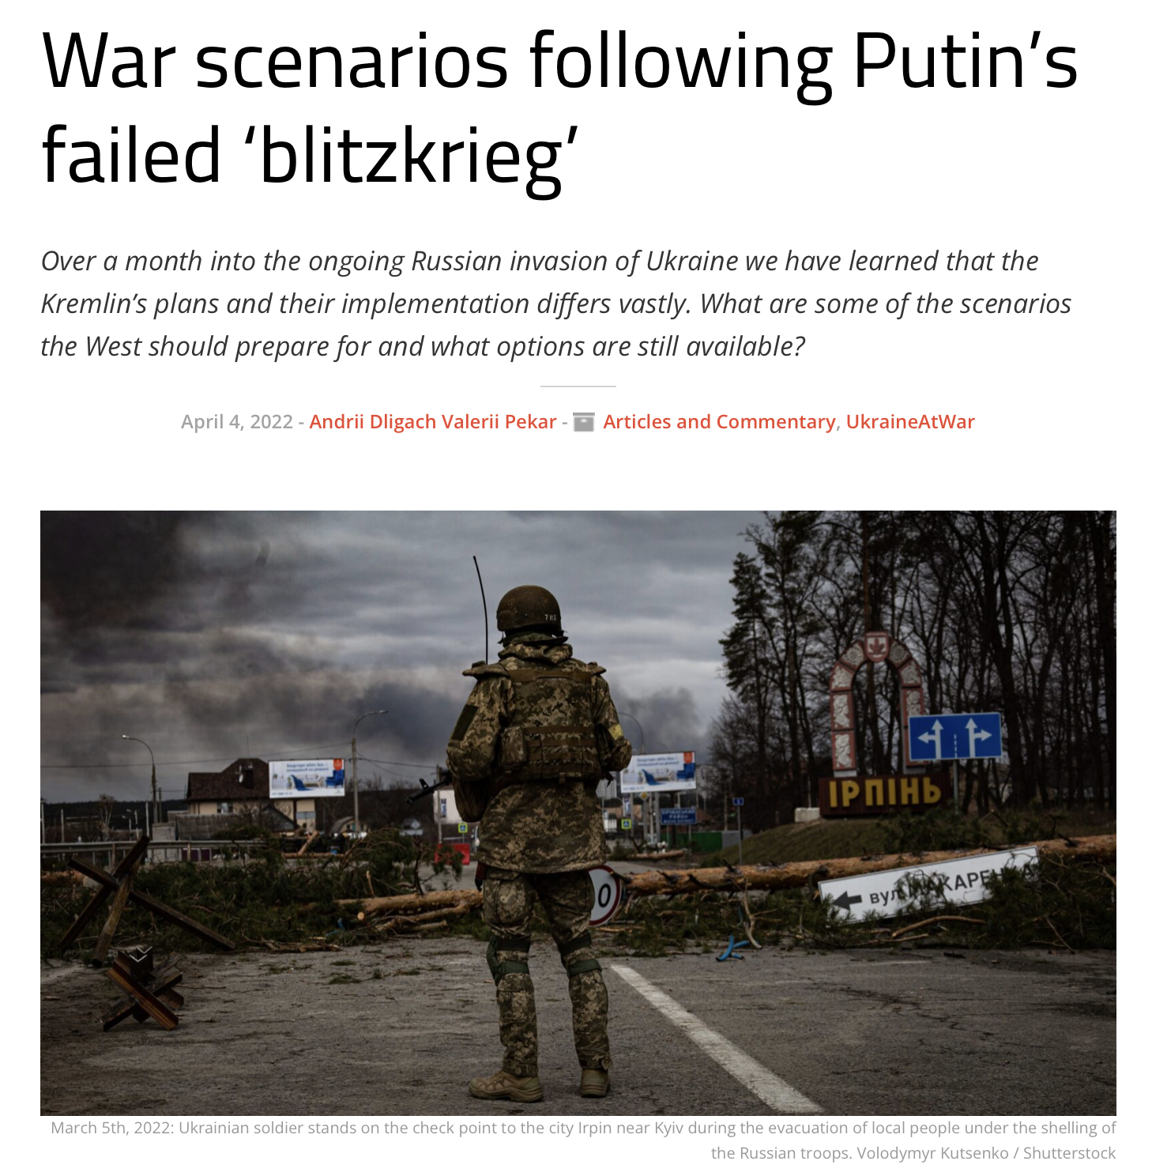
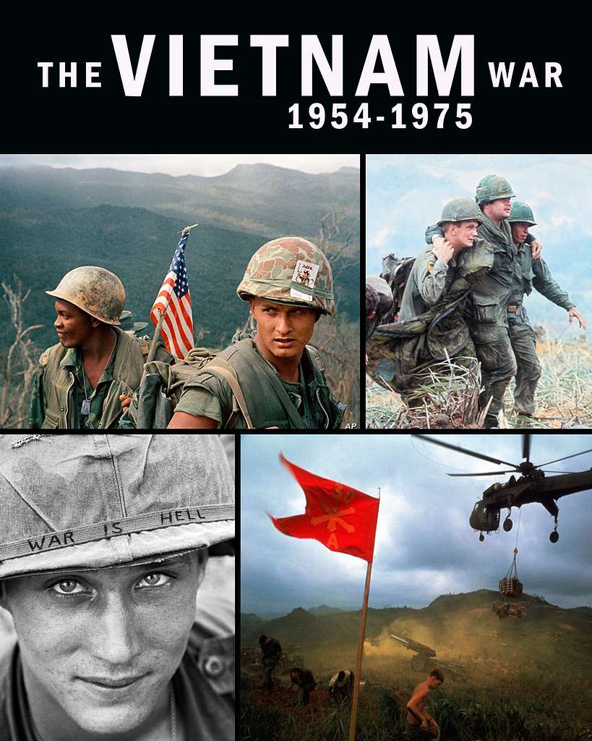
Time-as-resource in warfare
Wars as timing contests
Western “wartime paradigm”
=
Optimization for speed and short-term win
+
War as anticipatory risk management
Defense Visual Information Distribution Service, Public Domain
Sources: Hom, 2018; Schmitt, 2020
Source: https://neweasterneurope.eu/2022/04/04/war-scenarios-following-putins-failed-blitzkrieg/

Slide 13
Takeaways and outlook
Organizing in times of crisis depends on the skillful performance of temporal work
Temporal work can target:
  Time-as-structure to (re-)create a temporal order amidst temporal uncertainty
  Time-as-process to enact a sense of continuity amidst disruption
  Time-as-resource to leverage multiple time-horizons and regimes of timing and pacing
Wars and armed conflicts represent a specific type of crisis: “timing contests”
Faster is not always better
Assignment:
How could we explain the failure of Putin’s ”blitzkrieg” in Ukraine from the perspective of war as a “timing contest”? In your response, think especially about what you have learned about temporal uncoupling, continuity patterning, and time horizons and how these could help you understand how Ukraine managed to “slow down” the pace of the war. Support your argument with specific examples.

Slide 14
References
Antentas, J. M. 2020. Notes on corona crisis and temporality. Dialectical Anthropology, 44(3): 315–318.
Bansal, P., Kim, A., & Wood, M. O. 2018. Hidden in Plain Sight: The Importance of Scale in Organizations’ Attention to Issues. Academy of Management Review, 43(2): 217–241.
Bansal, P. (Tima), Reinecke, J., Suddaby, R., & Langley, A. 2022. Temporal Work: The Strategic Organization of Time. Strategic Organization, 20(1): 6–19.
Blagoev, B., Hernes, T., Kunisch, S., & Schultz, M. 2022. Time as a research lens in management and organization studies: A review and research agenda. Working paper.
Feldman, M. S., Worline, M., Baker, N., & Lowerson Bredow, V. 2022. Continuity as patterning: A process perspective on continuity. Strategic Organization, 20(1): 80–109.
Geiger, D., Danner-Schröder, A., & Kremser, W. 2021. Getting Ahead of Time—Performing Temporal Boundaries to Coordinate Routines under Temporal Uncertainty. Administrative Science Quarterly, 66(1): 220–264.
Hernes, T., & Schultz, M. 2020. Translating the Distant into the Present: How actors address distant past and future events through situated activity. Organization Theory, 1(1): 1–20.
Hom, A. R. 2018. Timing is Everything: Toward a Better Understanding of Time and International Politics. International Studies Quarterly, 62(1): 69–79.
Kunisch, S., Blagoev, B., & Bartunek, J. M. 2021. Complex times, complex time: The pandemic, time-based theorizing and temporal research in management and organization studies. Journal of Management Studies, 58(5): 1411–1415.
Schmitt, O. 2020. Wartime paradigms and the future of western military power. International Affairs, 96(2): 401–418.
Schultz, M., & Hernes, T. 2013. A Temporal Perspective on Organizational Identity. Organization Science, 24(1): 1–21.
Slawinski, N., & Bansal, P. 2015. Short on Time: Intertemporal Tensions in Business Sustainability. Organization Science, 26(2): 531–549.

