Slide 1
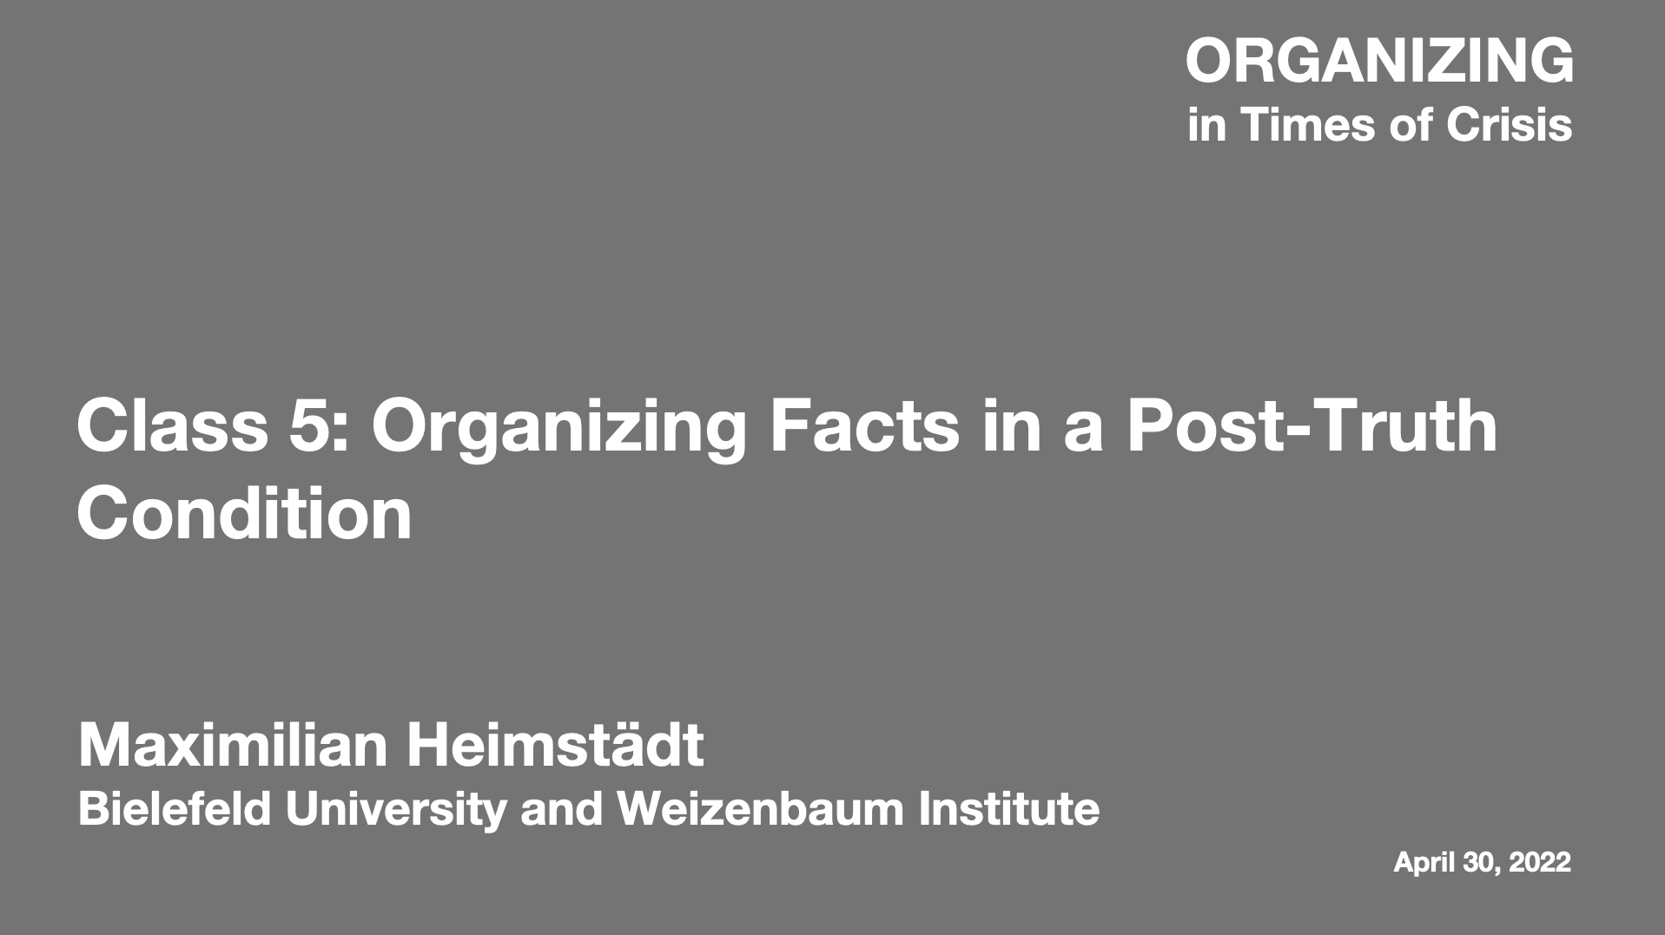

Slide 2

Dr. Maximilian Heimstädt
Bielefeld University
Weizenbaum Institute for the Networked Society

Slide 3
Challenges in Times of Crisis
Forms of Organizing

Slide 4
Challenge of Epistemic Uncertainty

Slide 5
What are forms of organizing that can reduce epistemic uncertainty in times of armed conflict and war?

Slide 6
Epistemic Uncertainty in the Covid-19 Pandemic
Journalists
Science Media Center
Scientists

Slide 7

Epistemic Uncertainty in Times of War
Centralized journalism
Case:
Bellingcat
Distributed events

Slide 8
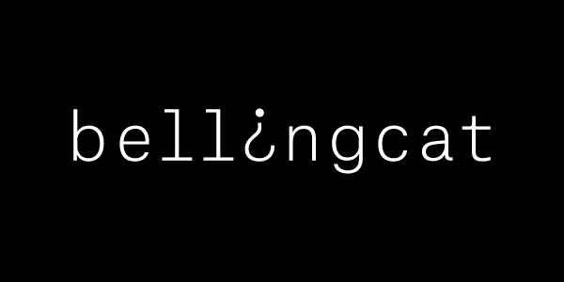
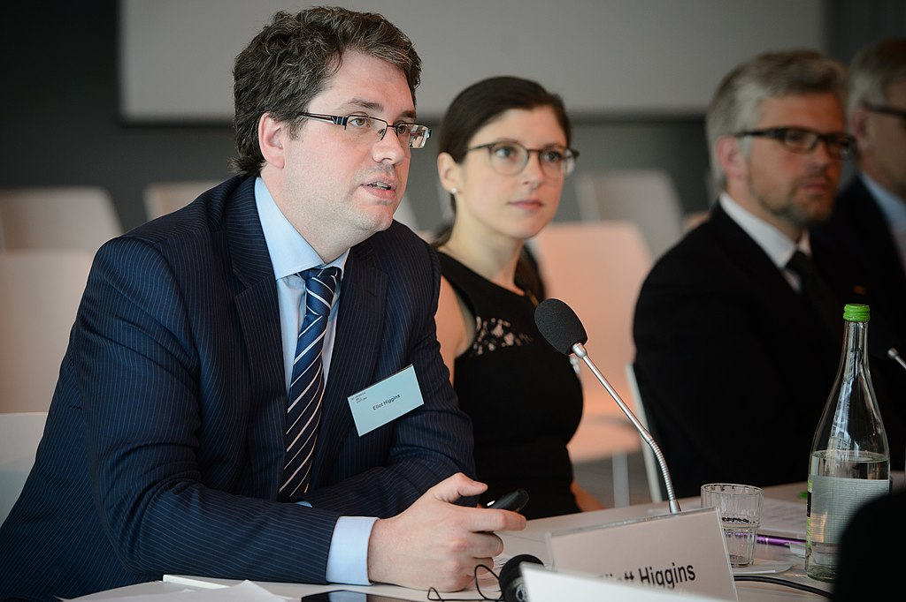
Source (left): https://www.bellingcat.com/
Source (right): Wikipedia, CC-BY-SA 2.0, Stephan Röhl

Slide 9
The “Bellingcat Method”
Reliance on openly available digital information (OSINT)
Focus on photos and videos
Tracing information across digital platforms
Geolocating photos through triangulation with satellite images
Combination of open crowdsourcing and (more) closed verification

Slide 10
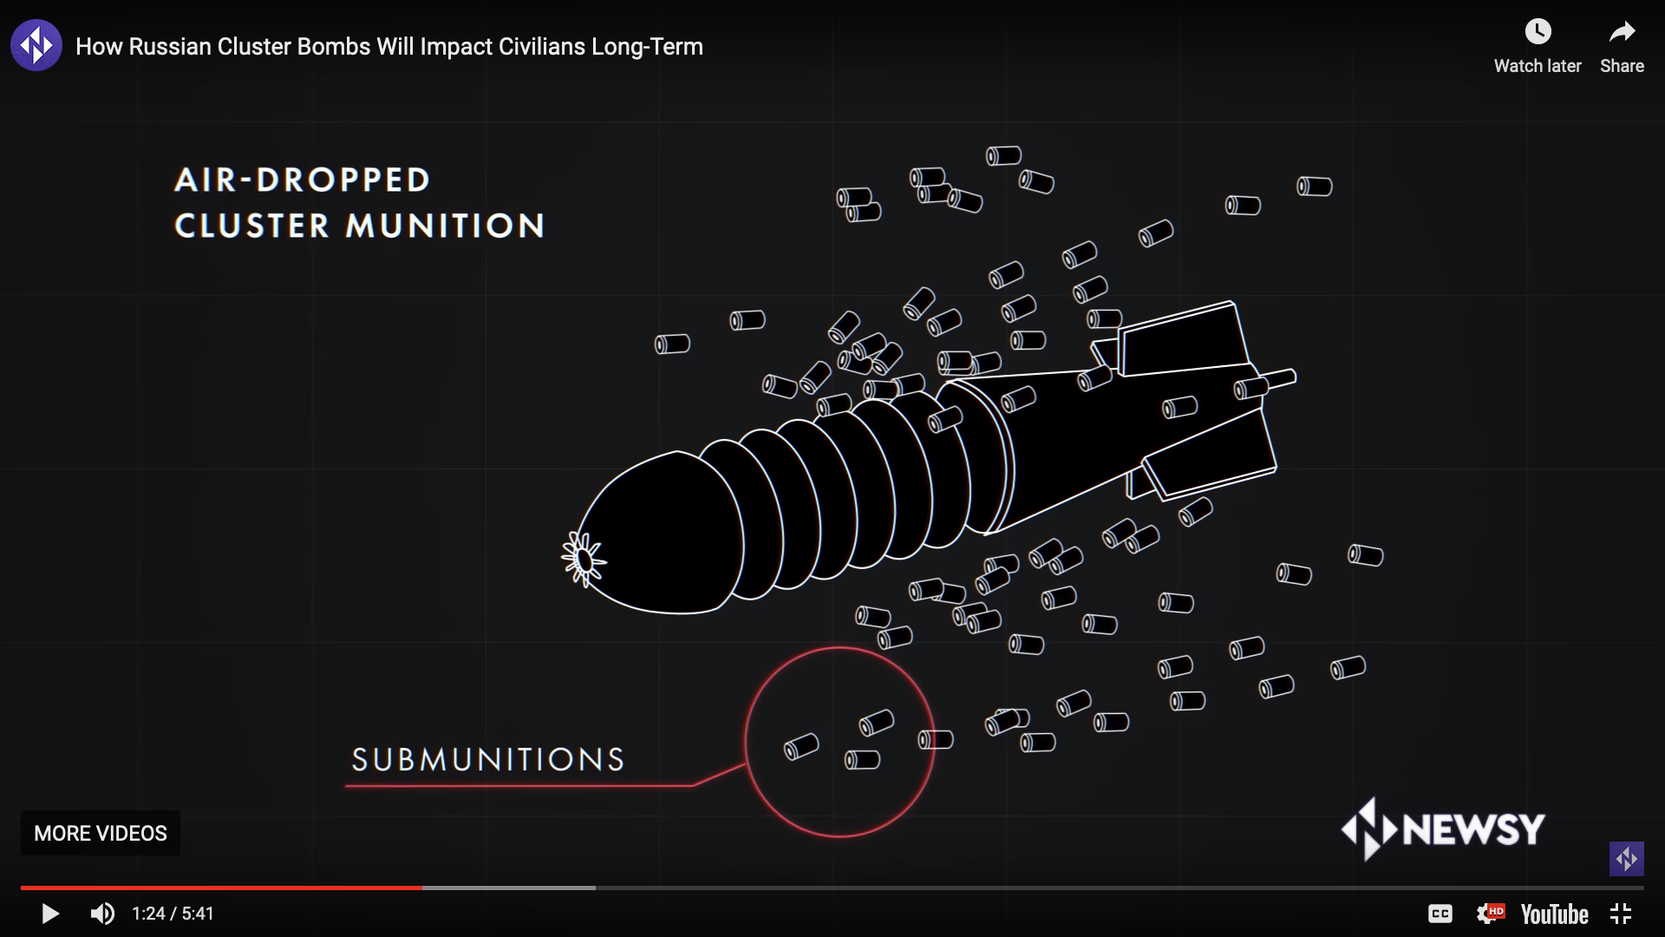
Tracking Cluster Munitions in Civilian Areas
Source: https://youtu.be/CtgTM5kmPsY

Slide 11
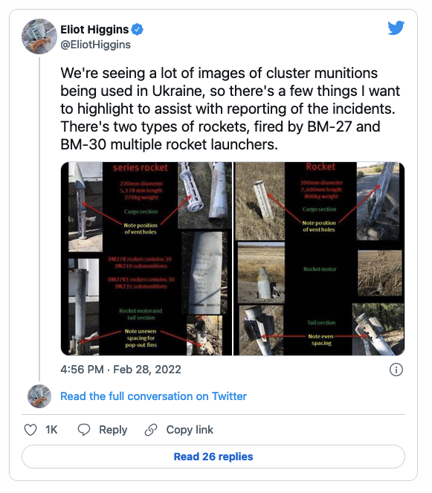
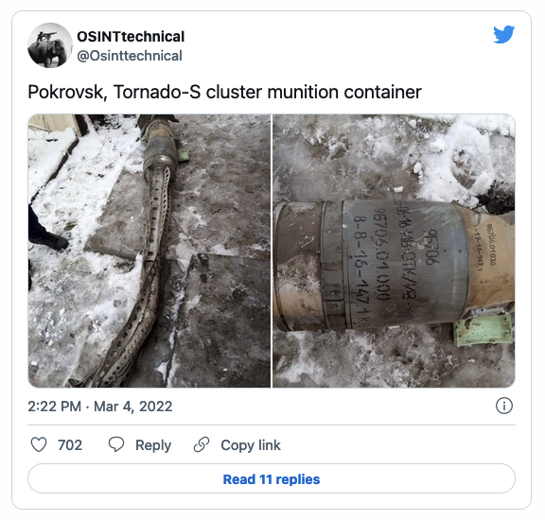

Slide 12
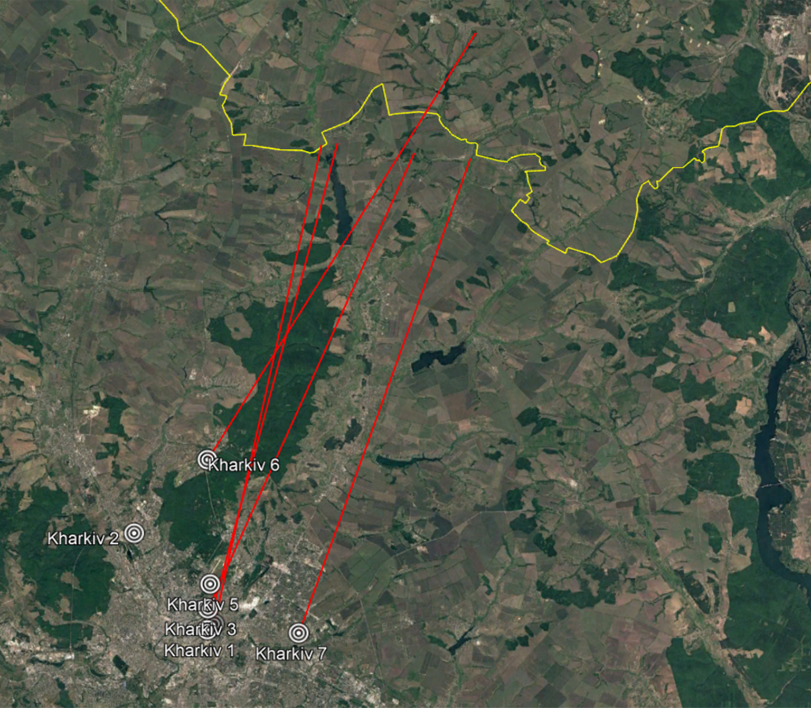
Source: https://www.bellingcat.com/news/2022/02/27/ukraine-conflict-tracking-use-of-cluster-munitions-in-civilian-areas/

Slide 13
New Form of Organizing Facts
Centralized journalism
Case:
Bellingcat
Distributed events
Most journalism startups fail within a few years
Successful methods or individuals move into traditional media firms
How did Bellingcat survive, grow, and stabilize as an organization?

Slide 14
Liability of Newness
Risk of failure for an organization is highest at the start
Strategies to overcome liability of newness:
  Building a network with other entrepreneurs
  Selecting the right location and ecosystem
  Hiring industry experts as consultants
  Building social acceptance with important stakeholders
Social acceptance of journalistic organizations is built on trust
Journalists protect sources, readers need to trust journalists
Breakdowns of trust need to be repaired (e.g., Claas Relotius)

Slide 15
Radical Transparency
Bellingcat adopted a strategy of radical transparency
  Collection of information in the open (e.g., Twitter)
  Discussion of ongoing investigations in forums (e.g., Reddit)
  Publication of detailed manuals for Bellingcat method
  Training other journalists in the Bellingcat method
Managed to overcome liabilities of newness by turning greatest weakness (lack of sources on the ground) into strength
Shifted the playing field: Instead of competing on the grounds of trust, they introduced transparency as a new quality dimension

Slide 16
Contact
E-mail: maximilian.heimstaedt@uni-bielefeld.de
Twitter: @heimstaedt
Web: heimstaedt.org

Slide 17
References
New Forms of Organizing Facts
Buschow, C. (2020). Why do digital native news media fail? An investigation of failure in the early start-up phase. Media and communication, 8(2), 51-61.
Buschow, C., Suhr, M., & Serger, H. (2022). Media work as field advancement: The case of Science Media Center Germany. Media and Communication, 10(1), 11-99.
Liability of Newness
Aldrich, H., Fiol, C. (1994). Fools rush in? The institutional context of industry creation. Academy of Management Review 19, 645-670.
Stinchcombe, A. (1965). Social structure and organizations. In: March, J.G. (Ed.), Handbook of Organizations. Rand McNally, Chicago, pp. 142-193.
Zimmerman, M.A., Zeitz, G.J. (2002). Beyond survival: achieving new venture growth by building legitimacy. Academy of Management Review 27, 414-431.
Transparency and Openness
Gegenhuber, T., & Dobusch, L. (2017). Making an impression through openness: how open strategy-making practices change in the evolution of new ventures. Long Range Planning, 50(3), 337-354.
Heimstädt, M. (2017). Openwashing: A decoupling perspective on organizational transparency. Technological forecasting and social change, 125, 77-86.
Heimstädt, M., & Dobusch, L. (2020). Transparency and accountability: Causal, critical and constructive perspectives. Organization Theory, 1(4), 2631787720964216.

