Slide 1
ORGANIZING
in Times of Crisis
Class 14: Organizations, Institutions & War
Ali Aslan Gümüsay
University of Hamburg and
Humboldt Institute for Internet & Society
April 2022

Slide 2
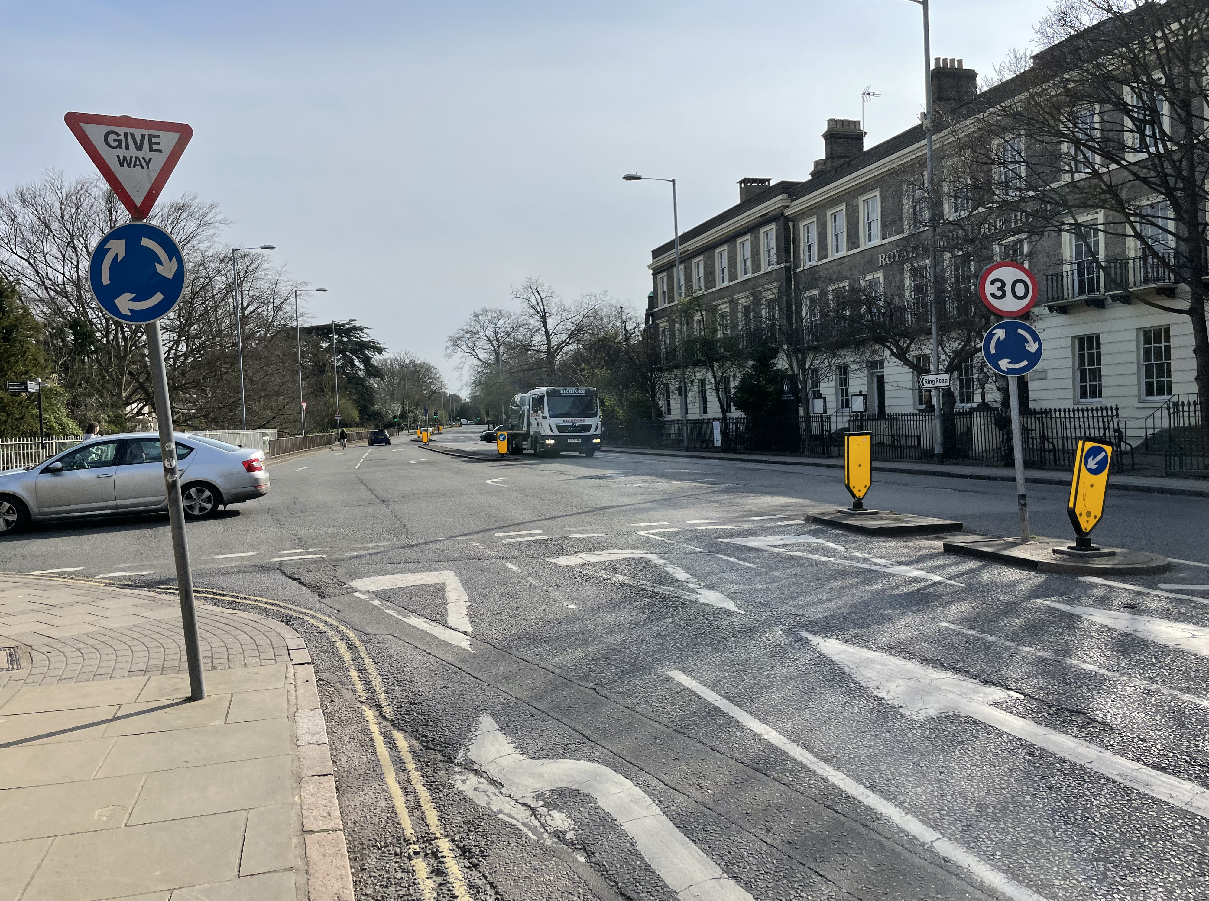

Slide 3
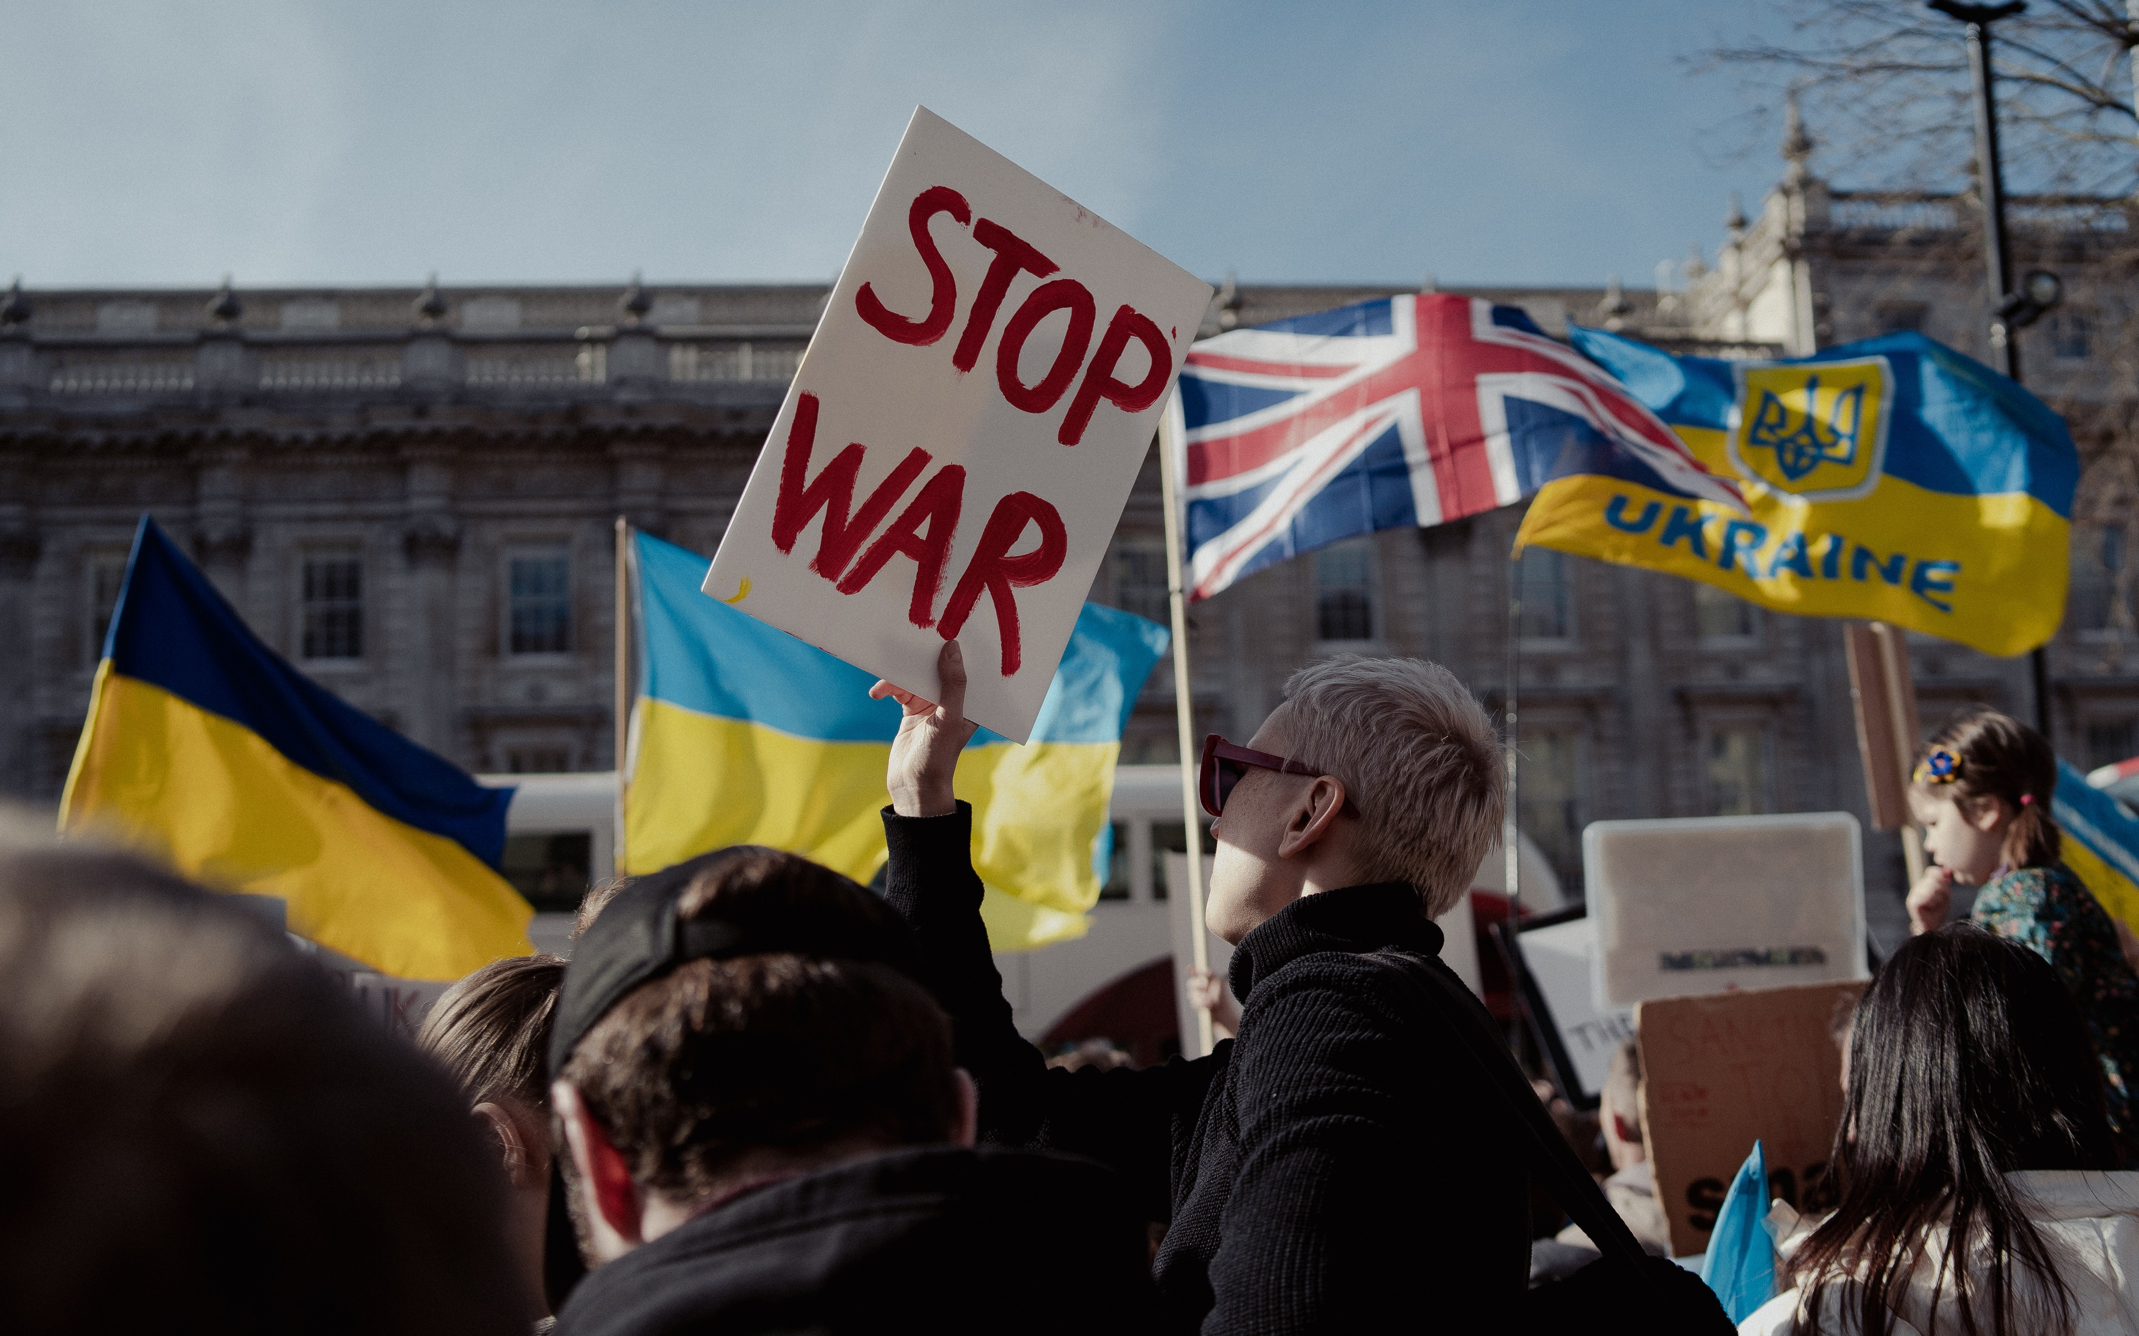
https://unsplash.com/photos/Fdd5C-hR3H0?utm_source=unsplash&utm_medium=referral&utm_content=creditShareLink

Slide 4
Institutional work
“the purposive action of individuals and organizations aimed at creating, maintaining and disrupting institutions.”
(Lawrence & Suddaby, 2006)

Slide 5
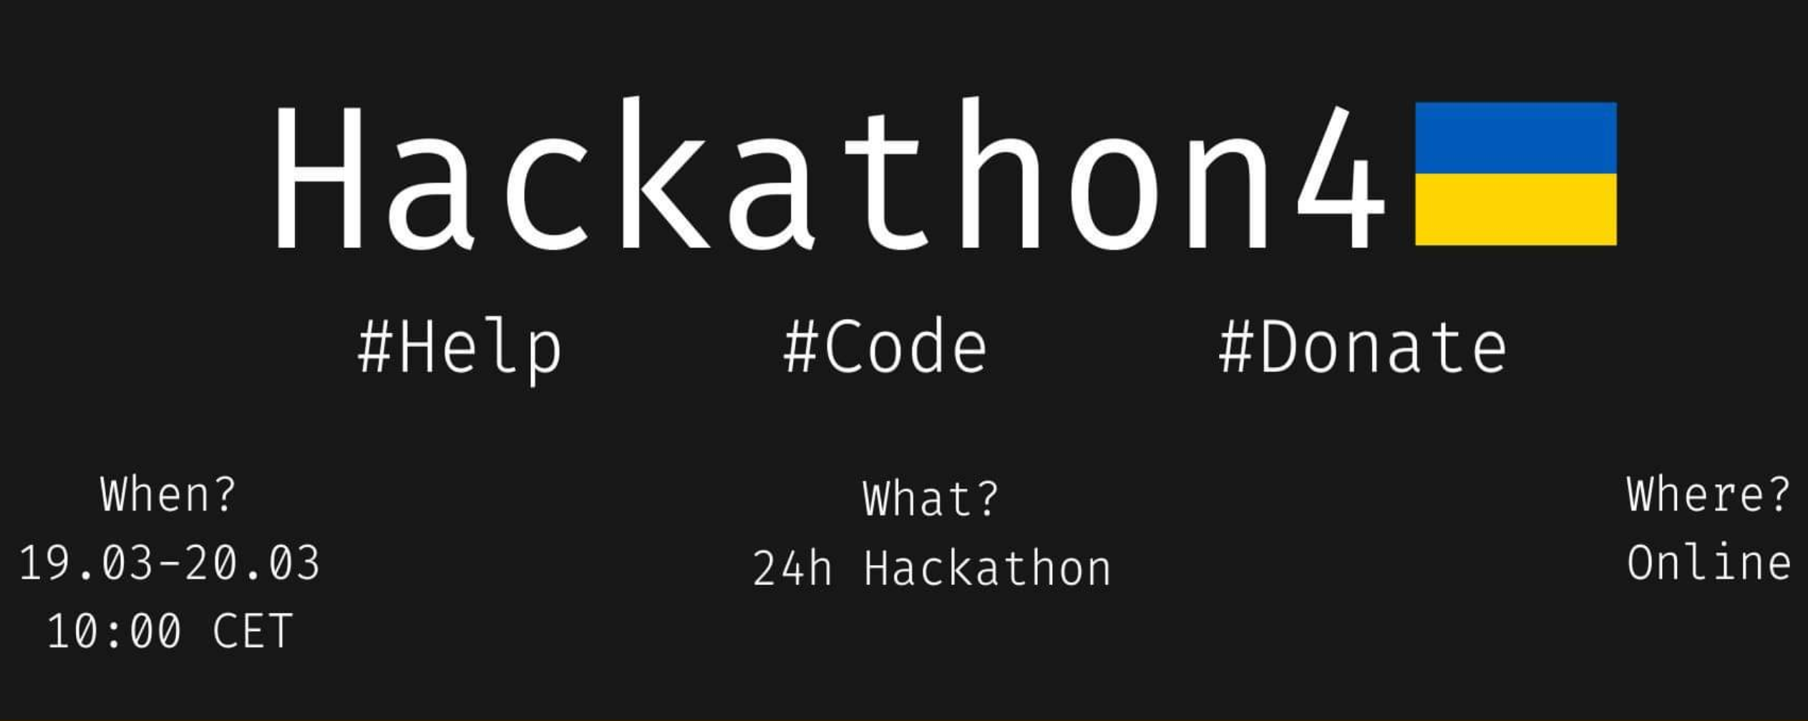
https://m.facebook.com/events/1132043360669520

Slide 6
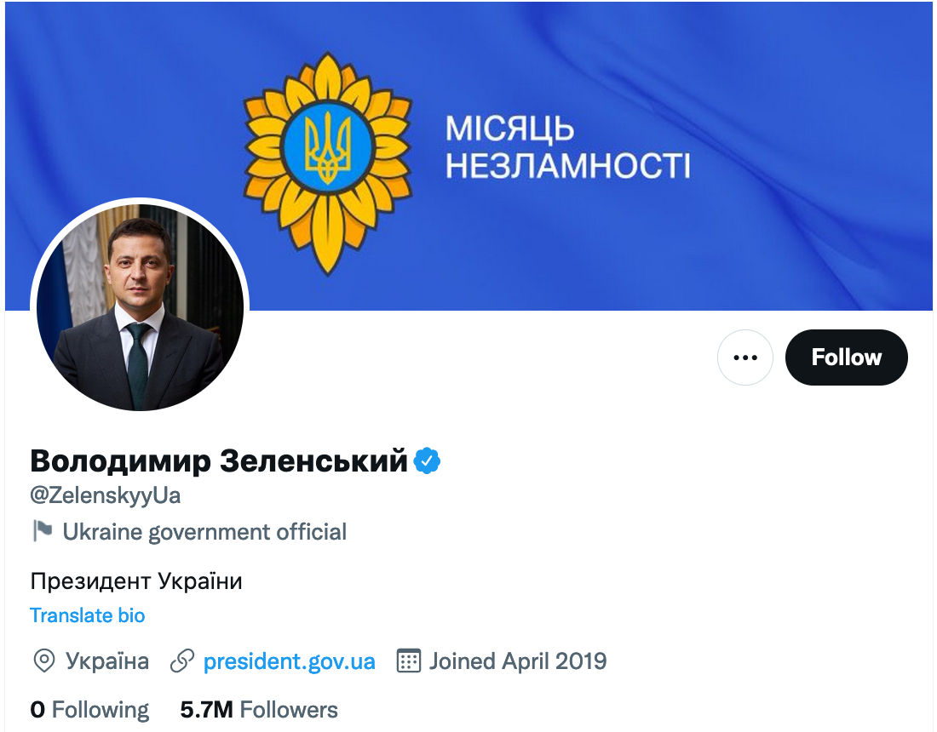
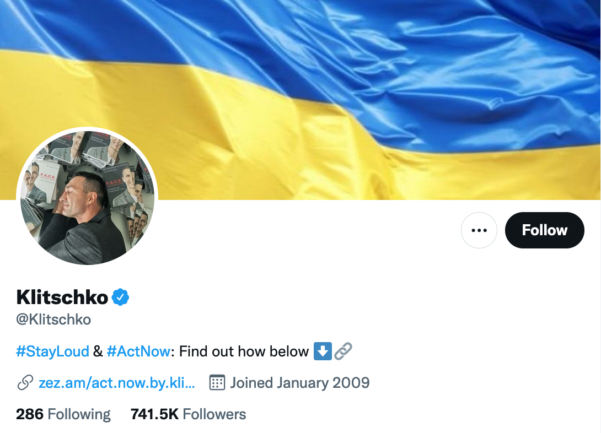

Slide 7



Slide 8
Literature & Assignment
Core reading
Hampel, C. E., Lawrence, T. B., & Tracey, P. 2017. Institutional Work: Taking Stock and Making It Matter. In R. Greenwood, C. Oliver, T. B. Lawrence, & R. Meyer (Eds.), The Sage Handbook of Organizational Institutionalism (2nd ed.): 558–590. London: Sage. Link.
Contemporary news article
Cieslak, M., & Gerken, T. 2022, March 19. Ukraine: How crowdsourcing is rescuing people from the war zone. BBC News. https://www.bbc.com/news/technology-60785339.
Background readings
Gkeredakis, M., Lifshitz-Assaf, H., & Barrett, M. 2021. Crisis as opportunity, disruption and exposure: Exploring emergent responses to crisis through digital technology. Information and Organization, 31(1). Link.
Gümüsay, A. A., Marti, E., Trittin-Ulbrich, H., & Wickert, C. 2022. How organizing matters for societal grand challenges. In A. A. Gümüsay, E. Marti, H. Trittin-Ulbrich, & C. Wickert (Eds.), Organizing for Societal Grand Challenges, vol. Research in the Sociology of Organizations: 1–14. Emerald. Link.
Gümüsay, A. A., Raynard, M., Albu, A., Etter, M., & Roulet, T. 2022. Digital technology and voice: How platforms shape institutional processes through visibilization. In T. Gegenhuber, D. M. Logue, B. Hinings, & M. Barrett (Eds.), Research in the Sociology of Organizations. Emerald. Link.
Scheidgen, K., Gümüsay, A. A., Günzel-Jensen, F., Krlev, G., & Wolf, M. 2021. Crises and entrepreneurial opportunities: Digital social innovation in response to physical distancing. Journal of Business Venturing Insights, 15: e00222. Link.
Post-lecture assignment
Identify an organization in any current conflict or war situation and describe how this organization does ‘institutional work’ (300-400 words).

Slide 9
ORGANIZING
in Times of Crisis
Thank you.
Ali Aslan Gümüsay
University of Hamburg and
Humboldt Institute for Internet & Society

