Slide 1
ORGANIZING
in Times of Crisis
Class 8: Corporate Social Responsibility and Stakeholder Relations
Nora Lohmeyer
Radboud University
March 31, 2022

Slide 2
Learning objectives
CSR and Stakeholder relations
Being able to reflect on corporate responsibilities in war as well as how stakeholder relationships are affected and potentially reconfigured in times of crisis.
How to get there?
  Getting a basic understanding of corporate social responsibility (CSR)
  Understanding the notion of stakeholder relations, including in relation to the shareholder approach to the firm

Slide 3





CSR as a response to Ongoing problems and crises
CSR and Stakeholder relations: (1) understanding CSR
How can companies take responsibility for their social, environmental, and economic impacts?
Avoiding harm
Contributing positively to society
Photos by Beth Jnr, Nuno Alberto, Magdalena Kula Manchee, Michal Matlon, Matt Palmer, Zeyn Afuang on Unsplash
Notes:
How can companies take responsibility for their social, environmental, and economic impacts?
Avoiding harm
Contributing positively to society

Slide 4



Defining CSR
CSR and Stakeholder relations: (1) understanding CSR
CSR = “situations where the firm goes beyond compliance and engages in ‘actions that appear to further some social good, beyond the interests of the firm and that which is required by law’.” (McWilliams et al., 2006, p. 1)

Slide 5
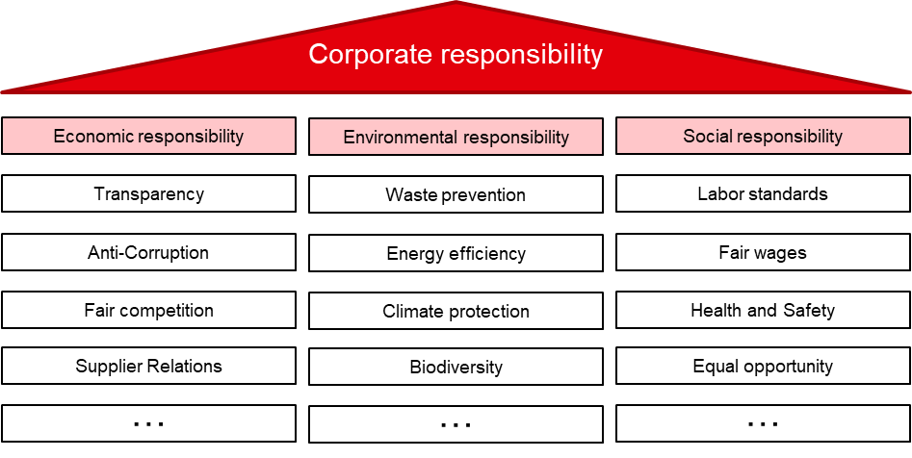
CSR and Stakeholder relations: (1) understanding CSR
Responsible business practices
Organizations are more or less responsible with regard to different areas
They can be responsible in some areas and irresponsible in others and levels of (ir)responsibility might change over time (e.g., Shao et al., 2021)
Notes:
… all of these topics could be aspects of what responsible organization means -> we need to select a few perspectives and cannot present all of them

Slide 6
CSR and Stakeholder relations: (1) understanding CSR
Why do organizations act more responsible?
CSR infrastructure
Intra-organizational
Inter-organizational, institutional
Ethical leaders and/or morally committed employees guided by moral motives
CSR oriented corporate strategy based on instrumental (‘business case for CSR’) or relational motives (‘social license to operate’)
Organizational structures, e.g., responsibility oriented KPIs and incentive systems, guidelines, routines
State/government institutions, e.g., Acts and laws, standards, directives and guidelines, government-led educational programs
Civil society/societal institutions, e.g., multi-stakeholder initiatives, NGOs, watchdogs and activists, ratings and rankings
Market/business initiatives, e.g., codes of conducts, monitoring, and reporting systems, business CSR-associations, responsible investment
Institutionalized norms regarding appropriate corporate behavior
Waddock, 2008; Aguilera et al., 2007; Campbell, 2007

Slide 7
CSR and Stakeholder relations: (2) Stakeholder relations
Organizations as embedded in society
share-holders
suppliers
Stakeholder = “any group or individual who is affected by or can affect the achievement of an organization’s object.”
(Freeman, 1984, p. 5)
customers
Business
Society
NGOs
…
Govern-ment
Supply chain workers

Slide 8
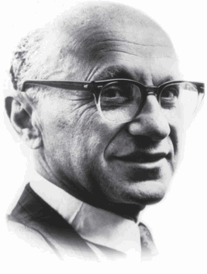
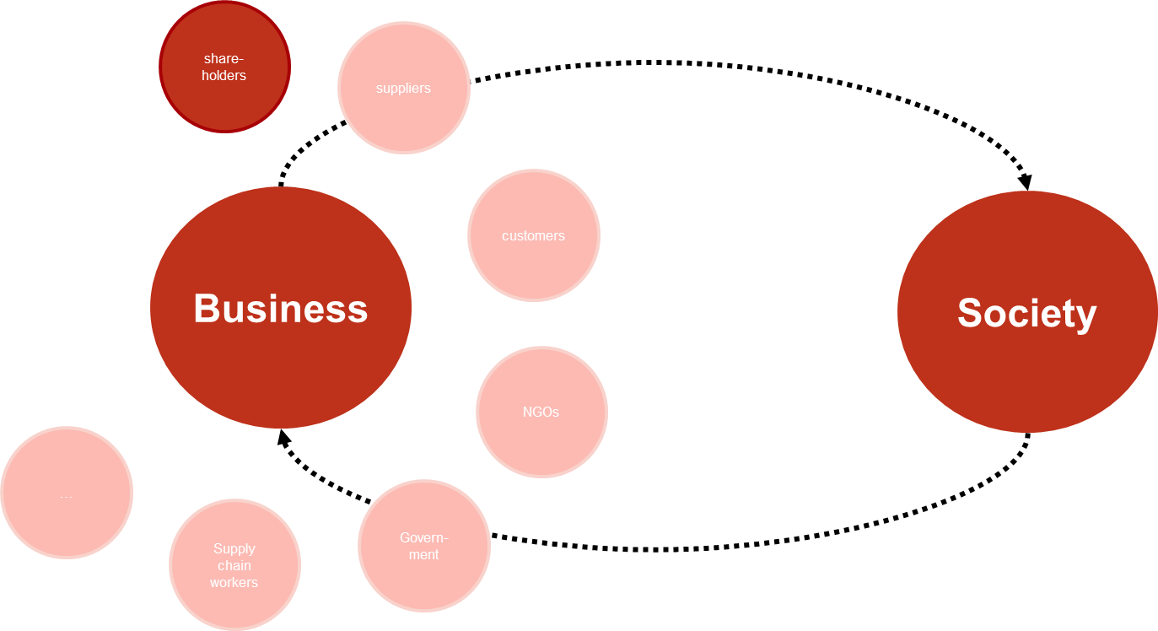
CSR and Stakeholder relations: (2) Stakeholder relations
Shareholder view of the firm
“
There is one and only one social responsibility of business – to use its resources and engage in activities designed to increase its profits so long as it stays within the rules of the game. (Friedman, 1970)
The Friedman doctrine:
firms being solely responsible towards their shareholders (within the limits of the law), i.e., maximizing shareholder value as a form of “corporate social responsibility”
Business as economic actors, with business and society/politics seen as separate
Friedman, 1970

Slide 9
CSR and Stakeholder relations: (2) Stakeholder relations
Critique of the Shareholder view
Promotion of short-term thinking and action and orientation towards purely economic and measurable success criteria
Isolated view on the firm, e.g., ignoring negative externalities and complexities of firms’ effects
Naïve understanding of regulatory processes and firms’ compliance to law
Lack of involvement of various stakeholder groups in company decisions

Slide 10
CSR and Stakeholder relations: (2) Stakeholder relations
The stakeholder View
share-holders
suppliers
Business
customers
Society
NGOs
…
The stakeholder perspective “emphasizes active management of the business environment, relationships and promotion of shared interests” (Freeman & McVea 2001, p. 192)
Govern-ment
Supply chain workers

Slide 11
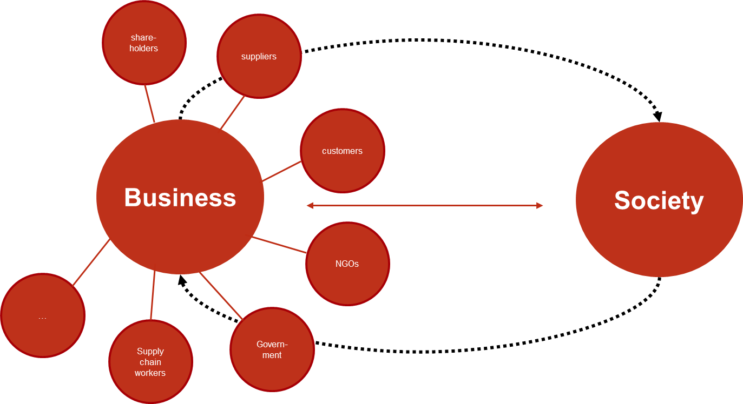
CSR and Stakeholder relations: (2) Stakeholder relations
stakeholder view: How different from the shareholder view?
Important to acknowledge the firm‘s embeddedness in society as well as the mutual dependencies of firms and society
However…
… solves conflicting stakeholder demands by integrating them in instrumental logic of the business case
… ultimately remains in the realm of shareholder prioritization because powerful stakeholders close to the organization are often preferred
Barnett, 2019

Slide 12

CSR and stakeholder relations – a critique
CSR and Stakeholder relations
Aggravation of systemic problems despite increase in CSR efforts
CSR as ineffective to solve macro-systemic problems (e.g., Banerjee, 2008; Crane et al., 2014)
CSR as a legitimation for deregulation and dismantling of institutionalized forms of responsibility (e.g., Marens, 2012; Kinderman, 2012; Kaplan, 2015; Kaplan & Lohmeyer, 2021)
CSR as an expansion of the market and business power (e.g., Fleming & Jones, 2013; Schneider, 2021)
CSR as ‘ethical seal’ and appropriation of capitalist critique (e.g., Costas & Kärreman, 2013; Barnett, 2019)
Photo by Evan Dennis on Unsplash

Slide 13
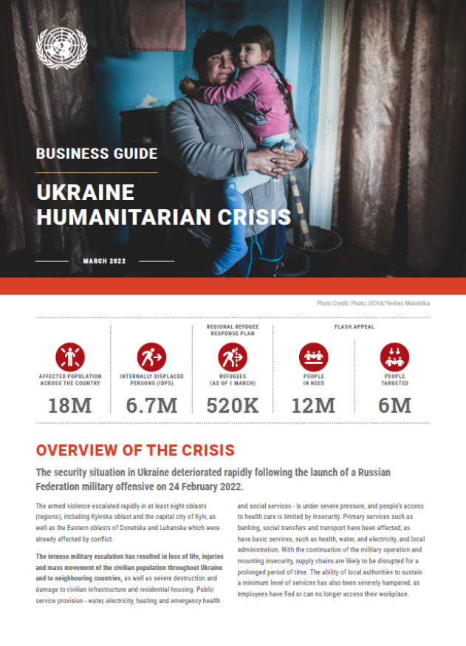
CSR and stakeholder relations in times of war
CSR and Stakeholder relations
Digging in: continuing business-as-usual in Russia, 215 companies
Buying time: postponing future planned investment/development/ marketing while continuing substantive business, 143 companies
Scaling back: scaling back some significant business operations but continuing some others, 121 companies
Suspension: temporarily curtailing most or nearly all operations while keeping return options open, 411 Companies
Withdrawal: totally halting Russian engagements or completely exiting Russia, 319 Companies
Source: https://som.yale.edu/story/2022/over-750-companies-have-curtailed-operations-russia-some-remain, last retrieved: May 2, 2022
Picture: UN Global Compact Business Guide, 2022

Slide 14
References
CSR and Stakeholder relations
Aguilera, R. V., Rupp, D. E., Williams, C. A., & Ganapathi, J. (2007). Putting the S back in corporate social responsibility: A multilevel theory of social change in organizations. Academy of Management Review, 32(3), 836-863.
Banerjee, S. B. (2008). Corporate social responsibility: The good, the bad and the ugly. Critical Sociology, 34(1), 51-79.
Barnett, M. L. (2019). The business case for corporate social responsibility: A critique and an indirect path forward. Business & Society, 58(1), 167-190.
Campbell, J. L. (2007). Why would corporations behave in socially responsible ways? An institutional theory of corporate social responsibility. Academy of Management Review, 32(3), 946-967.
Costas, J., & Kärreman, D. (2013). Conscience as control–managing employees through CSR. Organization, 20(3), 394-415.
Crane, A., Palazzo, G., Spence, L. J., & Matten, D. (2014). Contesting the value of “creating shared value”. California Management Review, 56(2), 130-153.
Fleming, P. & Jones, M. T. (2012). The end of corporate social responsibility: Crisis and critique. London: Sage.
Freeman, R. E. (1984). Strategic Management: A Stakeholder Approach. Boston: Pittman.
Freeman, R. E., & McVea, J. (2001) A stakeholder approach to strategic management. In M. A. Hitt, R. E. Freeman, & J. S. Harrison (Eds.), The Blackwell handbook of strategic management (pp. 189-207). Oxford: Blackwell.
Friedman, M. (1970). A Friedman doctrine: The social responsibility of business is to increase its profits. The New York Times Magazine, 13(1970), 32-33.
Kaplan, R. (2015). Who has been regulating whom, business or society? The mid-20th-century institutionalization of ‘corporate responsibility’ in the USA. Socio-Economic Review, 13(1), 125-155.
Kaplan, R., & Lohmeyer, N. (2021). A comparative capitalism perspective on the privatization of governance: Business power, nonbusiness resistance and state enforcement in Germany, 2000–2010. Socio-Economic Review, 19(1), 247-272.
Kinderman, D. (2012). ‘Free us up so we can be responsible!’The co-evolution of Corporate Social Responsibility and neo-liberalism in the UK, 1977–2010. Socio-Economic Review, 10(1), 29-57.
Marens, R. 2012. Generous in victory? American managerial autonomy, labour relations and the invention of corporate social responsibility. Socio-Economic Review, 10(1): 59-84.
Schneider, A. (2020). Bound to fail? Exploring the systemic pathologies of CSR and their implications for CSR research. Business & Society, 59(7), 1303-1338.
Shao, F., Murrell, A. J., Zhao, X., Zhang, K., & Hart, T. A. (2021). Understanding the dynamic relationships between CSR and CSIR. Journal of Strategy and Management, 14(4), 545-561.

Slide 15
Contact
Dr. Nora Lohmeyer
Assistant Professor of Organizational Design and Development
Institute for Management Research
Radboud University Nijmegen, NL
Email: nora.lohmeyer@ru.nl

