Slide 1
ORGANIZING
in Times of Crisis
Class 9: Political CSR and Business of Peace
Hannah Trittin-Ulbrich
Leuphana University Lüneburg
April 2022

Slide 2
ORGANIZING
in Times of Crisis
Hannah Trittin-Ulbrich
Leuphana University Lüneburg
April 2022

Slide 3

Photo by Danist Soh on Unsplash
Photo by Danist Soh on Unsplash

Slide 4
The impact of Globalization: Changing the relationship between politics and businesses (1/2)
Companies need to follow the jurisdiction of their nation states.
In a world without foreign trade and foreign direct investments (FDIs): Division of labor between national politics and private business
States can force companies to follow legislative rules and regulations.
Companies can follow their interests within the boundaries of state regulation.
(see also Scherer, 2013)
April 2022

Slide 5
The impact of Globalization: Changing the relationship between politics and businesses (2/2)
No state monopoly of power: A pluralism of systems of jurisdiction and communities of value.
In today’s globalized world: The division of labor between national politics and private business is eroding
Deficit in execution of state supervisory authorities.
Globally acting firms are not bound to one legal system: They can choose amongst many according to economic reasons.
(see also Scherer, 2013)
Globalization has led to a functional crisis of the nation state.
5
April 2022

Slide 6
How globalization leads to a legitimation crisis for business
6
Photo by José Martín Ramírez Carrasco on Unsplash
April 2022

Slide 7
From CSR to PCSR
Traditional CSR theories: Build on distinction between private & public sphere.
Traditional CSR theories: Assume that corporations only engage in political activities only for self-interest (e.g., lobbyism), view that corporations assume societal responsibilities only if they advance the long-term value of the firm.
Political CSR or Corporate Citizenship: The term „Corporate Citizenship“ refers to the political role of corporations and suggests that corporations compensate the gaps in national governance by voluntarily contributing to self-regulation and by producing public goods that are not delivered by governments (e.g., Matten & Crane, 2005; Scherer & Palazzo, 2011; Scherer, Palazzo, & Trittin, 2015)
April 2022

Slide 8
Global Governance
Photo by Jonathan Ansel Moy de Vitry on Unsplash
April 2022
8

Slide 9

April 2022
Notes:
https://www.youtube.com/watch?v=9APDajxL6wg

Slide 10
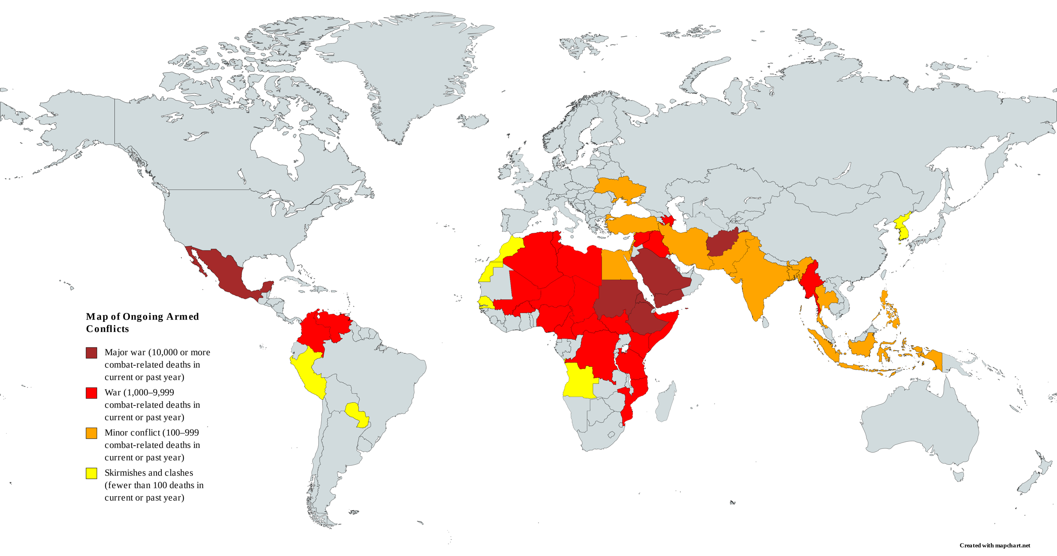
Source: From Wikimedia Commons, the free media repository

Slide 11
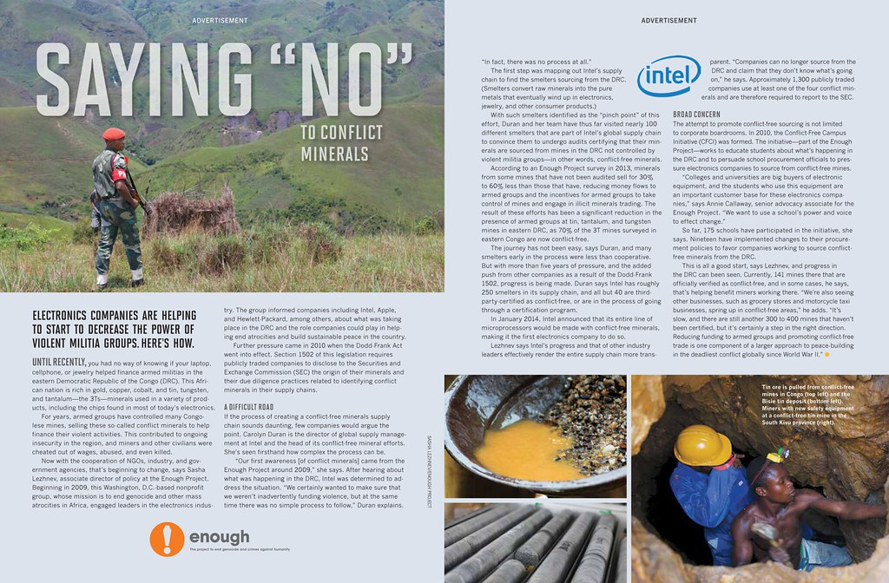
Source: https://www.flickr.com/photos/enoughproject/22096103224

Slide 12
Business of Peace
Photo by Sunguk Kim on Unsplash
April 2022

Slide 13
Business 4 Peace
https://www.unglobalcompact.org/engage-locally/manage/engagement/business-for-peace
April 2022

Slide 14
Thank you for your attention!
Contact:
hannah.Trittin@leuphana.de
Twitter: HaTrittin
Photo by Priscilla Du Preez on Unsplash
April 2022

Slide 15
References
Business for Peace (B4P) Initiative: https://www.unglobalcompact.org/engage-locally/manage/engagement/business-for-peace
Matten, D., & Crane, A. (2005). Corporate citizenship: Toward an extended theoretical conceptualization. Academy of Management review, 30(1), 166-179.
Melin, M. M. (2021). The building and breaking of peace. Corporate activities in civil war prevention and resolution. Oxford: Oxford University Press.
Melin, M. M. (2021). The business of peace: understanding corporate contributions to conflict management. International Interactions, 47(1), 107-134.
Rasche, A., & Gilbert, D. U. (2012). Institutionalizing global governance: the role of the United Nations Global Compact. Business Ethics: A European Review, 21(1), 100-114.
Scherer, A. G. (2013). Multinationale Unternehmen und Globalisierung: Zur Neuorientierung der Theorie der Multinationalen Unternehmung (Vol. 9). Springer-Verlag.
Scherer, A. G., & Palazzo, G. (2011). The new political role of business in a globalized world: A review of a new perspective on CSR and its implications for the firm, governance, and democracy. Journal of management studies, 48(4), 899-931.
Scherer, A. G., Palazzo, G., & Trittin, H. (2015). The changing role of business in global society: Implications for governance, democracy, and the theory of the firm. In Transnational corporations and transnational governance (pp. 355-387). Palgrave Macmillan, London.
Schouten, P., & Miklian, J. (2020). The business–peace nexus:‘business for peace’and the reconfiguration of the public/private divide in global governance. Journal of International Relations and Development, 23(2), 414-435.
15
April 2022

