Slide 1
ORGANIZING
in Times of Crisis
Class 10: Organizing Resilient and Responsible Global Supply Chains
Elke Schüßler
Johannes Kepler University
May 3, 2022

Slide 2
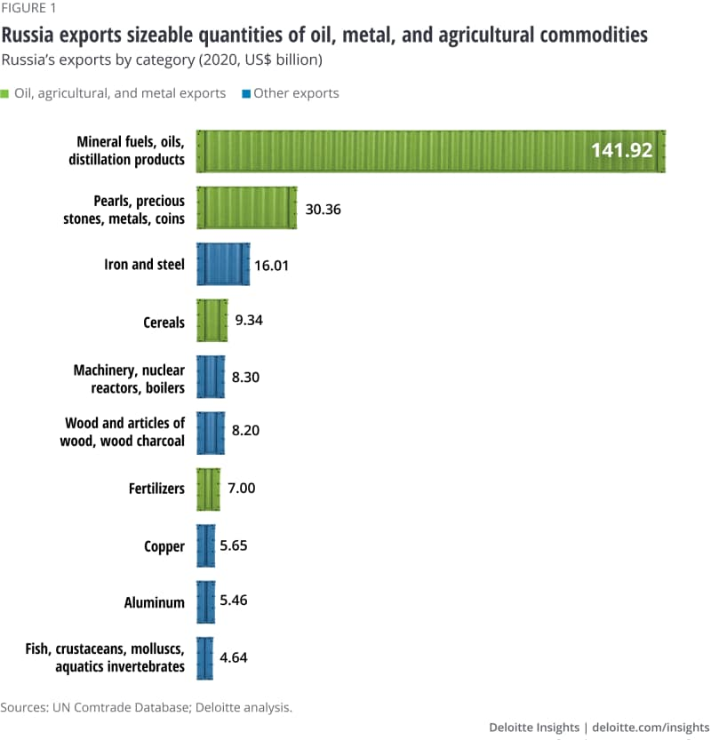
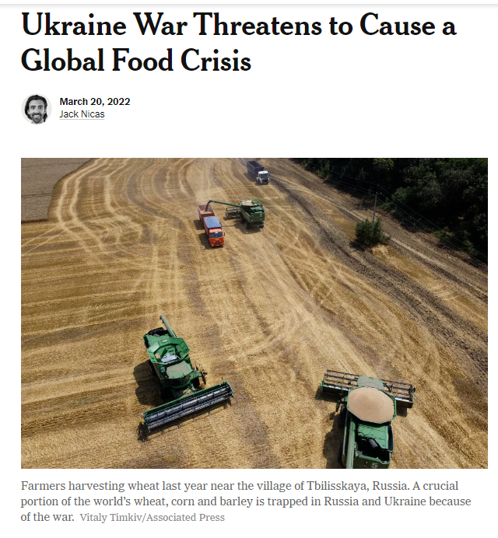
New York Times
Figure from: https://www2.deloitte.com/xe/en/insights/focus/supply-chain/supply-chain-war-russia-ukraine.html [2.5.2022]

Slide 3
Learning aims
Understand how global supply chains for different goods and services have developed historically.
Understand how global supply chains are organized and governed, making them prone to risks and responsibility concerns.
Understand how – by which governance mechanisms – global supply chains can be made more resilient and responsible.

Slide 4
The garment supply chain
Planning collection
Designing and prototyping models
Buying materials
Manufacture and assembly
Marketing
Distribu-tion
Retailing
Planning collection
Designing and prototyping models
Buying materials
Manufacture and assembly
Marketing
Distribu-tion
Retailing
Full package/full service
Planning collection
Designing and prototyping models
Buying materials
Manufacture and assembly
Marketing
Distribu-tion
Retailing
„New verticals“
Lane (2008), Schüßler (2009)

Slide 5
What is behind internationalization and fragmentation of value chains?
Motives
  Market access (export and labor)
  Efficiency considerations (cost cutting, focusing on core competences)
  Access to knowledge and expertise
  Escaping regulations and responsibility
Main drivers
  Trade liberalization, esp. WTO TRIPS (Agreement on Trade Related Aspects of Intellectual Property Rights, 1994) and WTO membership of China (2001)
  Global competition spurring industry concentration and cost cutting
Facilitator
  Information technology

Slide 6
Key concepts
Global…supply chains, commodity chains, value chains, value networks, production networks – common denominator: more than flows of goods
Lead firms and suppliers, networked interorganizational relationships
Buyer-driven vs producer-driven
Governance: coordination, but also specific allocations of resources and distributions of gains – market, modular, relational, captive, hierarchy
Inequality and upgrading
Gereffi (1999), Gereffi et al. (2005)

Slide 7
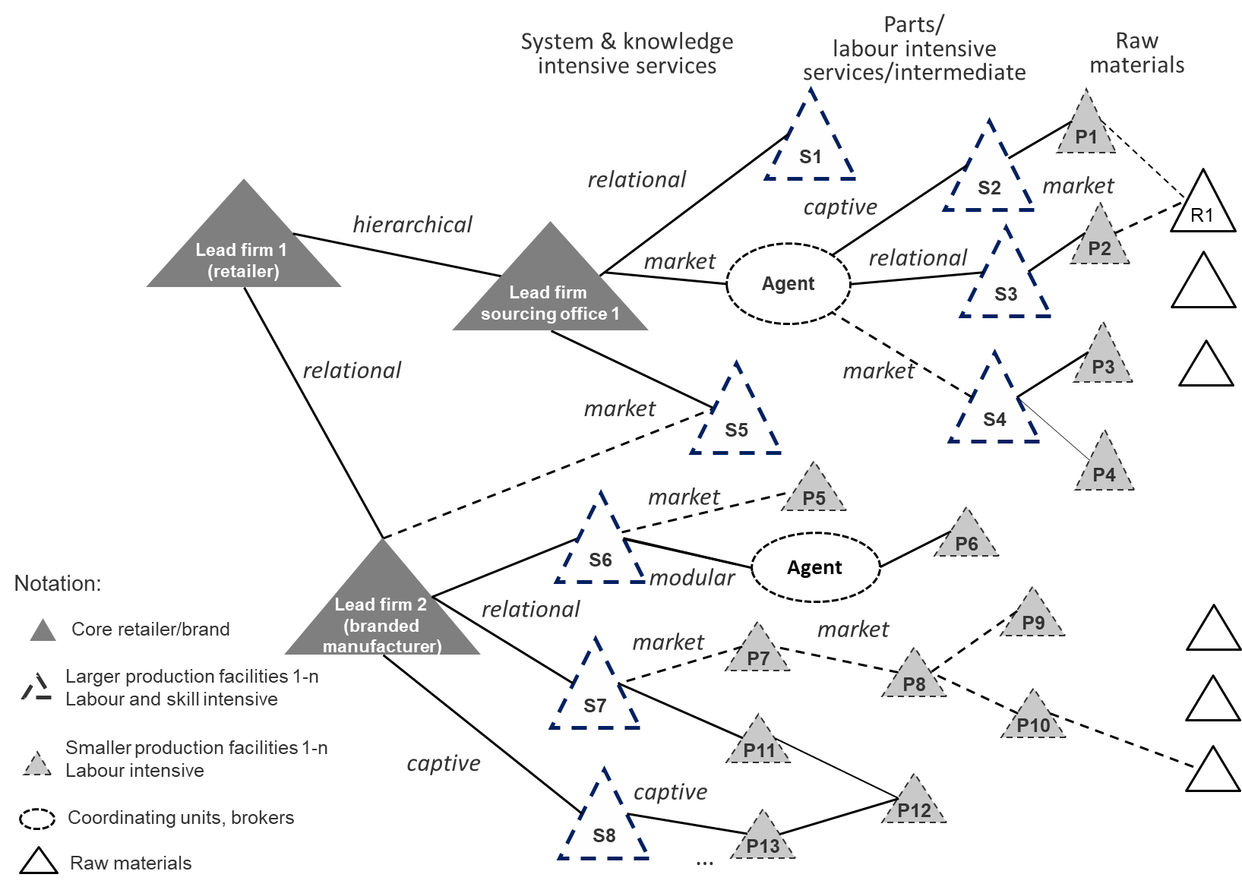
complexity 1: plural forms
Schematic picture of
garment industry
global value networks
Helfen et al. (2018)

Slide 8
Complexity 2: Regulatory gap
No “world government” and multiple collective action problems between firms, between suppliers and between nations
Legal complexity – legal vs moral responsibility boundaries; which jurisdiction should be applied?
International regulations such as the OECD’s corporate responsibility guidelines typically non-binding
Multinational Enterprises (MNEs) are called upon as political actors but face weak long-term incentives to act responsibly
e.g. Scherer & Palazzo (2011)

Slide 9

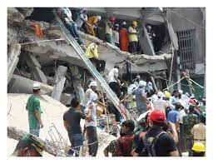
Complexity 3: VUCA – disruptive events
Image source: Wikimedia commons

Slide 10
Different avenues for managing complexities
Via network management (corporate-driven path)
Via private, multi-stakeholder regulation
Via public regulation

Slide 11
Basic Modes of regulation
 | “Hard” law (public) | “Soft” law (private)
Actors | State, industry associations, trade unions | Companies, NGOs, civil society, trade unions
Mechanisms | Law, sanctions | Incentives, information, moral appeals
Mode | Authority-oriented | Market-oriented
Examples | Loi de Vigilance; Brussels 1 regulation; national civil laws | UN Guiding Principles on Business and Human Rights; UN Global Compact
Own depiction; based on Hassel (2008)

Slide 12
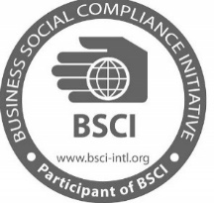







private, multi-stakeholder regulation
Multiple Firms
Industry-Led Initiatives
Multi-Firm Transnational Industrial
Relations
Initiatives
Labor-Inclusive MSIs (e.g. ETI)
II
IV
Protocol
Agreements
Inclusive of Unions
Exclusive of Unions
Codes of Conduct
Brand-Union Agreements
(e.g. GFAs)
I
III
Single Firms
Ashwin et al. (2020)

Slide 13
Network management for Resilience and responsibility
e.g. reducing the number of subcontractors; using health & safety as well as quality labor-standards as criteria in selection procedures
Reputation, customer expectations, union influence, regulation
Field level
Network dynamics, relational advantage
Plural GVN governance structures
market, modular, relational, captive,
hierarchical
GVN management practices selecting, allocating, regulating, evaluating
Network responsibility
Network level
Multi-employer relations in GVN
e.g. evaluating network reliability and assessing network risks in supply chain due diligence
Network participation and contribution, firm-level advantage
Organizational structure, culture, HRM
Helfen et al. (2018); Sydow et al. (2016; 2021)

Slide 14
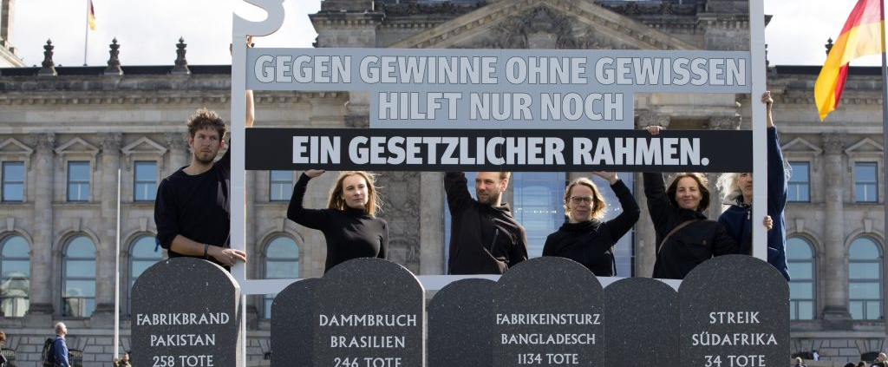
Public regulation – e.g. German Law on Supply Chain Due Diligence
Passing of the law on 11.6.21 after a long negotiation
process (entry into force: January 1st 2023)
German MNCs have to guarantee human rights and
environmental standards in their supply chains and
will be fined in case of violations
No civil right liability; NGOs or unions can file legal action on behalf of affected individuals
Initially (from 2023 on) only for companies > 3000 employees ~ 600 MNCs. From 2024 on > 1000 employees ~ 2.891 MNCs (BMAS)
A government agency controls compliance with legislation; sanctions through public procurement bans
Krajewski et al. (2021)

Slide 15
From risk to resilience and responsibility
Fine-grained supply chain structures
Resource dependence – increased through supplier consolidation
Outsourcing spirals and competency traps
Lean supply chains
Systemic inequalities
Weak regulation
Mixing make, buy and cooperate on a whole network level to allow for lose coupling, diversity, redundancy
Developing fair purchasing practices
Using new technologies, e.g. additive manufacturing
Strengthening global governance, collective action and binding agreements
Sharing responsibility in industry-specific MSIs
Developing regenerative strategies
Anner (2021); Baumann-Pauly et al. (2017); Frenkel & Schüßler (2021); Hahn & Tampe (2021); Phillips et al. (2022)

Slide 16
summary
States have a key role to play in setting the rules of the game of the global economy – supply chains are political arenas
The current structure of global supply chains bears several risks for lead firms, suppliers, workers and consumers, and risks are unequally distributed
Resilience and responsibility can be gained from taking a “whole networks” perspective on managing supply chains, involving stakeholders and developing industry-specific, collective agreements
Companies have already re-evaluated their supply chains during the pandemic – and will likely continue to do so

Slide 17

Contact
Prof. Dr. Elke Schüßler
Professor of Business Administration
Institute of Organization Science
Johannes Kepler University Linz
Mail: elke.schuessler@jku.at
Web: www.jku.at/org
Twitter: @ElkeSchuessler and @OS4Future

Slide 18
References (1/2)
Anner, M. (2021). Three labour governance mechanisms for addressing decent work deficits in global value chains. International Labour Review, 160(4), 611-629.
Ashwin, S., Oka, C., Schüßler, E., Alexander, R., & Lohmeyer, N. (2020). Spillover effects across transnational industrial relations agreements: The potential and limits of collective action in global supply chains. ILR Review. In print.
Baumann-Pauly, D., Nolan, J., Van Heerden, A., & Samway, M. (2017). Industry-specific multi-stakeholder initiatives that govern corporate human rights standards: Legitimacy assessments of the Fair Labor Association and the Global Network Initiative. Journal of Business Ethics, 143(4), 771-787.
Frenkel, S. J., & Schuessler, E. S. (2021). From Rana Plaza to COVID‐19: Deficiencies and opportunities for a new labour governance system in garment global supply chains. International Labour Review, 160(4), 591-609.
Gereffi, G., Humphrey, J., & Sturgeon, T. (2005). The governance of global value chains. Review of International Political Economy, 12(1), 78-104.
Gereffi, G. (1999). A commodity chains framework for analyzing global industries. Institute of Development Studies, 8(12), 1-9.
Hahn, T., & Tampe, M. (2021). Strategies for regenerative business. Strategic Organization, 19(3), 456-477.
Hassel, A. (2008). The evolution of a global labor governance regime. Governance, 21(2), 231-251.

Slide 19
References (2/2)
Helfen, M., Schüßler, E., & Sydow, J. (2018). How can employment relations in global value networks be managed towards social responsibility?. Human Relations, 71(12), 1640-1665.
Lane, C. (2008). National capitalisms and global production networks: An analysis of their interaction in two global industries. Socio-Economic Review, 6(2), 227-260.
Phillips, W., Roehrich, J. K., Kapletia, D., & Alexander, E. (2021). Global value chain reconfiguration and COVID-19: Investigating the case for more resilient redistributed models of production. California Management Review, in print.
Scherer, A. G., & Palazzo, G. (2011). The new political role of business in a globalized world: A review of a new perspective on CSR and its implications for the firm, governance, and democracy. Journal of Management Studies, 48(4), 899-931.
Schüßler, E. (2009). Strategische Prozesse und Persistenzen: Pfadabhängige Organisation der Wertschöpfung in der Bekleidungsindustrie. Kohlhammer.
Sydow, J., Schüßler, E., & Helfen, M. (2022). Managing global production networks: Towards social responsibility via inter-organizational reliability? In: Biggiero, L. et al. (eds.) The Relational View of Economics (pp. 133-158). Springer, Cham.
Sydow, J., Schüßler, E., & Müller-Seitz, G. (2016). Managing Inter-Organizational Relations: Debates and Cases. Macmillan International Higher Education.

