Slide 1
ORGANIZING
in Times of Crisis
Class 3: Institutional and Organizational Trust During Crises
Guido Möllering
Witten/Herdecke University
May 19, 2022

Slide 2
Agenda
1. Wartime organizing at Sombra
2. Trust in a classic crisis response model
3. Process views of trusting – in crises
4. Trust preservation practices during disruption
5. Examples of using and reinforcing trust

Slide 3
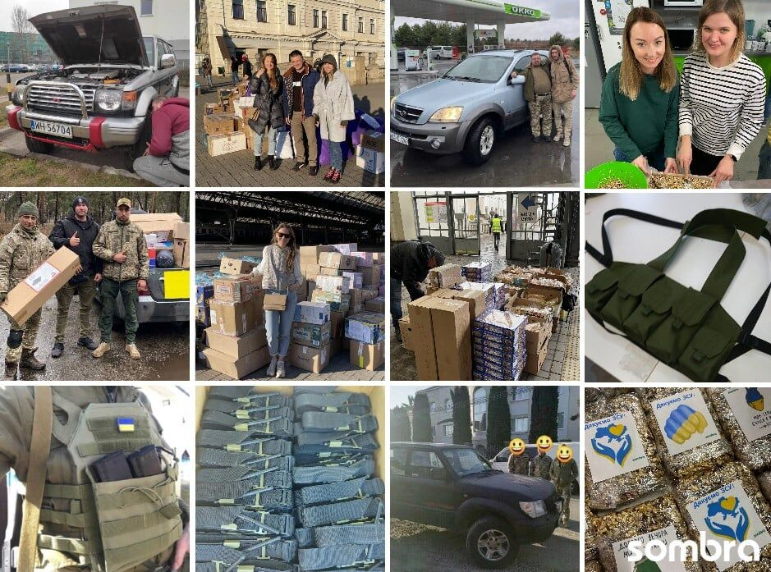
1. Wartime organizing at Sombra
Software development firm
Manage to continue their
usual business, but with
many restrictions
Started to do unrelated work
for the Ukranian army
Take care of their employees
and are still hiring!
Organizing donations and
contributing to discourse
https://www.linkedin.com/company/sombra-inc/

Slide 4
Agenda
✓
1. Wartime organizing at Sombra
2. Trust in a classic crisis response model
3. Process views of trusting – in crises
4. Trust preservation practices during disruption
5. Examples of using and reinforcing trust

Slide 5
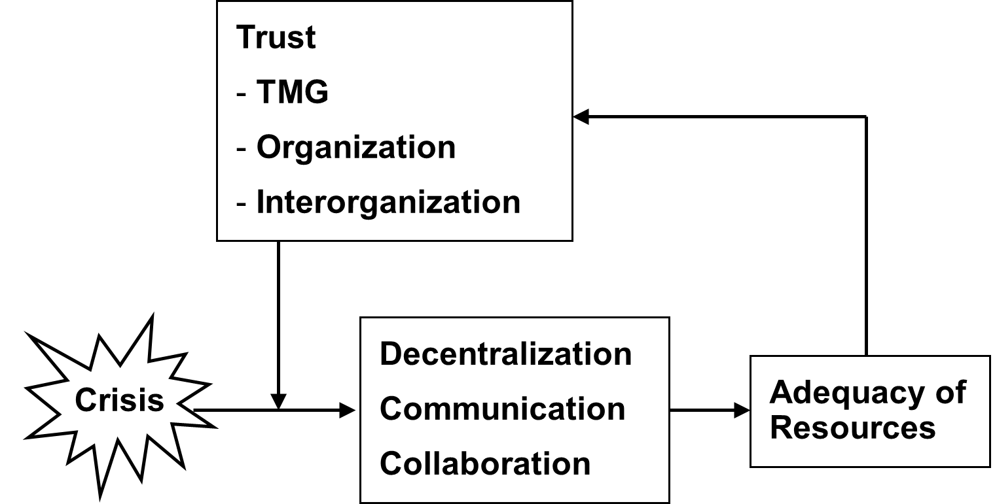
2. Trust in a crisis response model
Mishra (1996: 263)
Trust supports a more effective crisis response, which in turn reassures and reinforces trust.
But: What if the crisis shakes up trust?

Slide 6
Agenda
✓
1. Wartime organizing at Sombra
2. Trust in a classic crisis response model
3. Process views of trusting – in crises
4. Trust preservation practices during disruption
5. Examples of using and reinforcing trust
✓

Slide 7
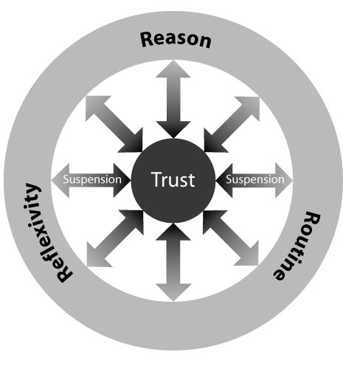
Defining trust
“A psychological state comprising the intention to accept vulnerability based upon positive expectations of the intentions or behavior of another” (Rousseau 1998: 395)
“Trust is an ongoing process of building on reason, routine and reflexivity, suspending irreducible social vulnerability and uncertainty as if they were favourably resolved, and maintaining thereby a state of favourable expectation towards the actions and intentions of more or less specific others.” (Möllering 2006: 111)
(Möllering 2006: 110)

Slide 8
3. Process views of trusting (1)
Mental
Process
Trusting
Social
Process
Möllering (2013)

Slide 9
3. Process views of trusting (2)
Trusting as Mental Process
Trusting as Social Process
state of mind
cognition and affect
decision making
interpretation
suspension
interaction
relationships
social context
practices*
institutionalization
* such as: signaling, negotiating, sense-making,
contracting, cooperating, reciprocating, investing,
imitating, complying …
Möllering (2013)

Slide 10
3. Process views of trusting (3)
Continuing
Mental
Process
Processing
Trusting
Learning
Social
Process
Becoming
Constituting
Möllering (2013)

Slide 11

3. Process views of trusting (4)
Trusting as Continuing
Trusting as Processing
Trusting as Learning
continuous, dynamic
temporal dimension
changes over time
longitudinal view
perception
information
judgement
bracketing
updating
skill development
familiarization
testing
Möllering (2013)

Slide 12
3. Process views of trusting (5)
Trusting as Becoming
Trusting as Constituting
identification
project of the self
opening out
social construction
structuration
practices
ongoing (re)production
institutional work
Möllering (2013)

Slide 13
Agenda
✓
1. Wartime Organizing at Sombra
2. Trust in a classic crisis response model
3. Process views of trusting – in crises
4. Trust preservation practices during disruption
5. Examples of using and reinforcing trust
✓
✓

Slide 14
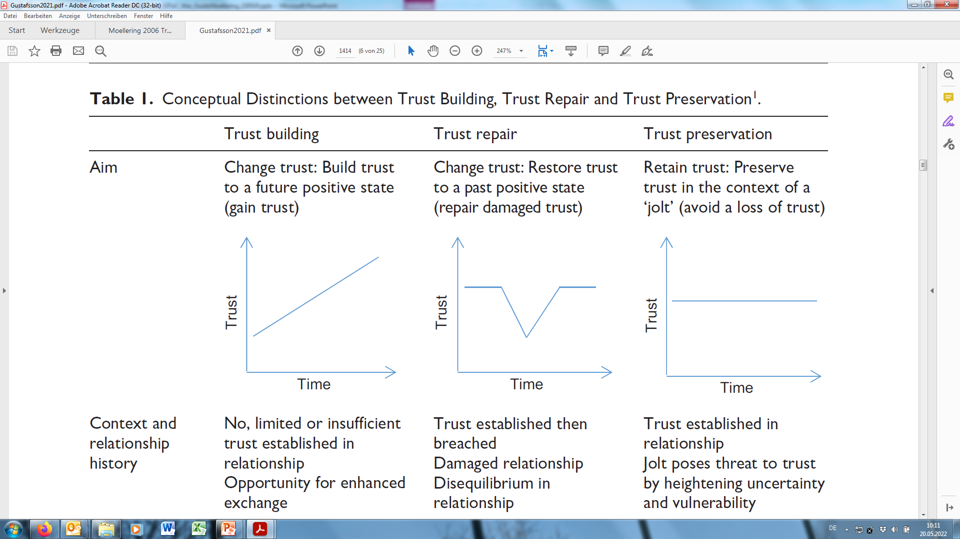
4. Trust preservation practices (1)
Gustafsson et al.
(2021: 1414)

Slide 15
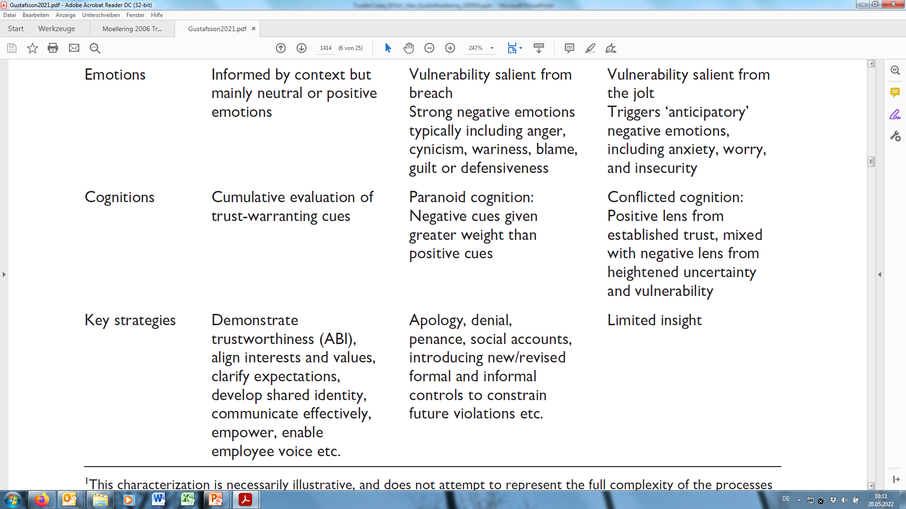
4. Trust preservation practices (2)
Gustafsson et al.
(2021: 1414)

Slide 16
4. Trust preservation practices (3)
Trust Preservation:
“Active practices to
preserve established
trust in the relationship,
triggered by a jolt that
heightens uncertainty
and vulnerability in
the relationship.”
cognitive bridging
emotional embodying
inclusive enacting
Gustafsson et al. (2021: 1413, 1426)

Slide 17
Agenda
✓
1. Wartime Organizing at Sombra
2. Trust in a classic crisis response model
3. Process views of trusting – in crises
4. Trust preservation practices during disruption
5. Examples of using and reinforcing trust
✓
✓
✓

Slide 18

5. Examples of using and reinforcing trust
Keep staff employed
Assist relocations
Pay salary – in advance
Collect donations
Offer free services
Stop business with Russia
and so on …
https://www.pexels.com/de-de/foto/wasser-sommer-dreckig-reise-11337712/

Slide 19
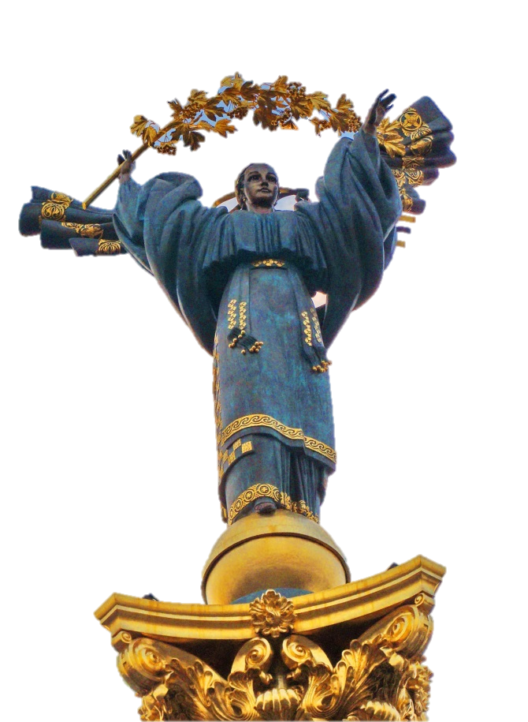
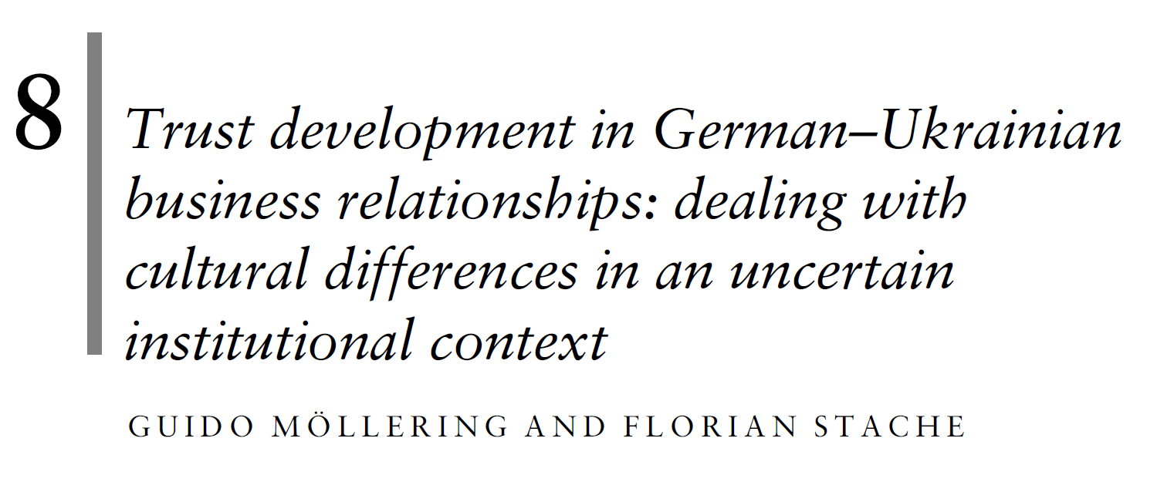
On a personal note …
https://unsplash.com/photos/JKhiMOS8uvg

Slide 20
Thank you for your attention!
References
Gustafsson, S., Gillespie, N., Searle, R., Hope Hailey, V., & Dietz, G., (2021). Preserving organizational trust during disruption. Organization Studies, 42(9), 1409-1433
Möllering, G. (2006). Trust: Reason, Routine, Reflexivity. Elsevire/Emerald.
Möllering, G. (2013). Process views of trusting and crises. In: Bachmann, R., & Zaheer, A. (Eds.): Handbook of Advances in Trust Research. Edward Elgar, 285-305. SSRN version
Mishra, A. (1996). Organizational responses to crisis: The centrality of trust. In: Kramer, R.M., & Tyler, T.R. (Eds.): Trust in Organisations: Frontiers of Theory and Research. Sage Publications, 261-287, Preprint
Möllering, G., & Stache, F. (2010). Trust development in German–Ukrainian business relationships: Dealing with cultural differences in an uncertain institutional context. In: Saunders, M.N.K., Skinner, D., Gillespie, N., Dietz, G., & Lewicki, R.J. (Eds.): Organizational Trust: A Cultural Perspective. Cambridge University Press, 205-226, MPIfG DP Version
Rousseau, D. M., Sitkin, S. B., Burt, R. S., & Carmerer, C. (1998). Not so different after all: A cross-discipline view of trust. Academy of Management Review, 23(3), 393–404.

